Slide 1
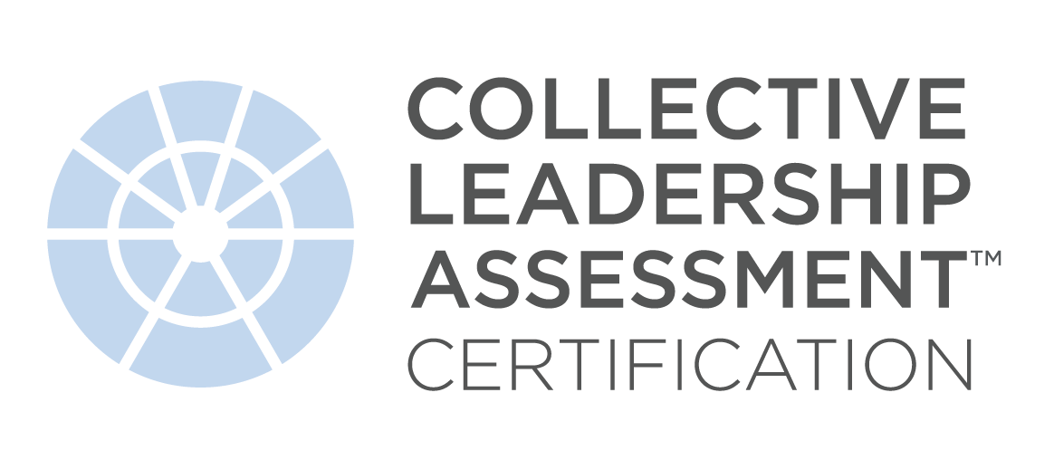
What to Expect From
The Collective Leadership Assessment Certification
Aaronde Seckou Creighton

Slide 2


WE EXIST TO EVOLVE THE CONSCIOUS PRACTICE OF LEADERSHIP,
TO STEWARD THE PLANET,
AND AWAKEN US ALL TO OUR INHERENT UNITY.

Slide 3
TODAY’S Objectives:
Learn about the Collective Leadership Assessment™ and how it measures the perception of collective leadership
Explore how you can use this assessment to work with teams and organizations
Discover how becoming Collective Leadership Assessment Certified can expand and scale your impact
Notes:
INTRO….Group Sessions: Best Practices:
Best Practices
March 2020 – TLC moved all certifications to virtual.
Some of the lessons learned:
Mike REVEAL next slide…

Slide 4

Leadership is scaling the capacity and capability in the organization to create outcomes that matter most.

Slide 5
Breakout Discussion:
What advantages do you see in teams working together – collectively – in their shared development?
Leadership is scaling the capacity and capability in the organization to create outcomes that matter most.

Slide 6
Leadership Circle Profile Group Report
Notes:
A

Slide 7
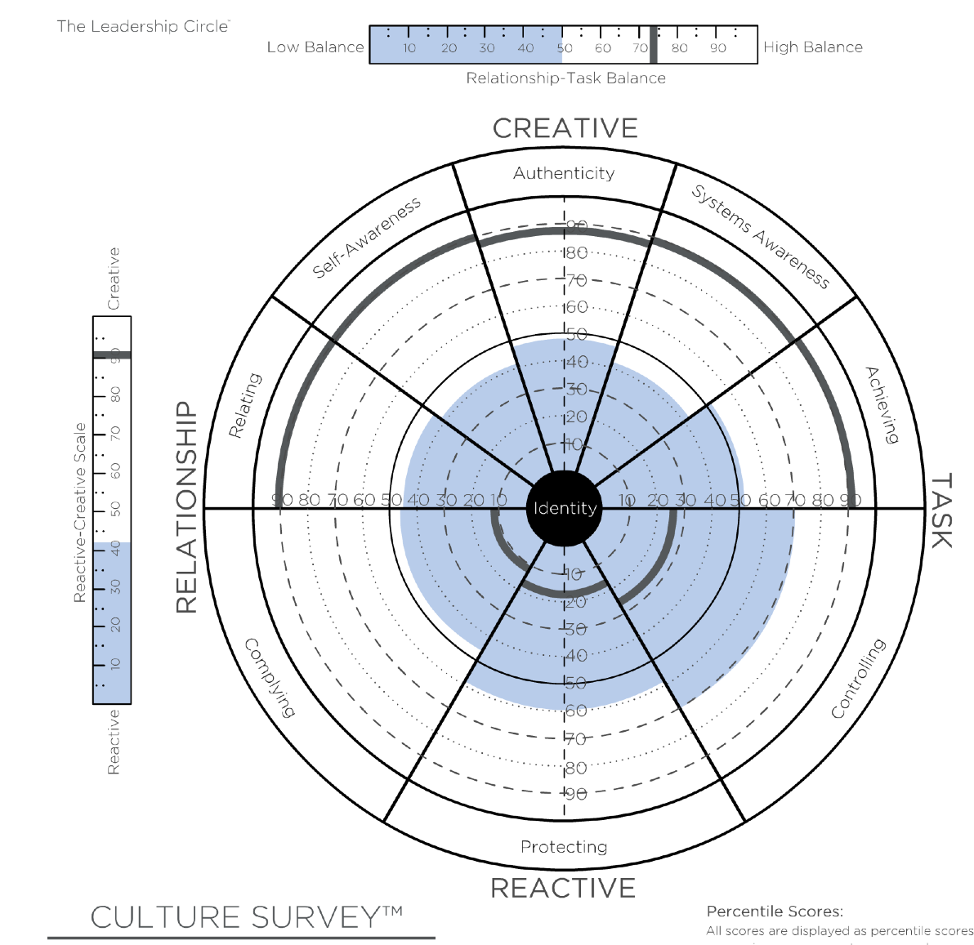
Leadership Circle Profile Group Report
Collective Leadership Assessment
Notes:
A

Slide 8
Key Differences Between LCP Group Profile and the Collective Leadership Effectiveness Assessment
Leadership Circle Aggregate Group Profile
Collective Leadership Effectiveness Assessment
Rollup of a collection of individual Leadership Circle Profiles
Focus of analysis is on the individual, and then scores are aggregated across the selected group
Is diagnostic in nature, allows a senior team or group to contemplate potential Reactive and Creative patterns as a team or group
Measures gap between current leadership effectiveness (Actual) and aspirational leadership effectiveness (Ideal)
Focus of analysis is on collective leadership
Is directional in nature and deeply informs the Collective Leadership Development Agenda
Notes:
Learning Objective 1: for participants to understand how the key distinctions between the LCP Group Profile and the CLA.

Slide 9
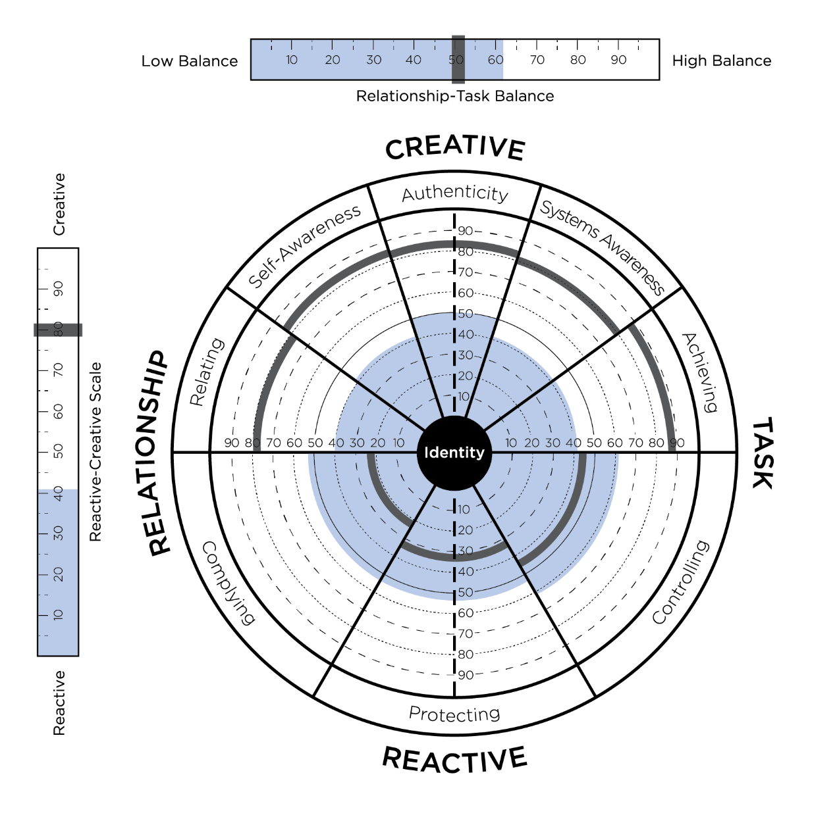
Collective Leadership Assessment
Actual Collective Leadership
Ideal Collective Leadership
Notes:
Learning Objective 1: for participants to understand that the basic structure of the CLA is one of current state leadership (ACTUAL) and future state or aspirational leadership (IDEAL).

Slide 10
COLLECTIVE LEADERSHIP ASSESSMENT:
Gaps as a Pathway for Greater
Leadership Effectiveness
The Gaps between Actual and Desired:
Put the spotlight on how collective leadership affects culture
Establish a compelling rationale for change
Provide insight into how strong vision and desire for change is
Indicate where the most energy for change is in the system
Help direct leaders to where the most critical conversations for effectiveness can be had linked to strategy
Notes:
Learning Objective 1: for participants to understand how the key distinctions between the LCP Group Profile and the CLA.

Slide 11
Sorts Tables from CLA Report

Slide 12
A Typical Collective Leadership Assessment
Focus:
Executive Team
BOARD
N=9
ALL
N=120
EXEC. TEAM
N=11
ELT 1
ELT 2
N=28
N=72
ELT. = Extended Leadership Team / Top 100
Notes:
Learning Objective 1: for participants to understand how a typical CLA might be structured with the unit of analysis the Executive Team and then the data sliced into 5 different reports.

Slide 13

Leadership: The Business Case
  Most research confirms that leadership (and the culture it creates) is really the ONLY single differentiator between organizations.
  People (the good ones) join great companies and leave lousy bosses (companies with ineffective leaders are vulnerable to losing the best talent).
  A great strategy implemented by ineffective leadership is sure to fail.
  Culture ALWAYS trumps strategy…. And leadership is the Number One influence on culture.
  Research confirms effective leadership (Creative) outperforms ineffective (Reactive) leadership
  Collective Leadership: Leaders impact the effectiveness of strategy execution.
  Research: Most effective organizations make developing leaders a strategic focus.

Slide 14

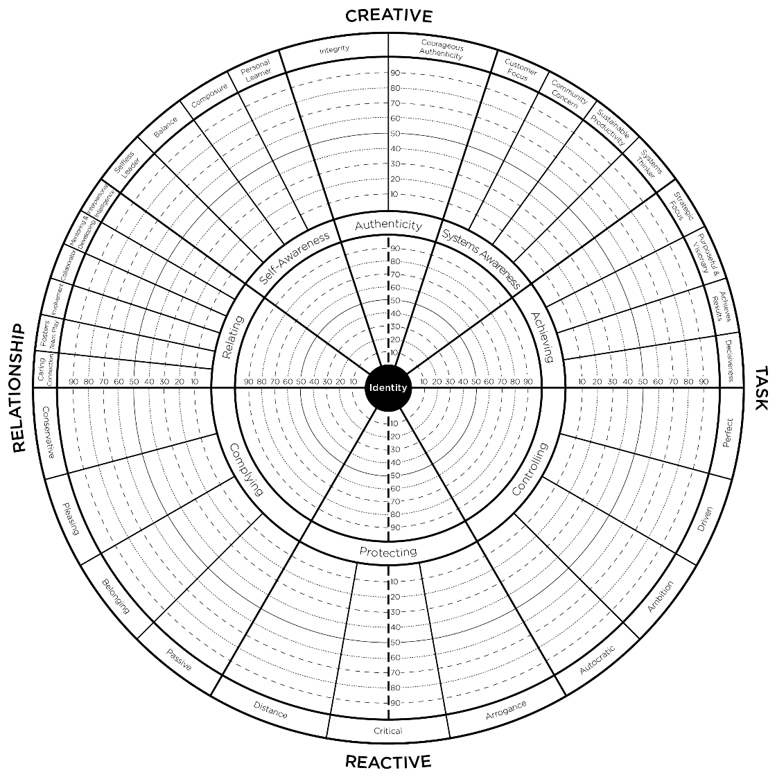



How Leaders Scale Leadership
Start with Self – “I am the project”
Develop Your Team and Teams
Connect the Leadership System
Notes:
Learning Objective 1: for participants to understand the progression of scaling leadership: self, team(s), connecting the leadership system.

Slide 15

An organization cannot perform
at a level higher than the CONSCIOUSNESS
of the leadership
Notes:
Learning Objective 1: for participants to understand the limitations of collective consciousness on organizational performance.

Slide 16

Starting with Self – I am the Project
GENERATIVE
ADULTHOOD
VUCA
Volatility
Uncertainty
Complexity
Ambiguity
Demand on Complexity
of Mind
Developmental
Challenge
STAGES OF
DEVELOPMENT
COMPLEXITY
OF CONTEXT
COMPLEXITY
OF SELF
Current Leadership Consciousness Threshold
Stability
Certainty
Simplicity
Clarity
ADAPTIVE
CHILDHOOD
SCSC
Notes:
Learning Objective 1: for participants to understand that scaling leadership towards the collective starts with the developmental work on the Self.

Slide 17

WHEN THE WHOLE IS LESS THAN THE SUM OF THE PARTS
SELF-TRANSFORMING
VUCA
Most 21st
Century
Challenges
Demand on Complexity
of Mind
COLLECTIVE
Developmental
Challenge
Team’s
Collective
Complexity
of Mind
SELF-AUTHORING
Current Leadership Consciousness Threshold
SOCIALIZED
SCSC
Notes:
Learning Objective 1: for participants to understand the developmental challenges of working with teams/collective leadership.

Slide 18
WHEN THE WHOLE IS MORE THAN THE SUM OF THE PARTS
SELF-TRANSFORMING
VUCA
Most 21st
Century
Challenges
Demand on Complexity
of Mind
COLLECTIVE
Developmental
Challenge
Team’s
Collective
Complexity
of Mind
SELF-AUTHORING
Current Leadership Consciousness Threshold
SOCIALIZED
SCSC
Notes:
Learning Objective 1: for participants to understand that collective developmental progress at the team/collective level can significantly impact results/systemic impact and reduce internally driven VUCA conditions created by a non-effective leadership team.

Slide 19
A Typical Collective Leadership Assessment
Focus:
Executive Team
BOARD
N=9
ALL
N=120
EXEC. TEAM
N=11
ELT 1
ELT 2
N=28
N=72
ELT. = Extended Leadership Team / Top 100
Notes:
Learning Objective 1: for participants to understand how a typical CLA might be structured with the unit of analysis the Executive Team and then the data sliced into 5 different reports.

Slide 20

Collective
Leadership Assessment
BEFORE
Collective Leadership Assessment

Slide 21
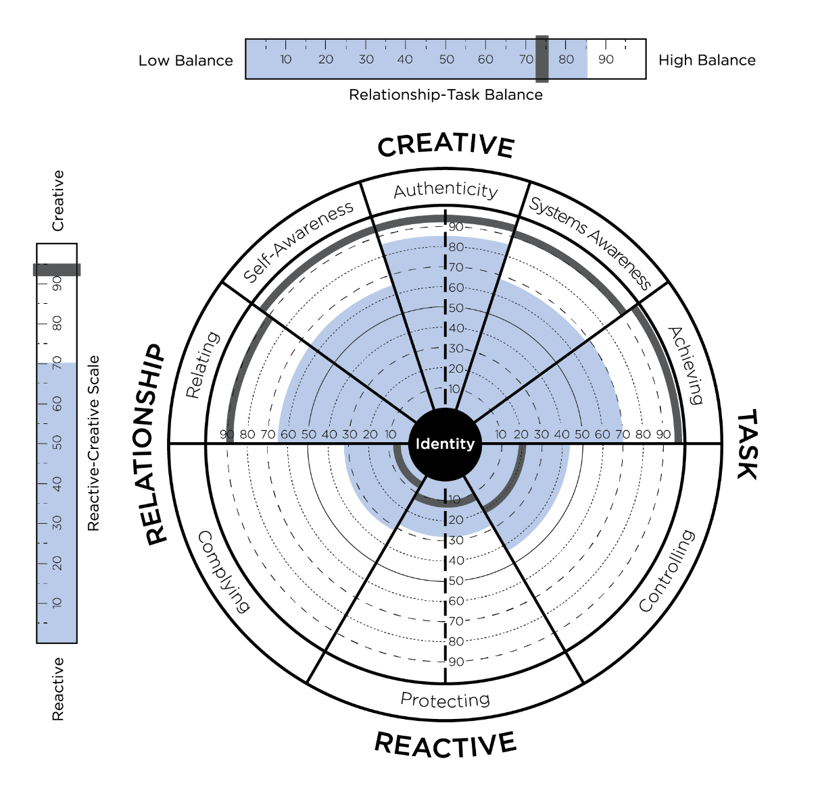
Collective
Leadership Assessment
AFTER
Collective Leadership Assessment

Slide 22
Sorts Tables from CLA Report
Notes:
Learning Objective 1: for participants to understand that the CLA report has four sort tables sorted by: ACTUAL, IDEAL, IDEAL TO IDEAL, and GAP BETWEEN ACTUAL AND IDEAL.

Slide 23
Certification Workshop
Collective Leadership “Brand”
How the team thinks they are leading…
Other people’s primary experience of the team…
COLLECTIVE LEADERSHIP ASSESSMENT

Slide 24
Benefits of Group/Team Coaching
Certification Workshop
Can be hugely cost effective for organization
Working with several members simultaneously can avoid group think
Allows for group skilling to occur in real time
Idea generation and innovation
Reflection periods allow for cascaded learning
Robust debates can test commercial assumptions
Learning paths can be replicated across an organizations
Skills learned can be role modelled
Senior leadership teams can ensure strategic interventions are executed across the spaces in the organization
COLLECTIVE LEADERSHIP ASSESSMENT
Notes:
Padraig to add notes …

Slide 25


Using the LCP and the CLA together:
Advantages of both the individual and collective view.
Which comes first?
Sequencing
Ongoing coaching and development

Slide 26
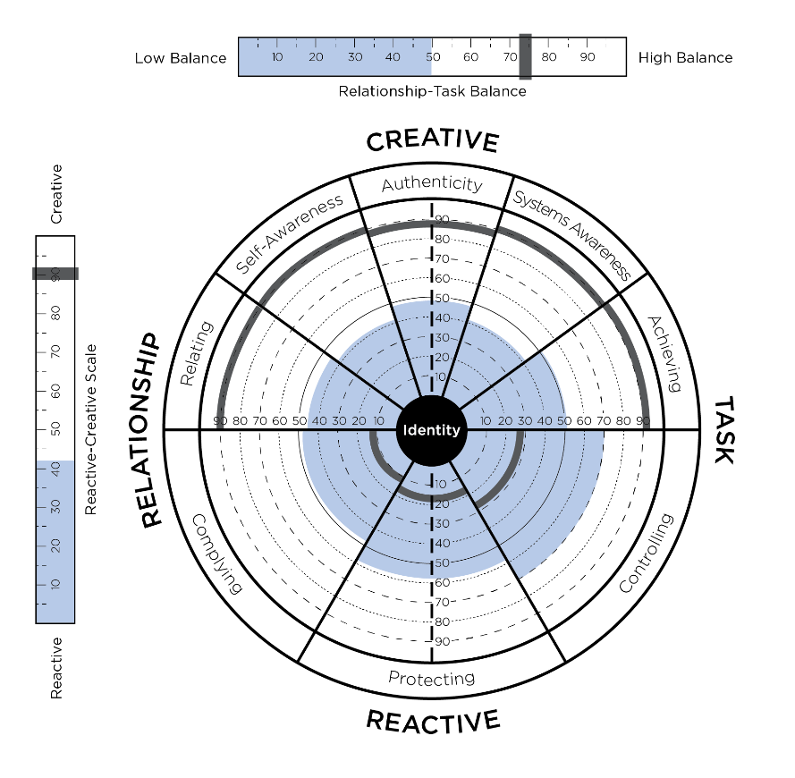
Collective Leadership Assessment
Certification
LeadershipCircle.com
All regions of the world
Full day or Two half days
$995.00 USD
Questions… contact support@theleadershipcircle.com

Slide 27

Thank you for joining us!
Until next time.

