Slide 1
Leadership Effectiveness
Scale & Correlations

Slide 2
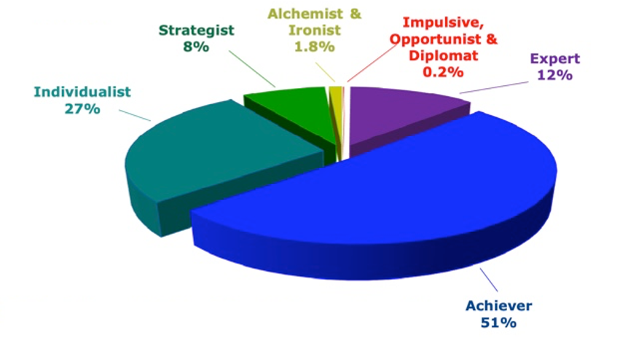
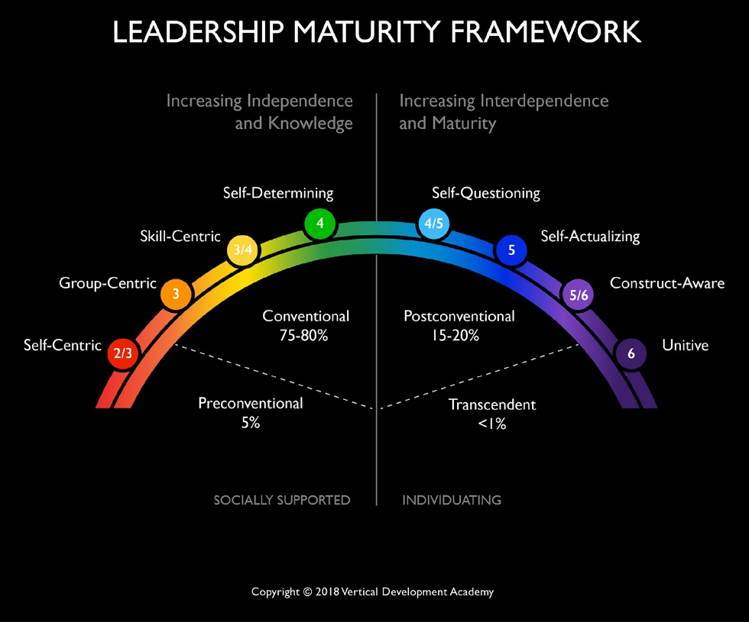
Adult Development Percentages
Self-Transforming Mind
<1%
Bill Torbert
Self-Authoring Mind
7%
Complexity of Mind
35%
Socialized Mind
47%
80% of Adults
8%
2%
Robert Kegan & Lisa Lahey – Immunity to Change
Time
Susan Cook-Greuter
Notes:
Learning Objective 1: for participants to understand that most of their clients will very likely be operating at at a transitional place between Socialized and Self-Authored (a self in both worlds) or be operating from a fairly consolidated Self-Authored stance.
Learning Objective 1: for participants to understand that while LCP data won’t tell them what stage of development a client is operating from, their conversation with their client will likely offer some good clues.

Slide 3







Reactive and Creative Leadership
UNITIVE
Aligned to Adult Development
5%
INTEGRAL
Self-Transforming Mind
CREATIVE
15%
Self-Authoring Mind
REACTIVE
80%
Socialized Mind
EGOCENTRIC
Notes:
These notes below complement those in the Appendix II in the Leaders’ Guide. Please study: 1) the Leaders’ Guide Appendix; 2) the notes below; and 3) the Mastering Leadership book (pp.61-86). The quotes below are lifted directly from the book as an aid to enriching your lecture.
*Note: Each advancement in the journey from one stage to the next transcends and includes the previous stages
Stage 2: Egocentric (Self-Sovereign Mind)
Roughly from 8 years of age until adolescence ends in early adulthood
“This identity does not notice other’ (often competing) needs.” (p.63)
“Kegan calls this stage “Self-Sovereign” because at this stage our needs are primary (Kegan and Lahey, 2009)” (p.63)
“The strength of egocentricity is the capacity to get our needs met and gain independence. We can defer impulse gratification long enough to plan and organize to meet our needs.” (p.63)
“Meeting our own needs is subject, meaning, we are not aware that we are defined by meeting our needs.” (p.63)
“We are not yet separate from our own needs to manage them—they manage us.” (p.63)
“We do not make decisions based on the impact of our behaviour on others with whom we are in relationship (no Mutual Perspective Taking). We make decisions primarily on what will happen to us if we please or displease others. For example, if we tell a lie, our concern is not about the loss of trust or the feeling of others, but about the consequences to us if they catch us in the lie and whether or not we can risk those consequences.” (pp.63-64)
“The absence of a shared reality is the structural limit of this phase.” (p.64)
“Growth at this phase is taking other’s needs and expectations into account…As this happens, our needs move from subject to object…A subject-object shift moves that to which we were formerly subject to an object of reflection. We are then no longer subject to that limited understanding of ourselves and the world…More behavioural options are available.” (pp.64-65)
“About 5% of leaders who do not fully make this transition and continue to operate with an Egocentric Mind tent to be autocratic and controlling—‘My way or the highway.’” (p.65)
“Unquestioned loyalty to the leader, not the organization, is the first priority. The organization and its employees exist to serve them.” (p.65)
Stage 3: Reactive (Socialized Self) – Kegan “Triumph of development”
As people transition from the Egocentric stage into the Reactive stage, the learn that “…if they want to get on in the world, they need to take on its rules, values, expectations, and ways of operating.” (p.66)
“The developmental challenge of the Reactive Mind is to merge with society.” (p.66)
“This ability to take up membership, to work and live co-relationally with others and within organizations, is the triumph of this stage of development. It enables us to build a life of meaning, self-worth, and security. This is the strength of this stage, and also the liability.” (p.66)
“As we embrace the Reactive Mind, we build our new identity by living up to and into the expectations of others and the culture. Messages and expectations from key influences, institutions and individuals shape who and what we become. …We craft our identity in harmony with these expectations. We internalize them and define our personal worth and security by living up to them.” (pp.66-67)
“We define ourselves, not from the inside out, but from the outside in. Our externally validated sense of self-worth and security are in others’ hands; thus, we must live up to their expectation in order to feel successful, safe, and worthwhile.” (p.67) (External locus of control
“My worth and security = X (where X is a strength) (p.70
I am my work. I am my relationships. They define me. I am my house, my car, my clothes, my achievements.
Lots of achievements: building domain expertise, skills and competencies, influence, momentum, etc. Very positive phase of growth.
75% of managers operate out of a Reactive iOS
The transition from Reactive to Creative is the Hero’s Journey* and requires the shedding of “…some old assumptions that have been running us all our lives; and second, we initiate a more authentic version of ourselves as we shift from Reactive to Creative.” (p.75)
Stage 4: Creative (Self-Authoring Mind)
“By shedding well-patterned assumptions, we start to see the habitual ways of thinking that we adopted while growing up that were socialized into us. These embedded habits of thought form the core of the Reactive iOS. They have served us well and are now reaching operational limits. They are not complex enough for the complexity of life and leadership into which we have grown.” (p.75)
“The central questions of the Independent, Self-Authoring, Creative Mind are: ‘Who am I? What do I care most about? What do I stand for? How can I make my life and my leadership a creative expression of what matters most?’ (p.75)
This stage marks the shift to an internal locus of control.
“We begin to orient our life and leadership less on what we assumed was expected of us as we grew up and more out of our own deeper sense of personal purpose and vision. Transitioning to the Creative Self is the major transition in adult life and leadership.” (p.76-77)
This new self is configured from the inside out, rather than outside in, for the first time.
“Vision springs from within. Action becomes an authentic expression of an emerging sense of inner purpose.” (p.77)
“Creative leadership [based on a Creative iOS] is the minimum level required to create lean, engaged, innovative, visionary, creative, agile, high-involvement, high-fulfillment organizations and to evolve adaptive organizational designs and cultures that can thrive today.” (p.80)
Kegan says that most leadership literature is written for Stage 4 (e.g., on vision, collaboration, dialogue, partnership, etc.).
However, only 20% (roughly speaking) of managers operate primarily at this level.
Stage 5: Integral (Self-Transforming Mind)
In the transition to Integral Mind, “…the hard-earned authentic, self-authoring, visionary, creative self, with which we are identified at the Creative Stage, begins to fray. We begin to realize that not only are we this authentic visionary person; we are also its opposite.” (p. 82)
Here is the first taste of our meaning-making as an illusion created by our stories—narratives about our self.
“…a deeper engagement of the shadow side of the self—the parts of us that we have ignored and not developed. Shadow does not mean dark or bad, but ignored or left behind.” (p.83) We begin to see an integration of all aspects of personality: light and shadow.
“As we embrace our partialness, we no longer need to pretend completeness and can move toward the unacknowledged aspects of ourselves with compassion and curiosity.” (p.83)
“We see others this way—as complex multi-dimensional beings.” (p.83)
“Integral mind is built for complexity. It is a level of mind and leadership that can lead through the redundant polarities and problems that make up complex challenges. Integral Mind can hold opposites in tension without reactive to resolve them quickly (superficially). (p. 82)
“It can hold conflicting visions of the future within a diverse set of stakeholders without championing one over the other. It looks for the merits of all perspectives and works toward synergistic synthesis.” (p.82)
It is open to feedback from all directions, and diversity of thought from all.
For all these reasons, integral Mind is best suited to lead the transformation of complex systems.
Only about 5% of adults develop Integral Mind.
Unitive stage (Note…some would say this the Unitive is not a true stage, but a level of consciousness that is on another plane)
“In the spiritual literature, there is a progression of awareness that moves through sequential stages, up to the highest level of sacred union with All that Is.” (p.85)
“Up to this point, the self has seen itself as a separate self, as located within the body-mind. Now the self realizes that ‘I am not the body, nor the mind.’ In the early phases of the Unitive stage, we identify with the ‘soul’—an essential self in communion with the Divine Reality.” (p.85)
“The Integral self is not discarded. That richly nuanced self is used to act in the world. It is highly functional and effective. It becomes a useful tool of the spirit.” (p.85)
“Leaders at this level function as global visionaries and enact world service for the universal good. From the perspective of Unity, we are all each other.” (p.85)
Less than 1% of the population configures primarily at this level of consciousness, however many of us have experienced Unitive states—peak experiences that connect us to a greater whole.

Slide 4
Research Studies (Kegan, Cook-Greuter, Torbert)
SOCIALIZED MIND
SELF-AUTHORING MIND
Kegan A
N=342
2-3
Stage 3
Transition Stage 3 to 4
Stage 4
4-5
Kegan B
N=497
Stage 3
Transition Stage 3 to 4
Stage 4
4-5
SCG
N=4310
Diplomat
Expert
Achiever
Pluralist
S
BT
N=384
Pre-Exp
Expert
Achiever
C
CC
0 10 20 30 40 50 60 70 80 90 100
Percentage of Sample in Each Stage
Notes:
This slide is a comparison of four research studies done by Kegan (first two), Susanne Cook-Grueter, and Bill Torbert. They show both the overlap and the differences between various theorists’ stage delineations. What they seem to all agree on is that, within the width of the brackets for “Socialized Mind” and “Self-Authoring Mind,” about 80% of the population falls.

Slide 5
Correlations
R = the relationship between 2 variables
How much of the movement of one variable is described by movement of the other.
Can have a positive or a negative correlation.
Are not causal
high
Positive Correlation
Rsq = the degree to which the data tightly clusters around the line of best fit.
A high Rsq means that the data doesn’t vary much and fits tightly together around the line of best fit.
Health
Negative
Correlation
.2 = weak
.3 = trend beginning
.4 = moderate, becoming meaningful
.6 = strong
.8+ = very strong
R scores
low
Food Intake
Nutritious vs.
Malnutritious
high

Slide 6
Leadership Effectiveness Scale Questions
ü
I am satisfied with the quality of leadership that
this leader provides.
ü
This leader is the kind of leader that others should
aspire to become.
ü
This leader is an example of an ideal leader.
ü
This leader's leadership helps this organization to thrive.
ü
Overall, this leader provides very effective leadership.
Notes:
Learning Objective 1: for participants to understand that when a person completes a LCP, they answer each of the 119 questions against the backdrop of their (perhaps unconscious) tacit belief in what makes someone an effective leader. The 5 questions explicitly ask evaluators to rate the leader directly against their picture of the ideal leadership.
Learning Objective 2: for participants to understand that these additional five questions constitute a “survey within a survey,” in that they answers are not used to compute any part of the graph other than this Leadership Effectiveness Scale.

Slide 7
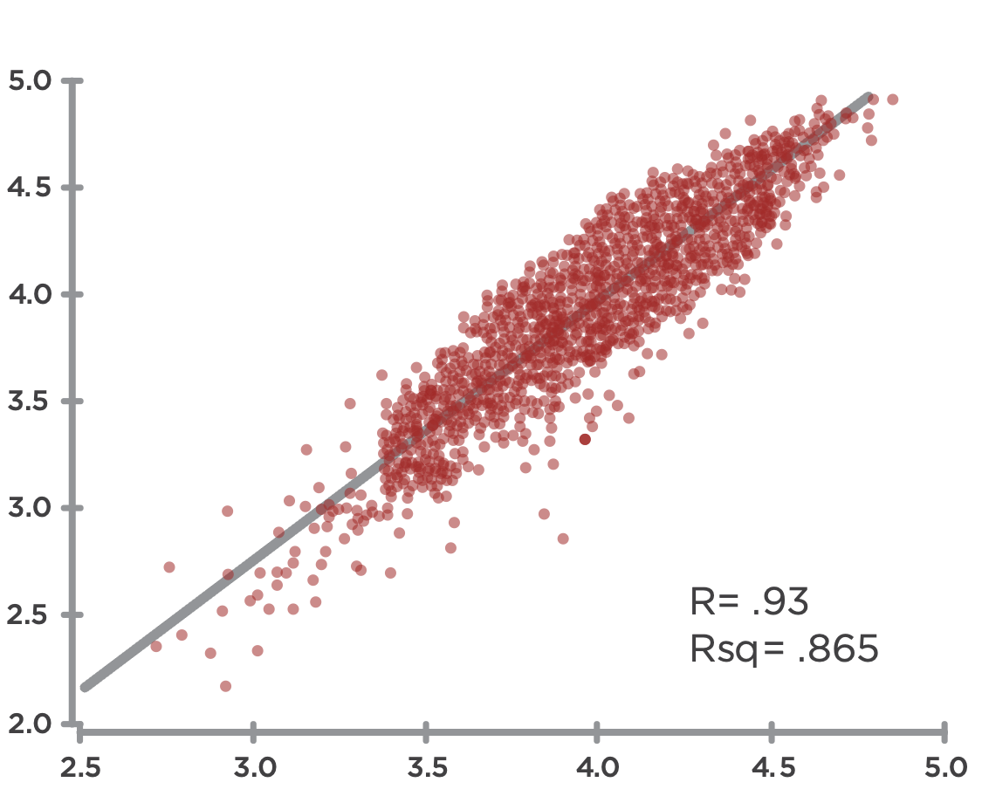
Leadership Effectiveness & Creative Competencies
Leadership Effectiveness
Creative Competencies
Notes:
Learning Objective 1: for participants to understand that an initial research question was the degree to which the LCP model actually measured what is commonly understood to be effective leadership. We found a strong positive correlation between the Creative aspects of the LCP and the LE questions indicating that the battery of 18 Creative competencies in the LCP are tracking with what it takes to be an effective leader across many contexts.
Learning Objective 2: for participants to understand that r = the relationship between the two variables or the line of best fit through the data—so how much of the movement of one variable is described by movement of the other. In this case, r = 0.93 means that if the Average Creative Score increases 1.00 (one unit of measure), the Leadership Effectiveness score will likely increase on average by 0.93. This is a very strong correlation.
Learning Objective 3: for participants to understand that rsq = the degree to which the data tightly cluster around the line of best fit. A high rsq means that the data don’t vary much and fit tightly together around the line of best fit (the prediction of the model). A low rsq means that the data are more scattered around the line of best fit. (Technically, rsq measures the amount of variability among the data points that can be explained by the model or predicted by the line of best fit).

Slide 8
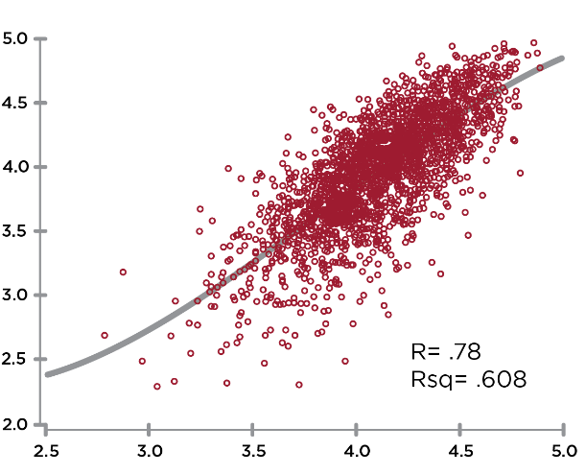
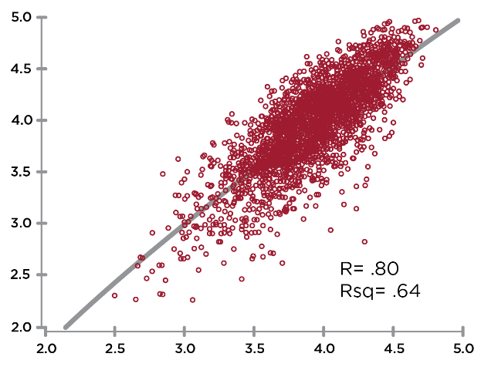
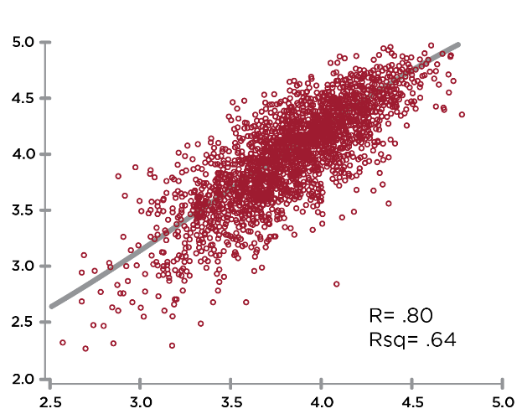
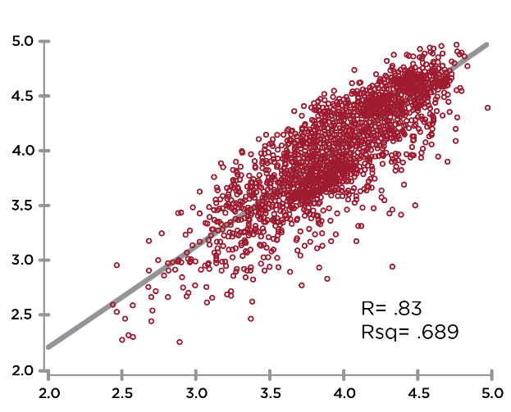
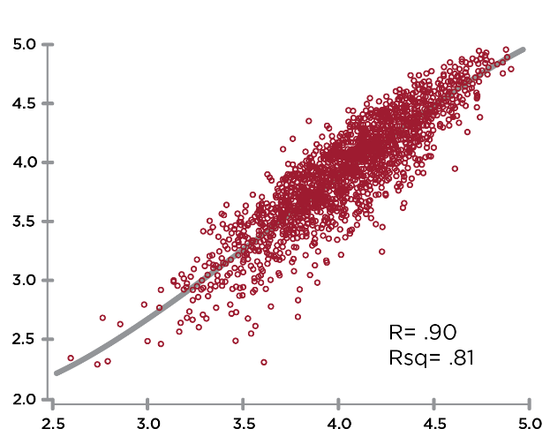
CREATIVE Correlations to
Leadership Effectiveness
Leadership Effectiveness
Leadership Effectiveness
Leadership Effectiveness
R=.78
Authenticity
R=.76
R=.84
Self Awareness
Systems Awareness
Leadership Effectiveness
Leadership Effectiveness
R=.85
R=.91
Relating
Achieving
Notes:
Learning Objective 1: for participants to understand that perceptions of Leadership Effectiveness (the 5 questions on the scale) are strongly correlated with the Creative Competencies.

Slide 9
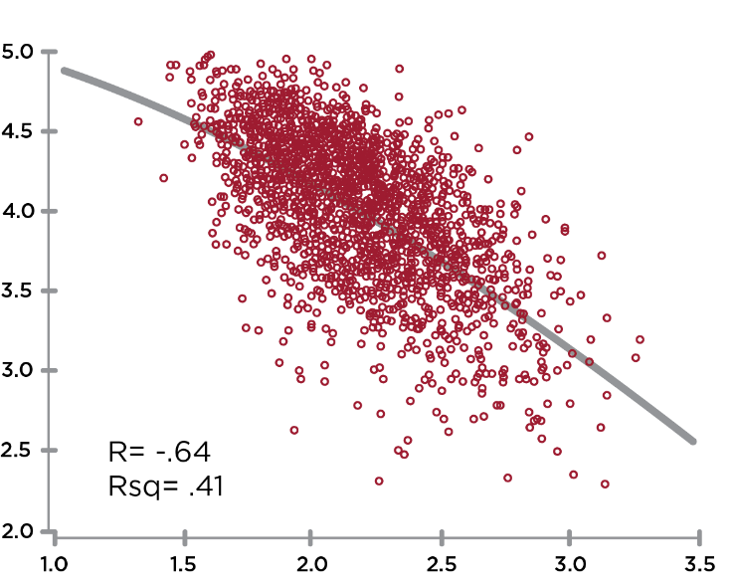
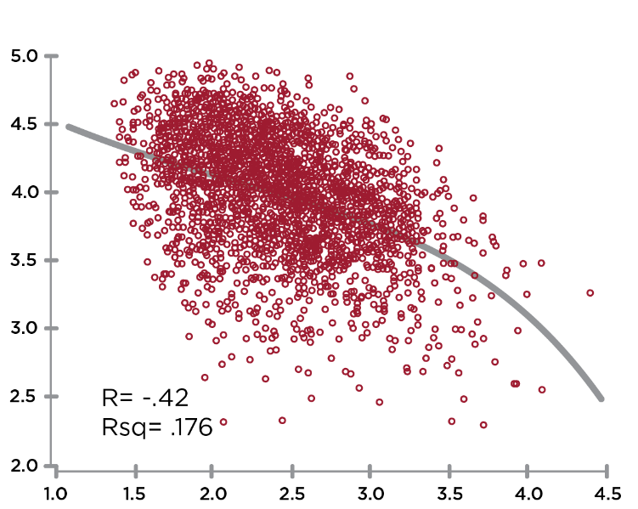
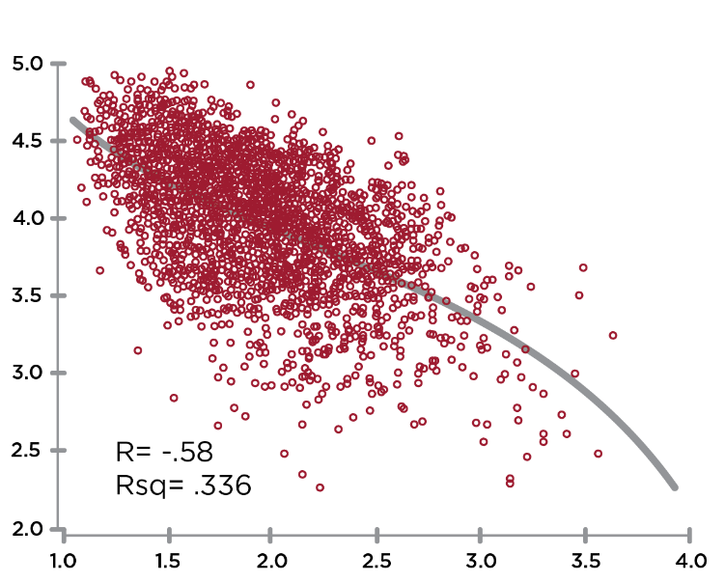
REACTIVE Correlations to
Leadership Effectiveness
Leadership Effectiveness
Leadership Effectiveness
R= -.63
R= -.41
Complying
Leadership Effectiveness
Controlling
R= -.56
Protecting
Notes:
Learning Objective 1: for participants to understand that perceptions of Leadership Effectiveness (the 5 questions on the scale) are strongly correlated with the Creative Competencies.

Slide 10
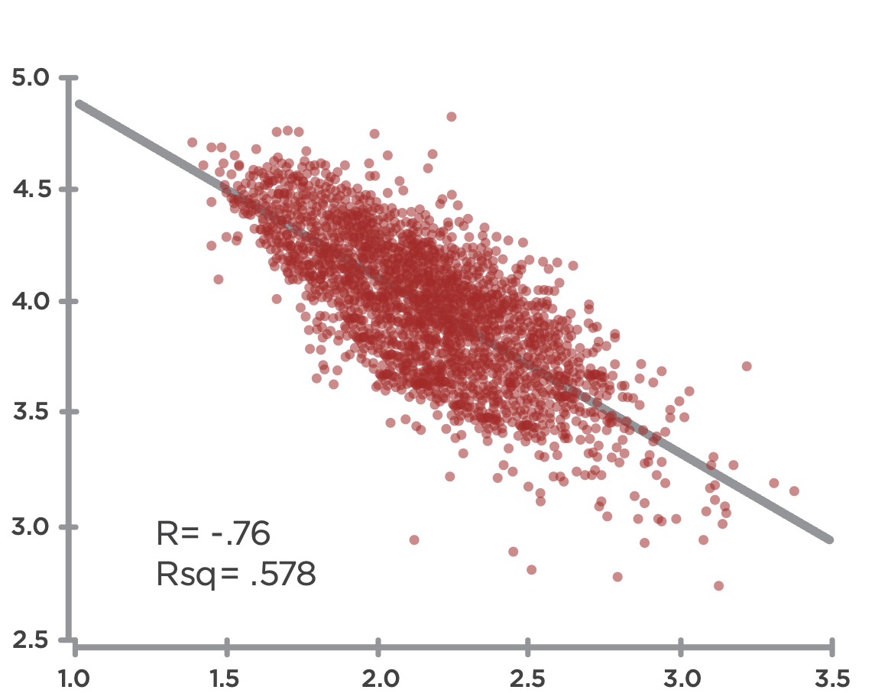
Creative Competencies & Reactive Tendencies
Creative
R= -.76
Rsq= .578
Reactive
Notes:
Learning Objective 1: for participants to understand that the Creative Competencies are strongly negatively correlated (-.76) with the Reactive Tendencies.
Learning Objective 2: for participants to understand that the implication of this correlation is that Reactive Tendencies significantly block/cancel the expression of Creative Competencies.

Slide 11
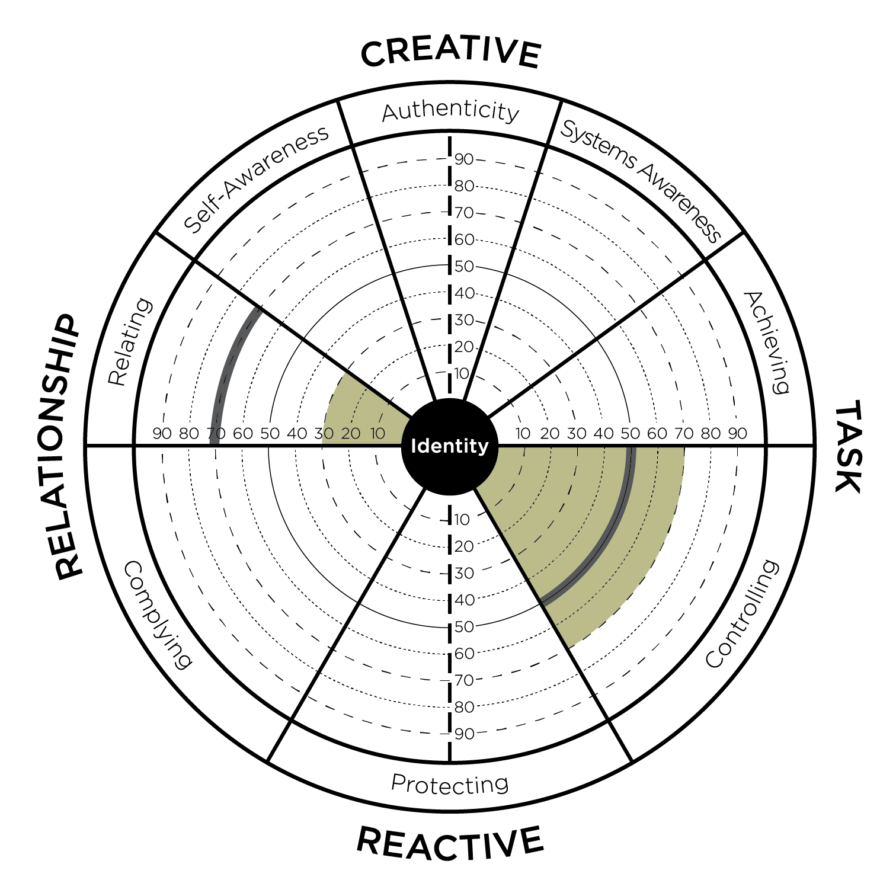
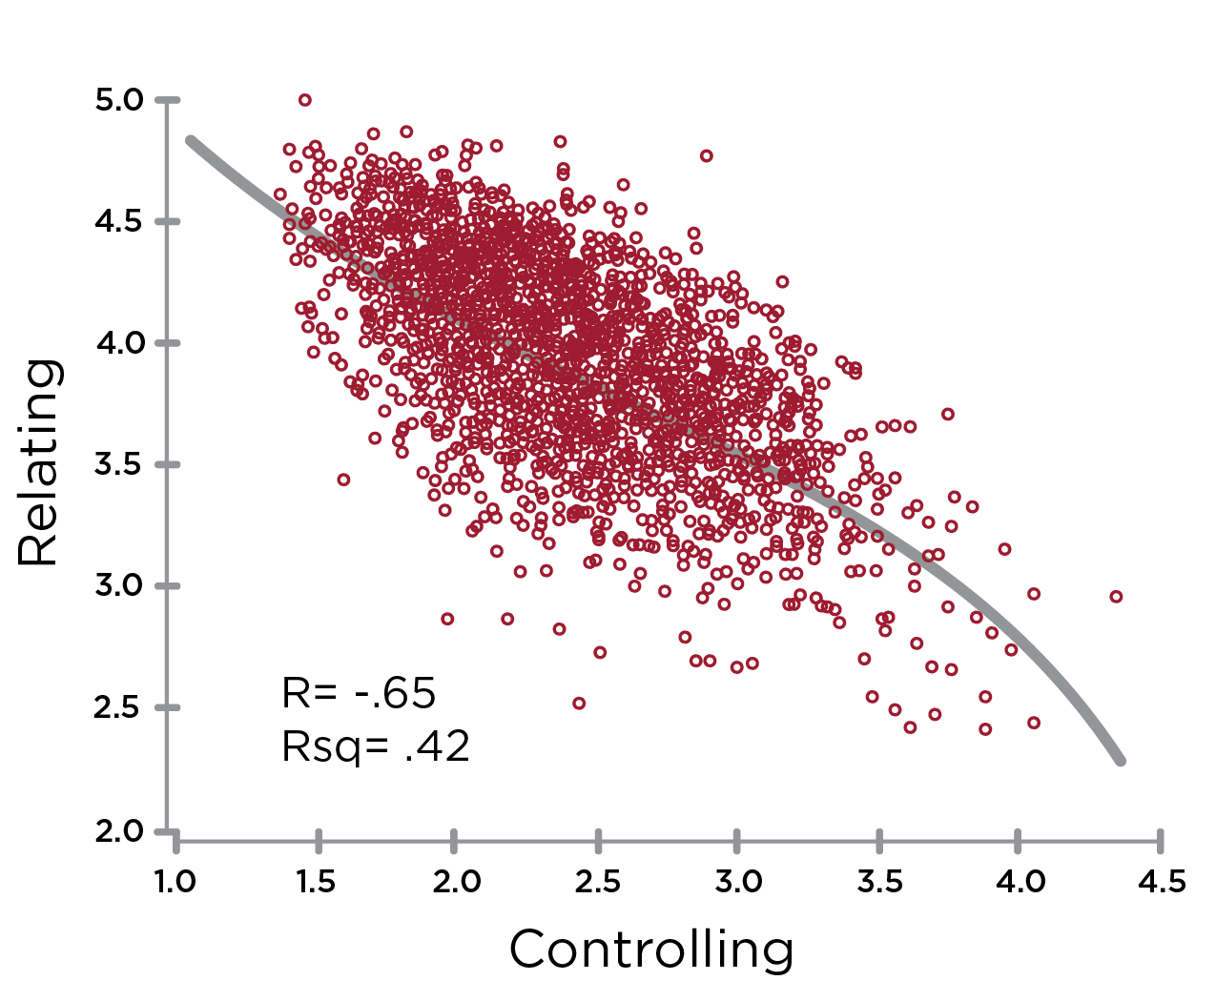
Opposites: Controlling & Relating
Notes:
Learning Objective 1: for participants to understand that Controlling has a large negative effect on Relating (-.65) and thus they are opposite one another on the graph.
Learning Objective 1: for participants to understand that Controlling also has a large negative effect on Self Awareness (-.66) and thus they are also opposite one another on the graph.
Learning Objective 3: for participants to understand that a typical developmental trajectory for someone with high Controlling would be up and across the graph working on improving Relating and/or improving Self Awareness.
Learning Objective 4: for participants to understand that Controlling is negatively correlated with Relating (-.65).

Slide 12
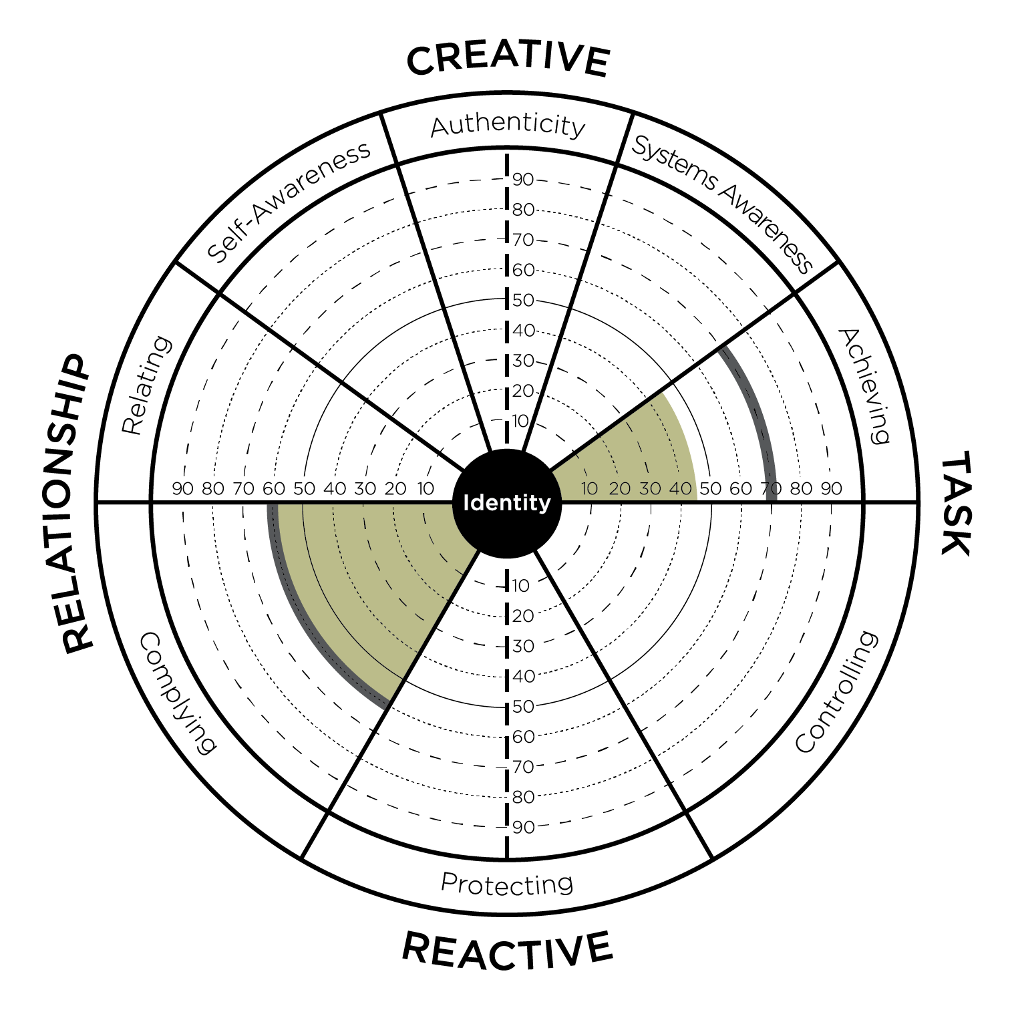
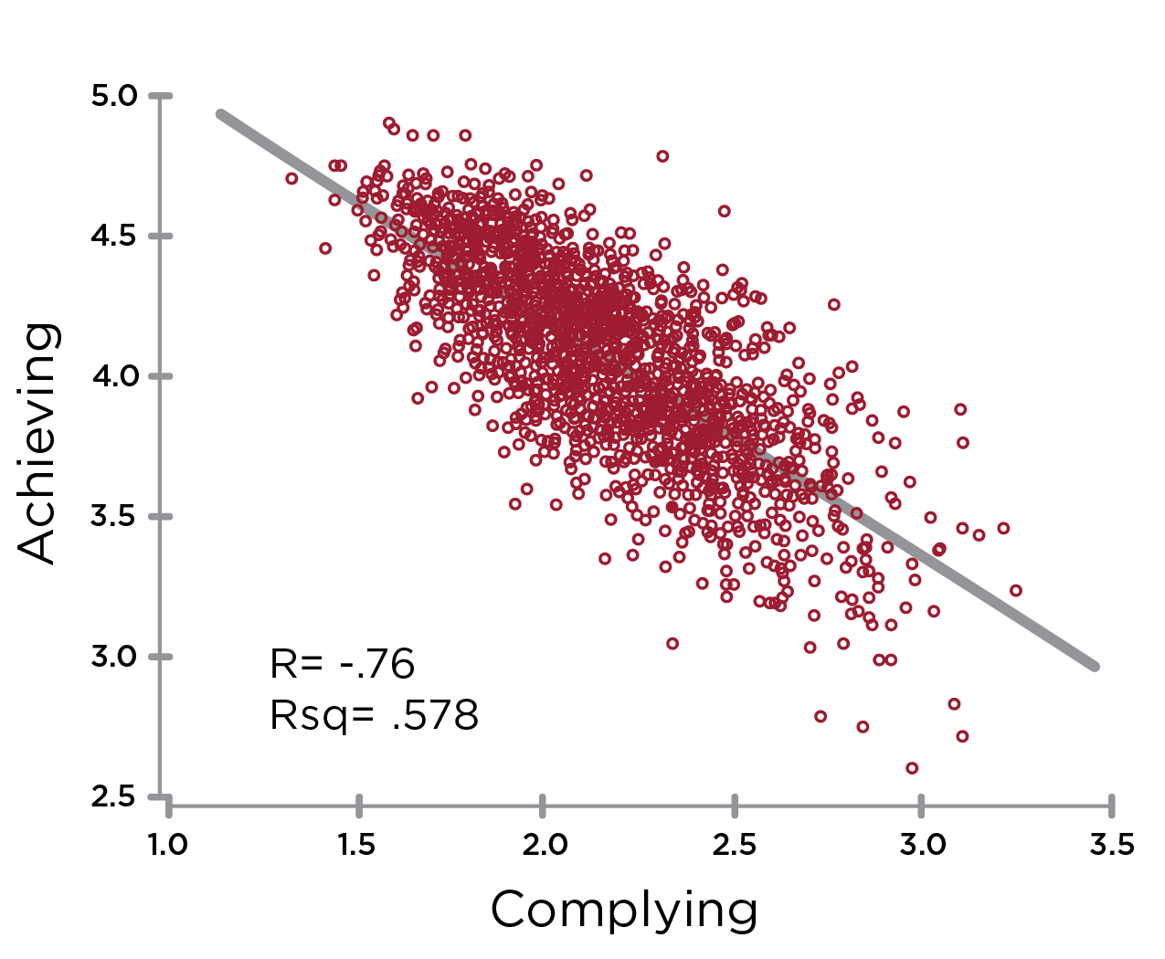
Opposites: Complying & Achieving
Notes:
Learning Objective 1: for participants to understand that Complying has its biggest negative effect on Achieving (-.76) and thus they are opposite one another on the graph.
Learning Objective 2: for participants to understand that a typical developmental trajectory for someone with high Complying would be up and across the graph working on improving Achieving.
Learning Objective 3: for participants to understand that Complying has its second biggest negative effect on Authenticity (-.62) and this is also another common developmental trajectory (particularly working on Courageous Authenticity).
Learning Objective 4: for participants to understand that Complying is negatively correlated with Achieving (-.76).

Slide 13
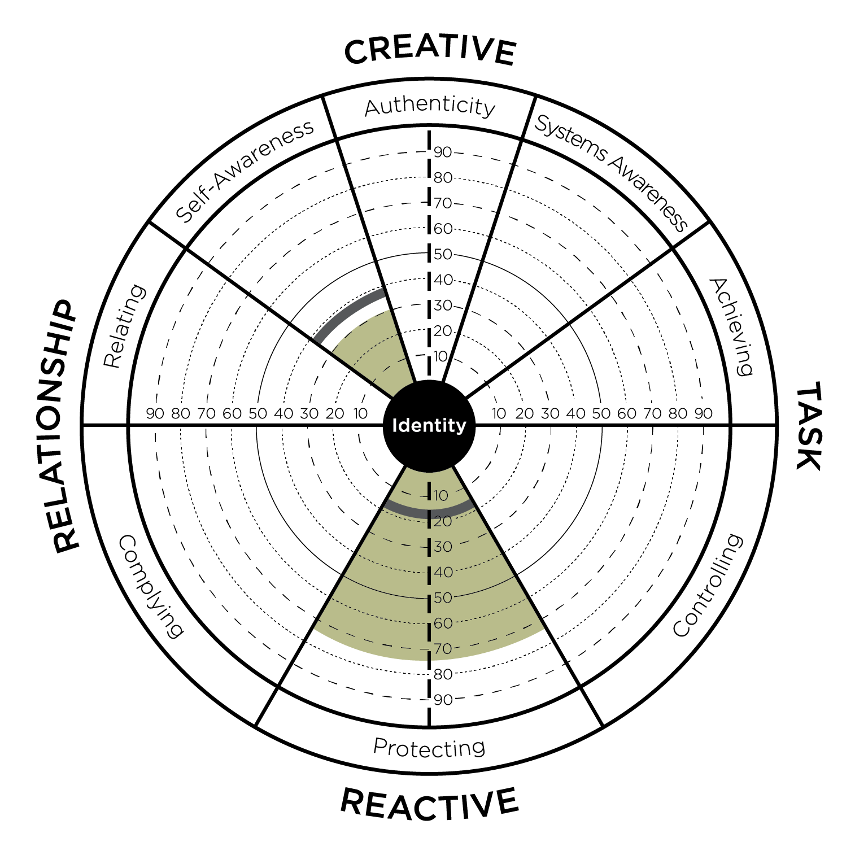
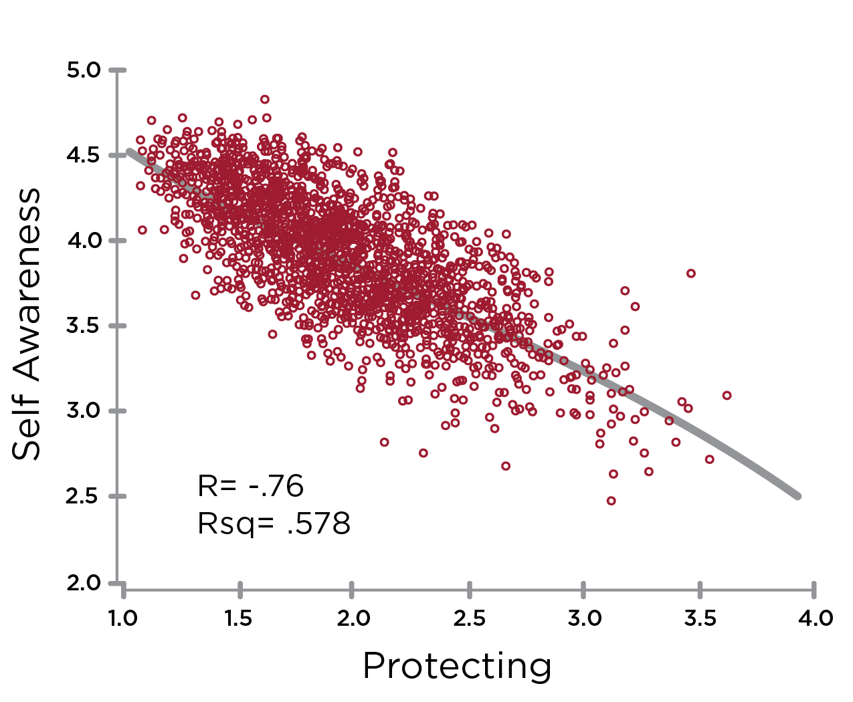
Opposites: Protecting & Self Awareness
Notes:
Learning Objective 1: for participants to understand that Protecting has a large negative effect on Self Awareness (-.70) and thus they opposite on the graph.
Learning Objective 2: for participants to understand that Protecting has a large negative effect on Relating as well (-.73).
Learning Objective 3: for participants to understand that a typical developmental trajectory for someone with high Protecting might be up and to the left across the graph working on improving Self Awareness and Relating.
Learning Objective 4: for participants to understand that Protecting is negatively correlated with Self Awareness (-.76).

Slide 14
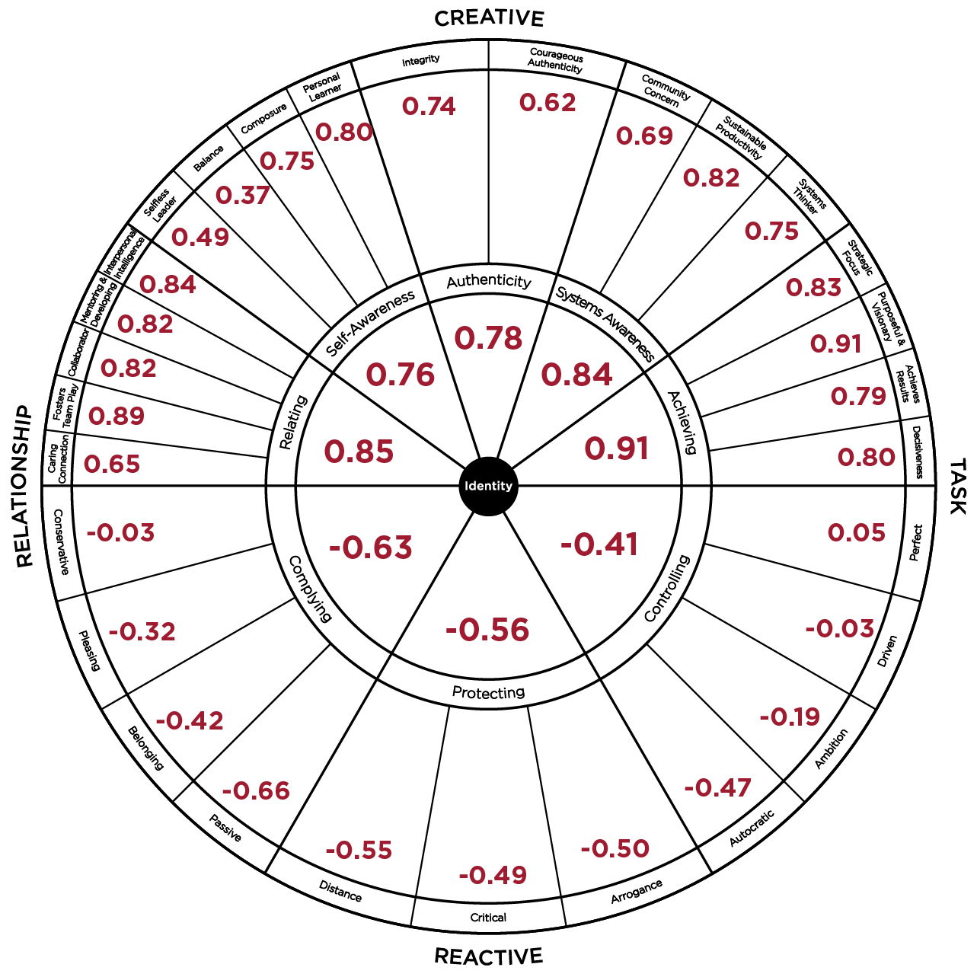
LCP Correlations to Leadership Effectiveness
ü
I am satisfied with the quality of leadership that
this leader provides.
ü
This leader is the kind of leader that others should
aspire to become.
ü
This leader is an example of an ideal leader.
ü
This leader’s leadership helps this organization to thrive.
ü
Overall, this leader provides very effective leadership.
Notes:
Learning Objective 1: for participants to understand that each of the 29 Creative/Reactive dimensions of the LCP have their own unique correlation to Leadership Effectiveness (the five Ideal Leader questions).
Learning Objective 2: for participants to look at their own LCP data through the lens of these more granular correlations to see if it generates any new developmental understanding or insight.
Learning Objective 2: for participants to imagine/brainstorm how they might use these correlations with their clients.

Slide 15
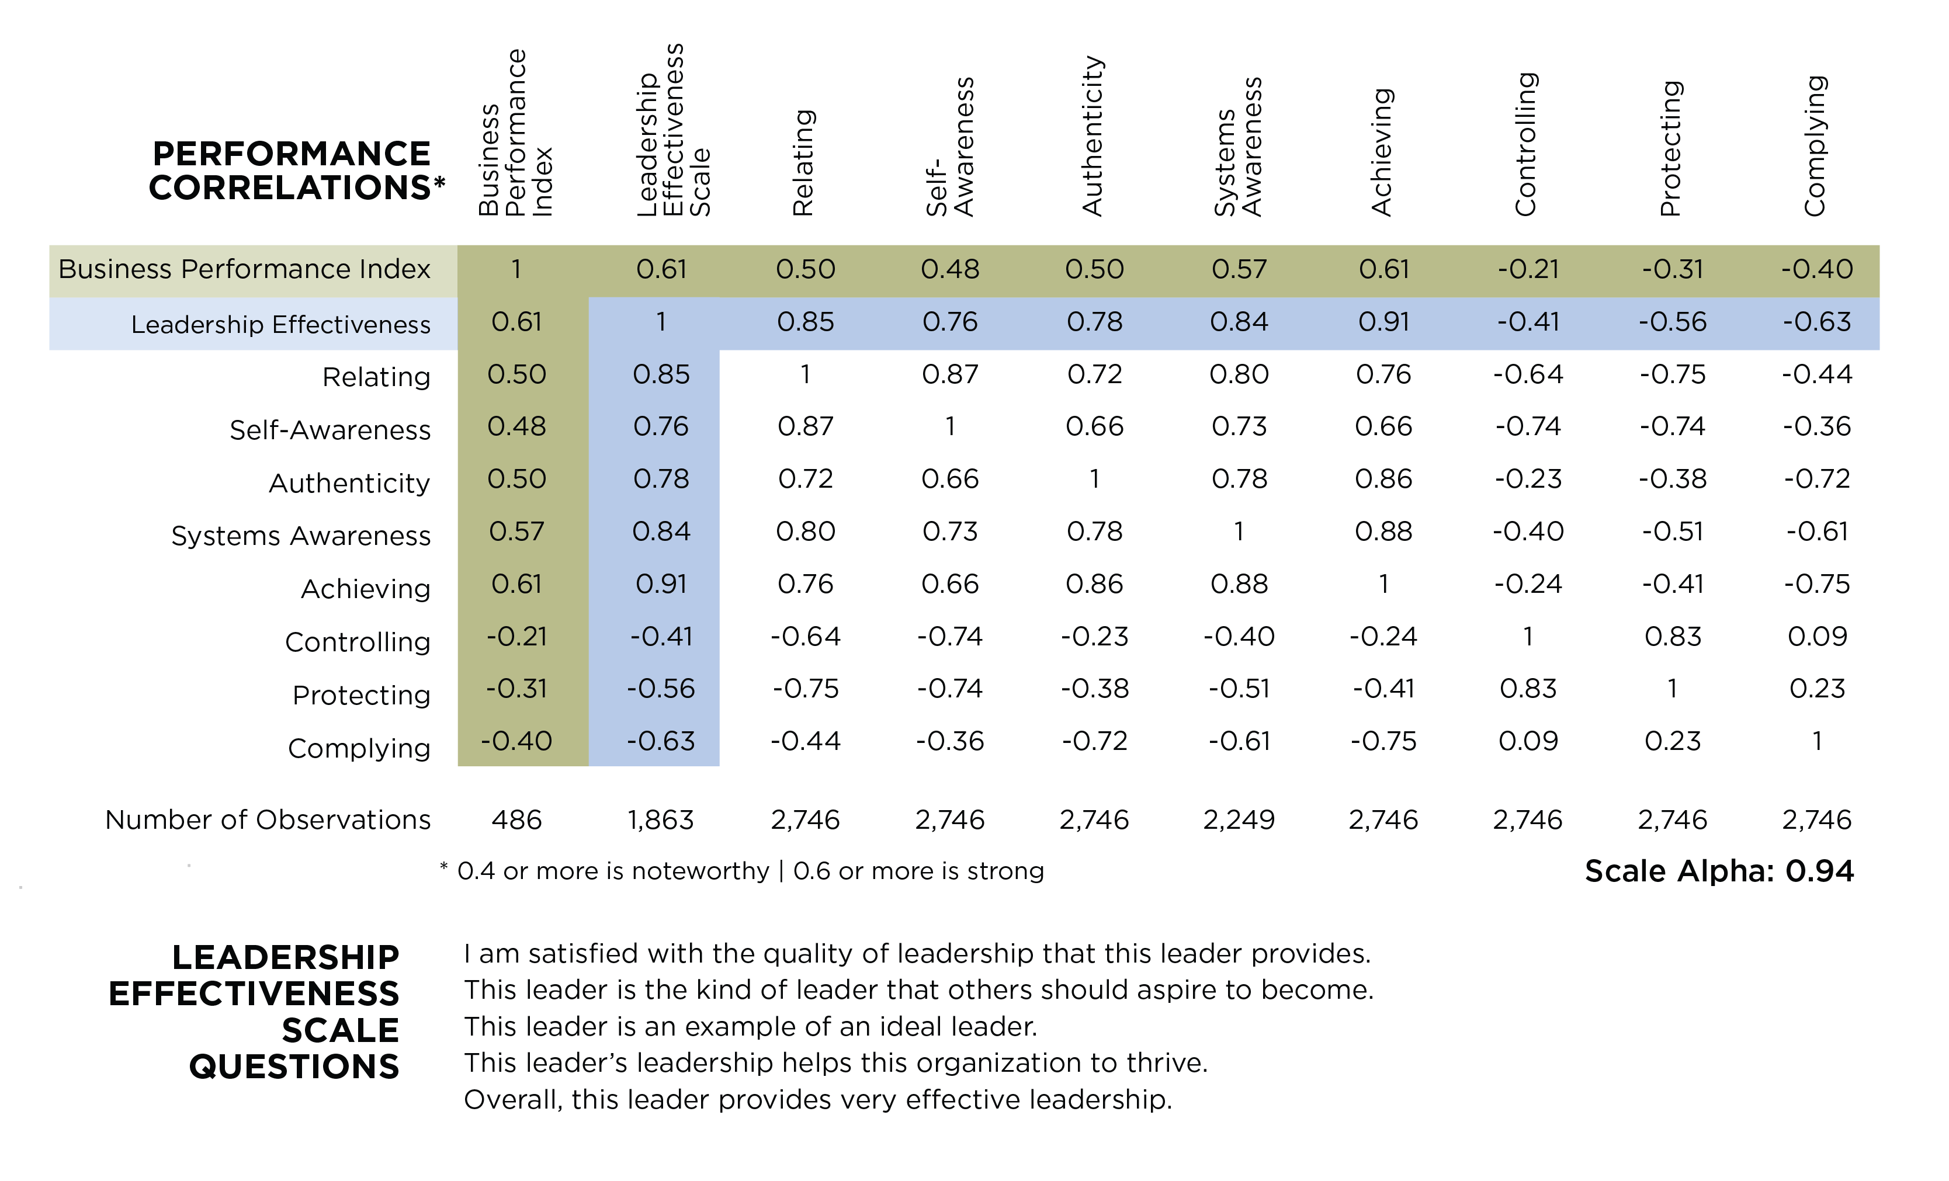
Notes:
Learning Objective 1: for participants to understand that each of the 29 Creative/Reactive dimensions of the LCP have their own unique correlation to Leadership Effectiveness (the five Ideal Leader questions).
Learning Objective 2: for participants to look at their own LCP data through the lens of these more granular correlations to see if it generates any new developmental understanding or insight.
Learning Objective 2: for participants to imagine/brainstorm how they might use these correlations with their clients.

Slide 16
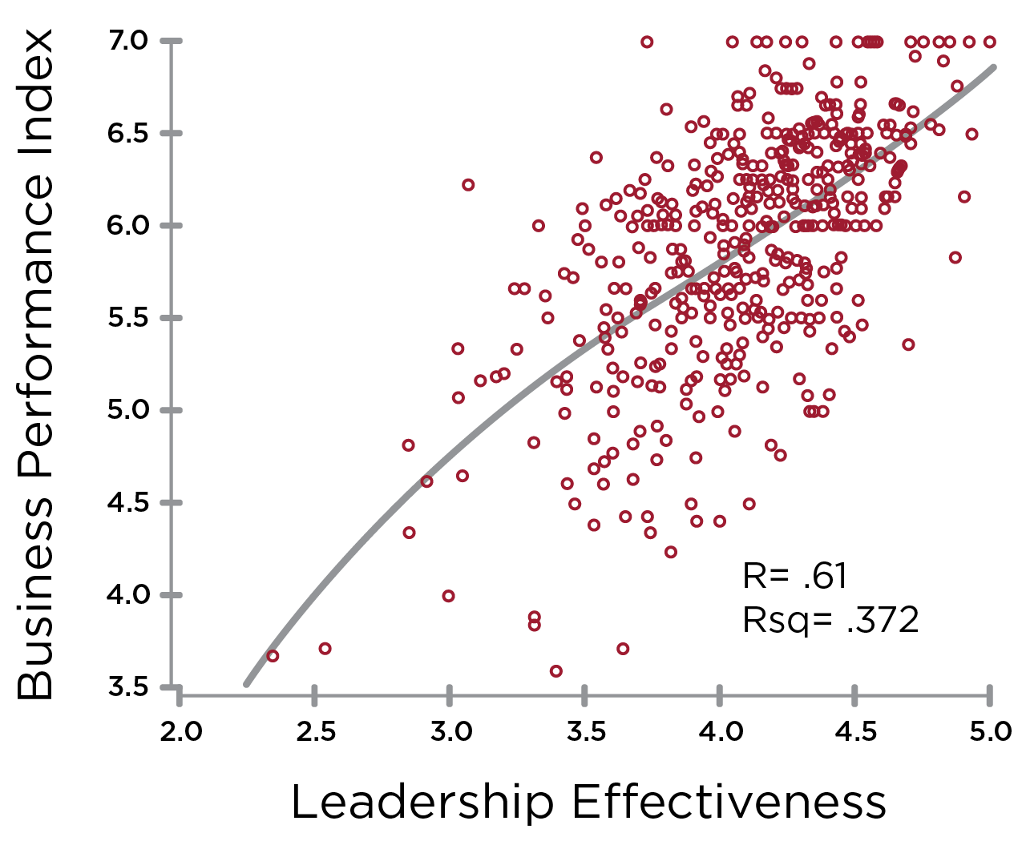
Leadership Effectiveness & Business Performance
Notes:
Learning Objective 1: for participants to understand the correlation between Leadership Effectiveness (measured by the five ideal leader questions) and Business Performance (measured by the six elements of the Business Performance Index).

