Slide 1

Evolving the Conscious Practice of Leadership

Slide 2
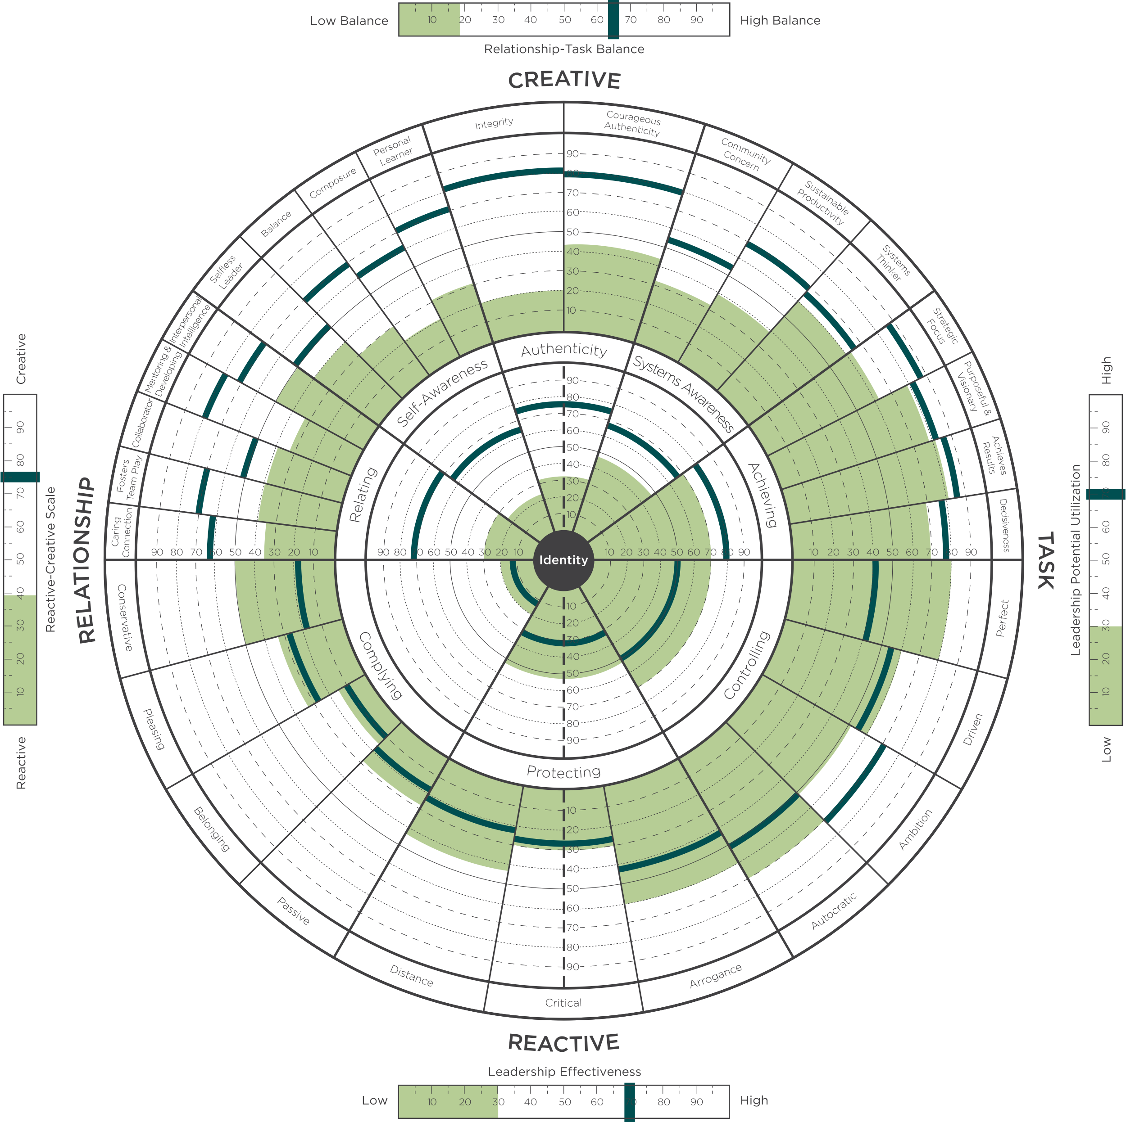

Notes:
Learning Objective 1: for participants to understand the Reactive Creative scale measures the degree that a person’s leadership is experienced by others primarily through their Creative Competencies (high score) or through their Reactive Tendencies (low score) or some combination of the two (medium score).
Learning Objective 2: for participants to understand that this summary measure is a good indication of where a person spends their leadership energy and bandwidth.
Learning Objective 3: for participants to understand that this score reflects the visual of the graph. Lots of green on the top with little green on the bottom (high score). Little green on the top with lots of green on the bottom (low score). Mix of green on both top and bottom (medium score).

Slide 3
The Leadership Circle Profile
Universal leadership consulting model
The world’s only fully integrated leadership model and tool
Over 125,000 leaders have used the TLC Profile in their development
Over 2000 certified practitioners in North America
Experienced in over 1,400 organizations worldwide, including Fortune 500s, not-for-profits, and across all industries.
Notes:
MO

Slide 4
360º Assessment Tool
What is a 360 Assessment?
Benefits
An assessment based on research proven leadership traits and dimensions.
A questionnaire, both for a leader (self) and others (raters)
Confidential feedback
A foundation to ongoing coaching and development
Focuses development on key competencies
Identifies strengths to build upon
Shows the impact of your leadership style on others
Highlights gaps in awareness
Links thinking and behavior
Reduces potential for derailment
Notes:
MO

Slide 5


Two Structures of Mind
Problem - Reacting
Outcome - Creating
Problem
Threat
Purpose
Vision
Reaction
Fear
Action
Passion
Results
Results
Time
Time
Anxiety Containing
Potential Unleashing
Notes:
Learning Objective 1: for participants to understand the two structures of mind (metaphorically, the two operating systems) that generate very different experiences of life and leadership.
Learning Objective 2: for participants to see the pattern of reaction is what they just got a glimpse of in the Gravity Stick exercise (their particular physical, emotional, cognitive, behavioral, and narrative routine).
Learning Objective 3: for participants to understand that the core function of the Reactive iOS is to contain anxiety and the core function of the Creative iOS is to unleash potential.

Slide 6
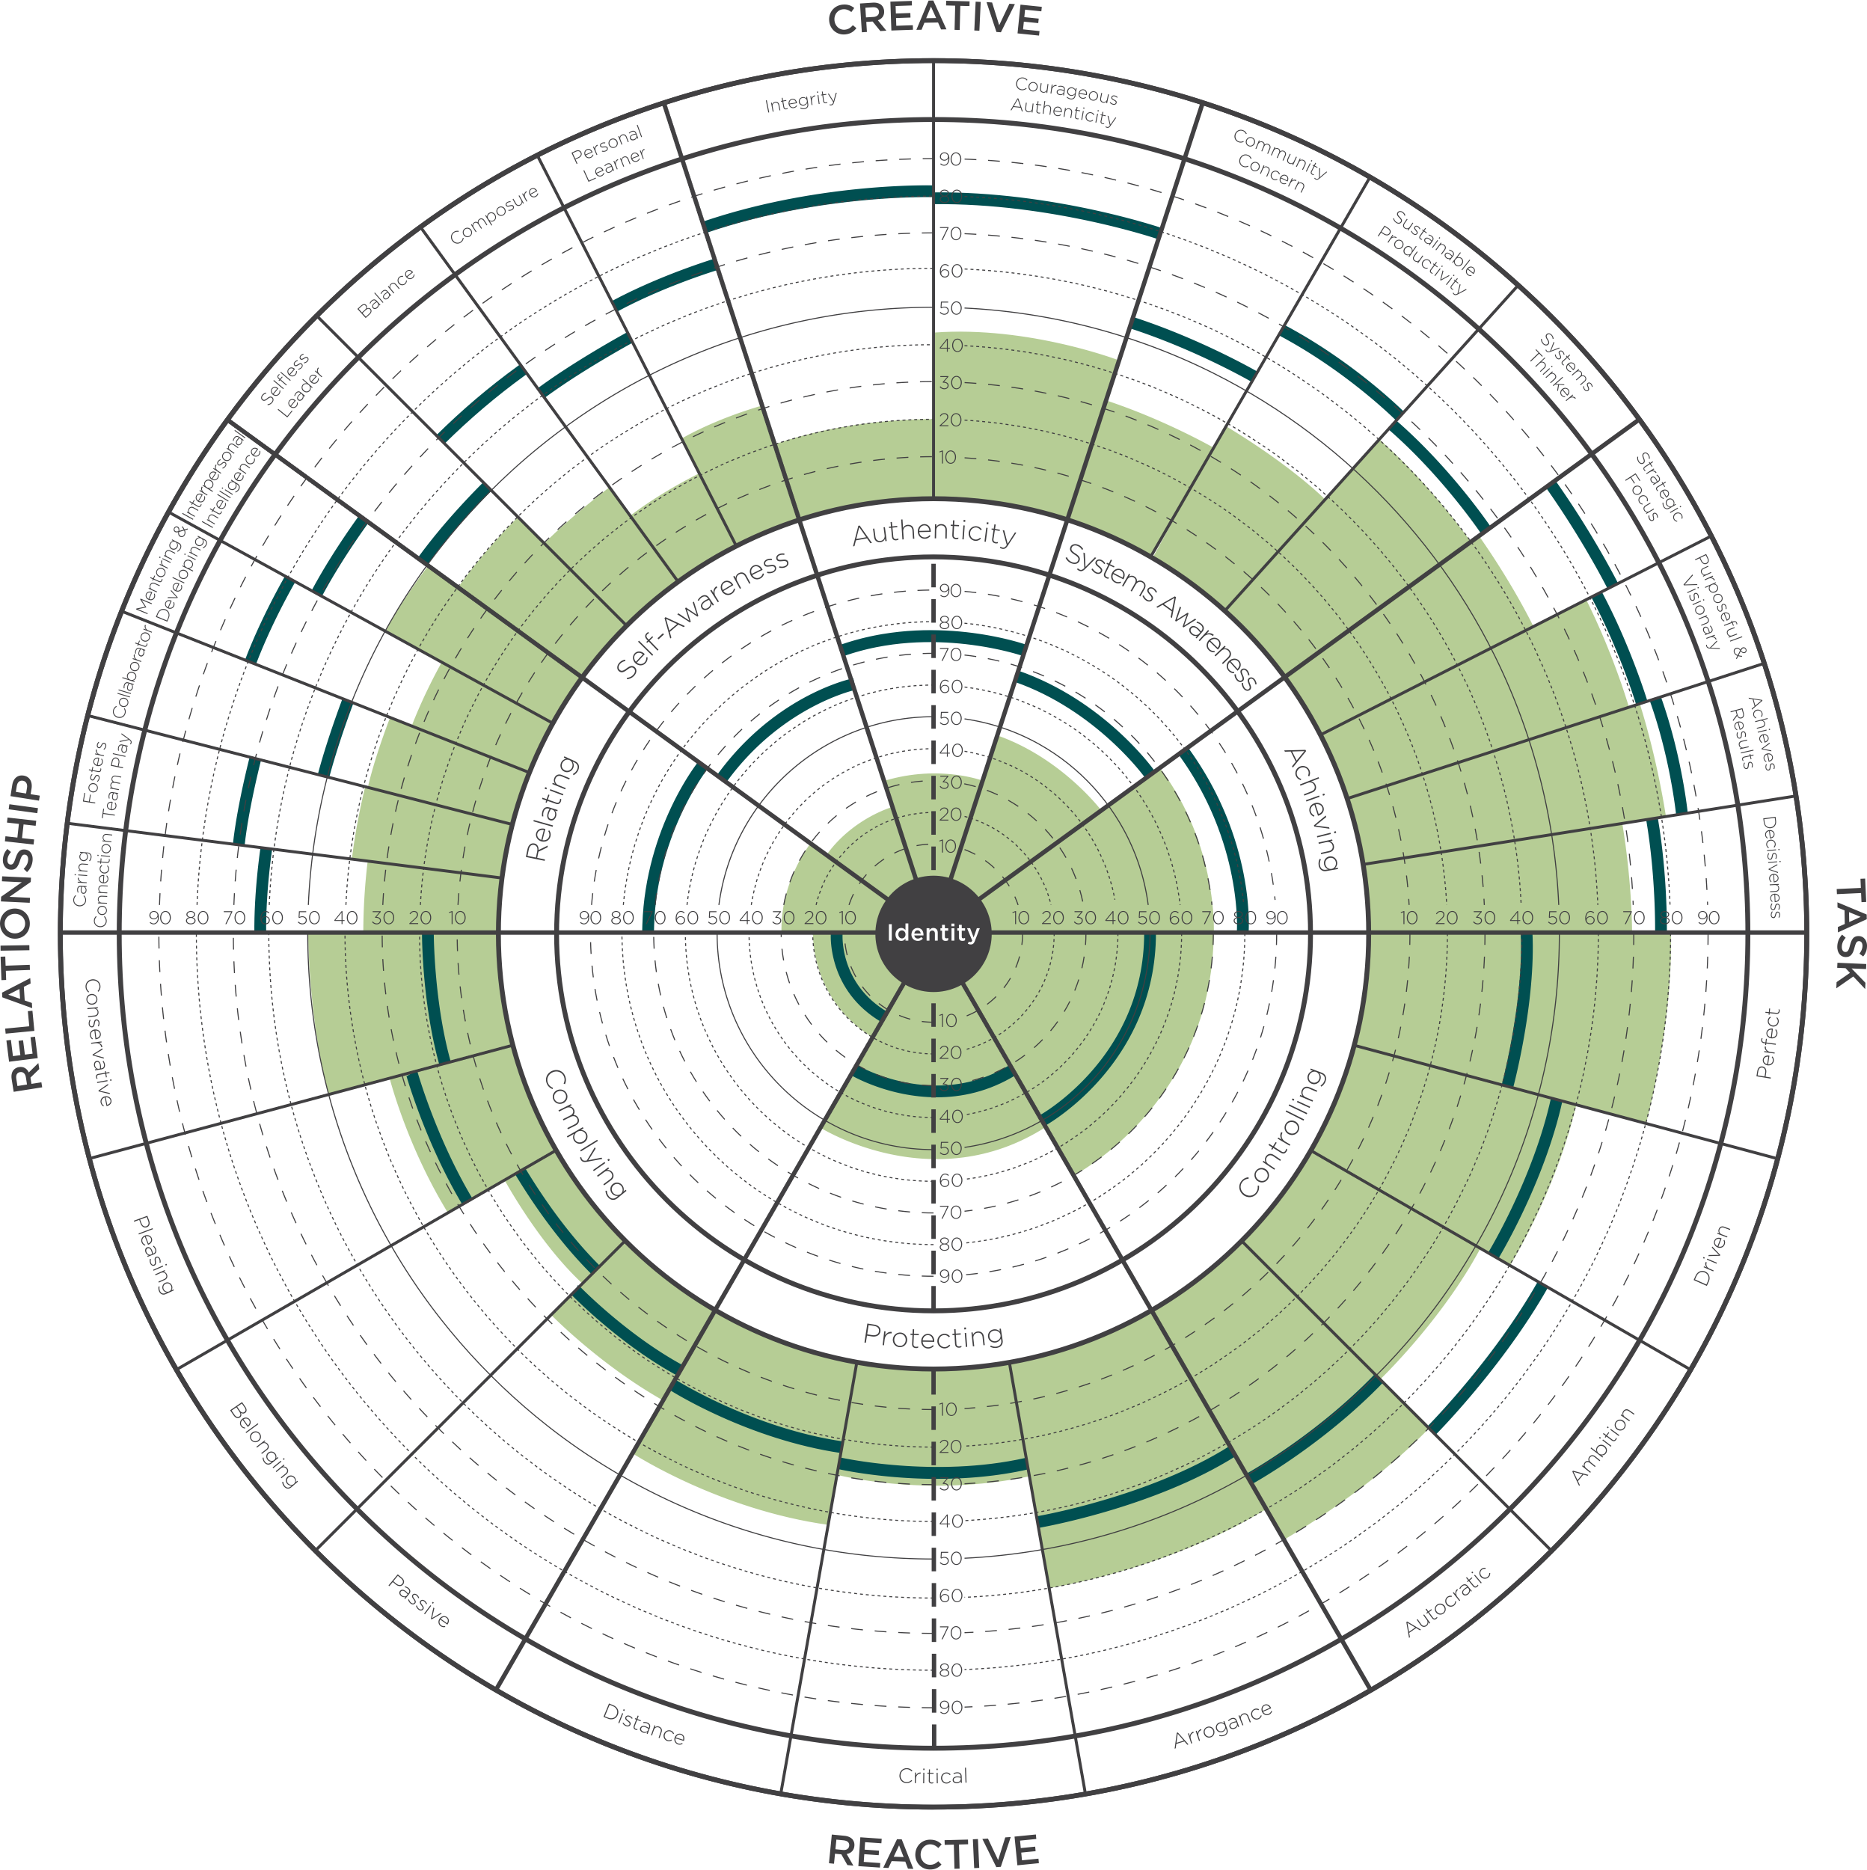
3 Leadership Assessment Categories
Competencies
Competencies
Assumptions
Assumptions
Style-Type-Personality
Style-Type-Personality
Notes:
First, You can measure Competencies—this is the most common choice for organizations.
Competencies tell you what is going on with key behaviors that impact your ability to achieve results. An example of a competency might be Strategic Focus or Collaboration. A competency describes a positive leadership behavior, but does not answer the question ‘”What it going on under the surface that supports or inhibits these key behaviors”? Examples of competency assessments include Benchmarks, PDI and Lominger.
(Click) The next choice for assessments measure what’s going on under the surface. These are self-awareness tools that measure the internal motivations that drive behavior. These tools are very useful if they help managers get insight into why they are behaving in certain ways. However, these tools seldom show any direct connection to competencies or measures of effectiveness in leadership. Tools in this category include Hogan, FIRO-B, and Emotional Intelligence.
(Click) And finally, in the third category you have Tools that measure Style and Personality. These tools are mostly used to help managers and teams understand their differences, but these tools fail to clarify how Style and Personality impacts competencies or business results. Tools in this category include Meyers Briggs or Disc.
With any of these tools, used separately, you are getting, at best, a third of the whole picture. If you are serious about leadership development—you need to help managers get the whole story. Otherwise, It’s like trying to see with one eye closed…. (CLICK) With the LCP you get the full picture of your leadership – 3 assessments in one

Slide 7
What’s Going On
Why It’s Going On
Pathway For Change
Notes:
With the LCP you get the full picture of your leadership. At last, you see, in one assessment, what you are missing in all the others. TLC is unique because it measures
-- (Click) Leadership competencies
--(Click) Assumptions that drive Behavior
Assumptions that lead to effectively developing key leadership competencies
Assumptions that run reactive, self-limiting behavior.
-- (Click) and LCP reveals style and personality…all at the same time.

Slide 8

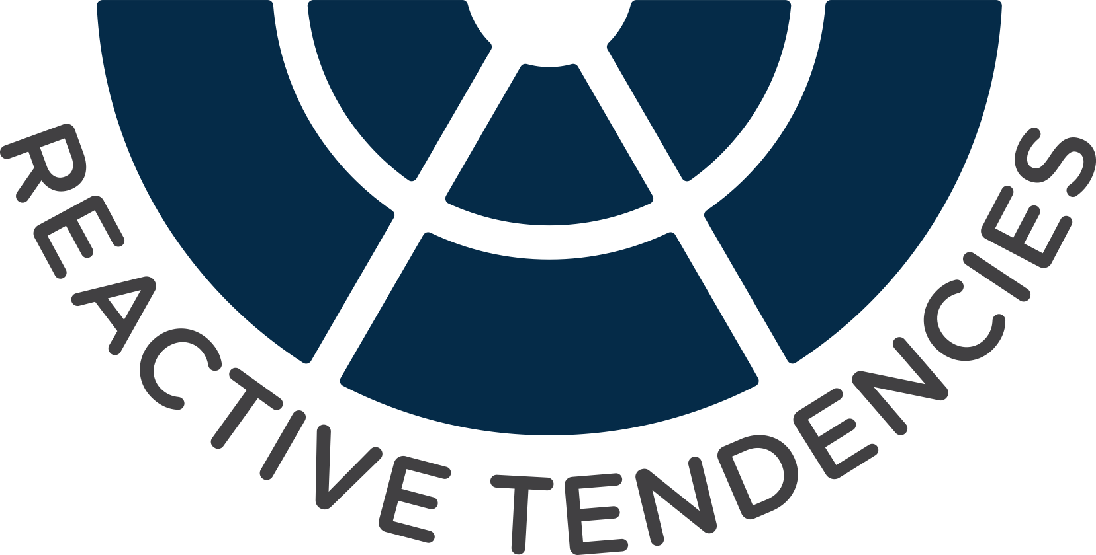
The Model Fundamental: Two Structures of Mind

Slide 9
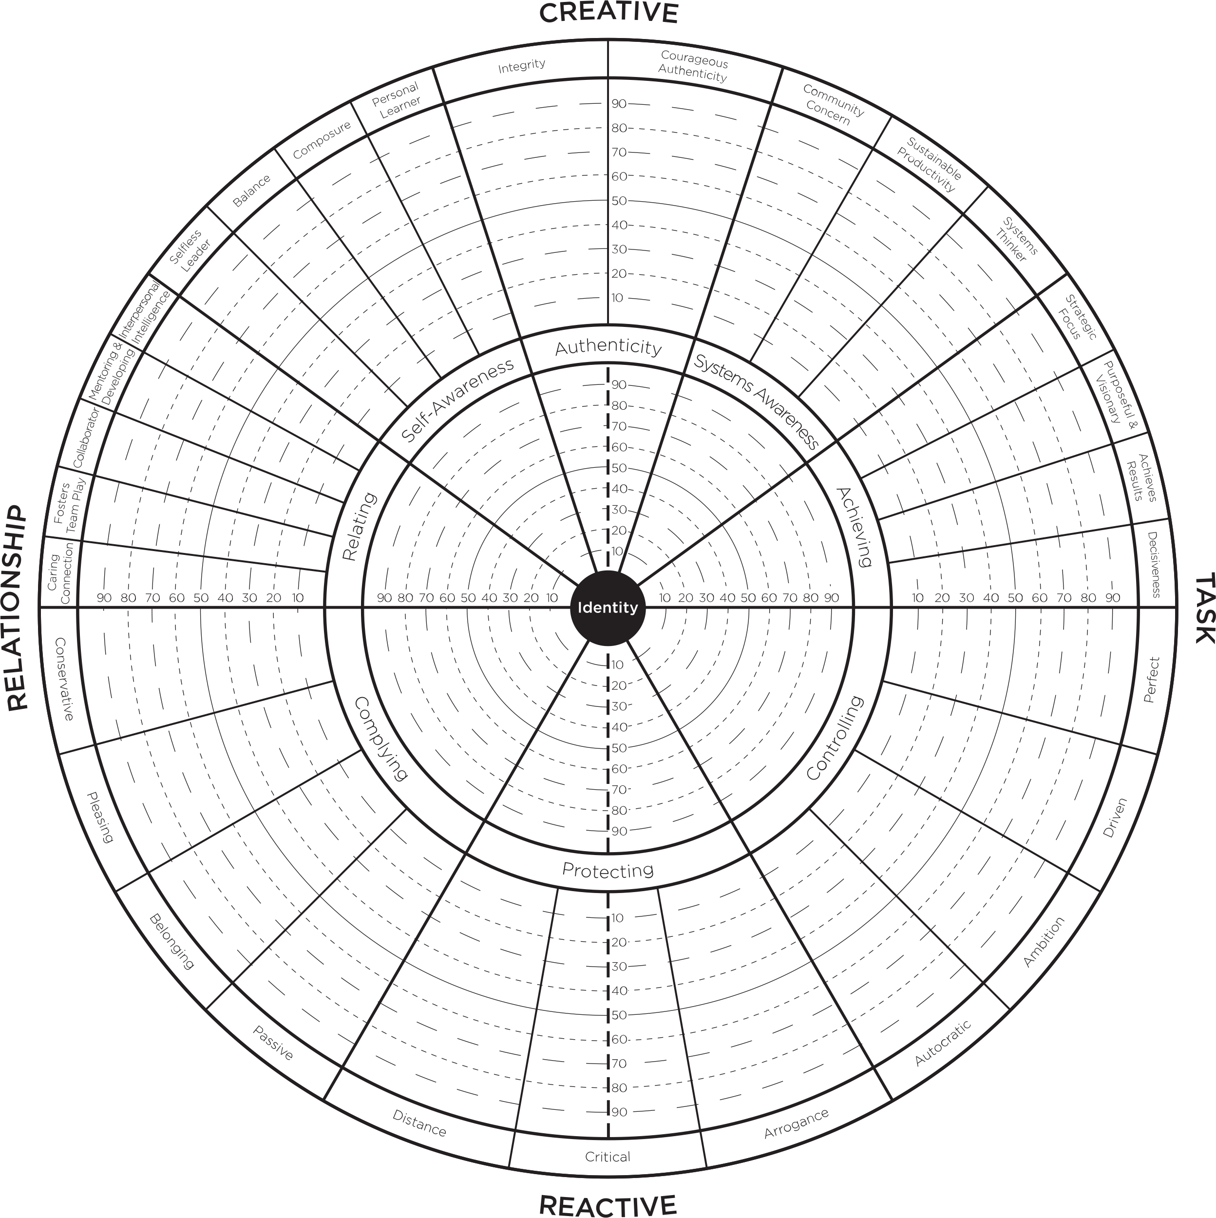


Creative Competencies
Relating
Systems Awareness
Caring Connection
Fosters Team Play
Collaborator
Mentoring and Development
Interpersonal Intelligence
Community Concern
Sustainable Productivity
System Thinker
Self Awareness
Achieving
Selfless Leader
Balance
Composure
Personal Learner
Strategic Focus
Purposeful and Visionary
Achieves Results
Decisiveness
Authenticity
Integrity
Courageous Authenticity

Slide 10

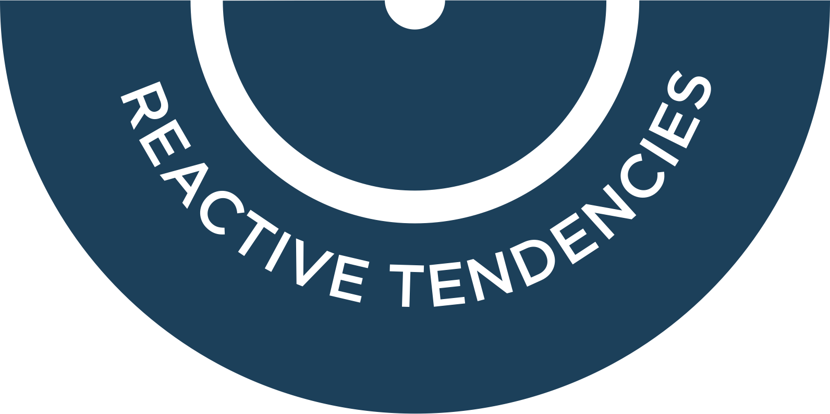

Reactive Styles
Complying
Conservative
Pleasing
Belonging
Passive
Protecting
Distance
Critical
Arrogance
Controlling
Autocratic
Ambition
Driven
Perfect

Slide 11


Relationship & Task

Slide 12
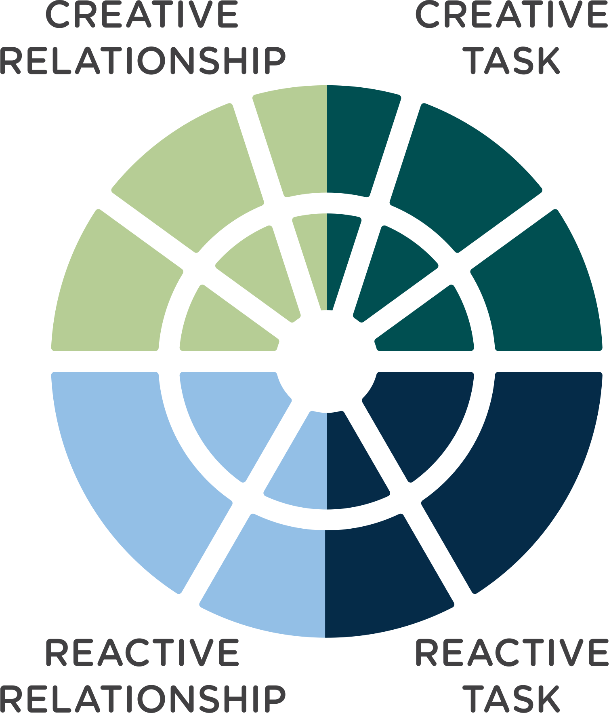
Four
Quadrants

Slide 13
5 Inner Circle
Core Leadership Dimensions
18 Outer Circle
Creative Competencies

Slide 15
3 Inner Circle
Reactive Dimensions
11 Outer Circle
Reactive Tendencies

Slide 17
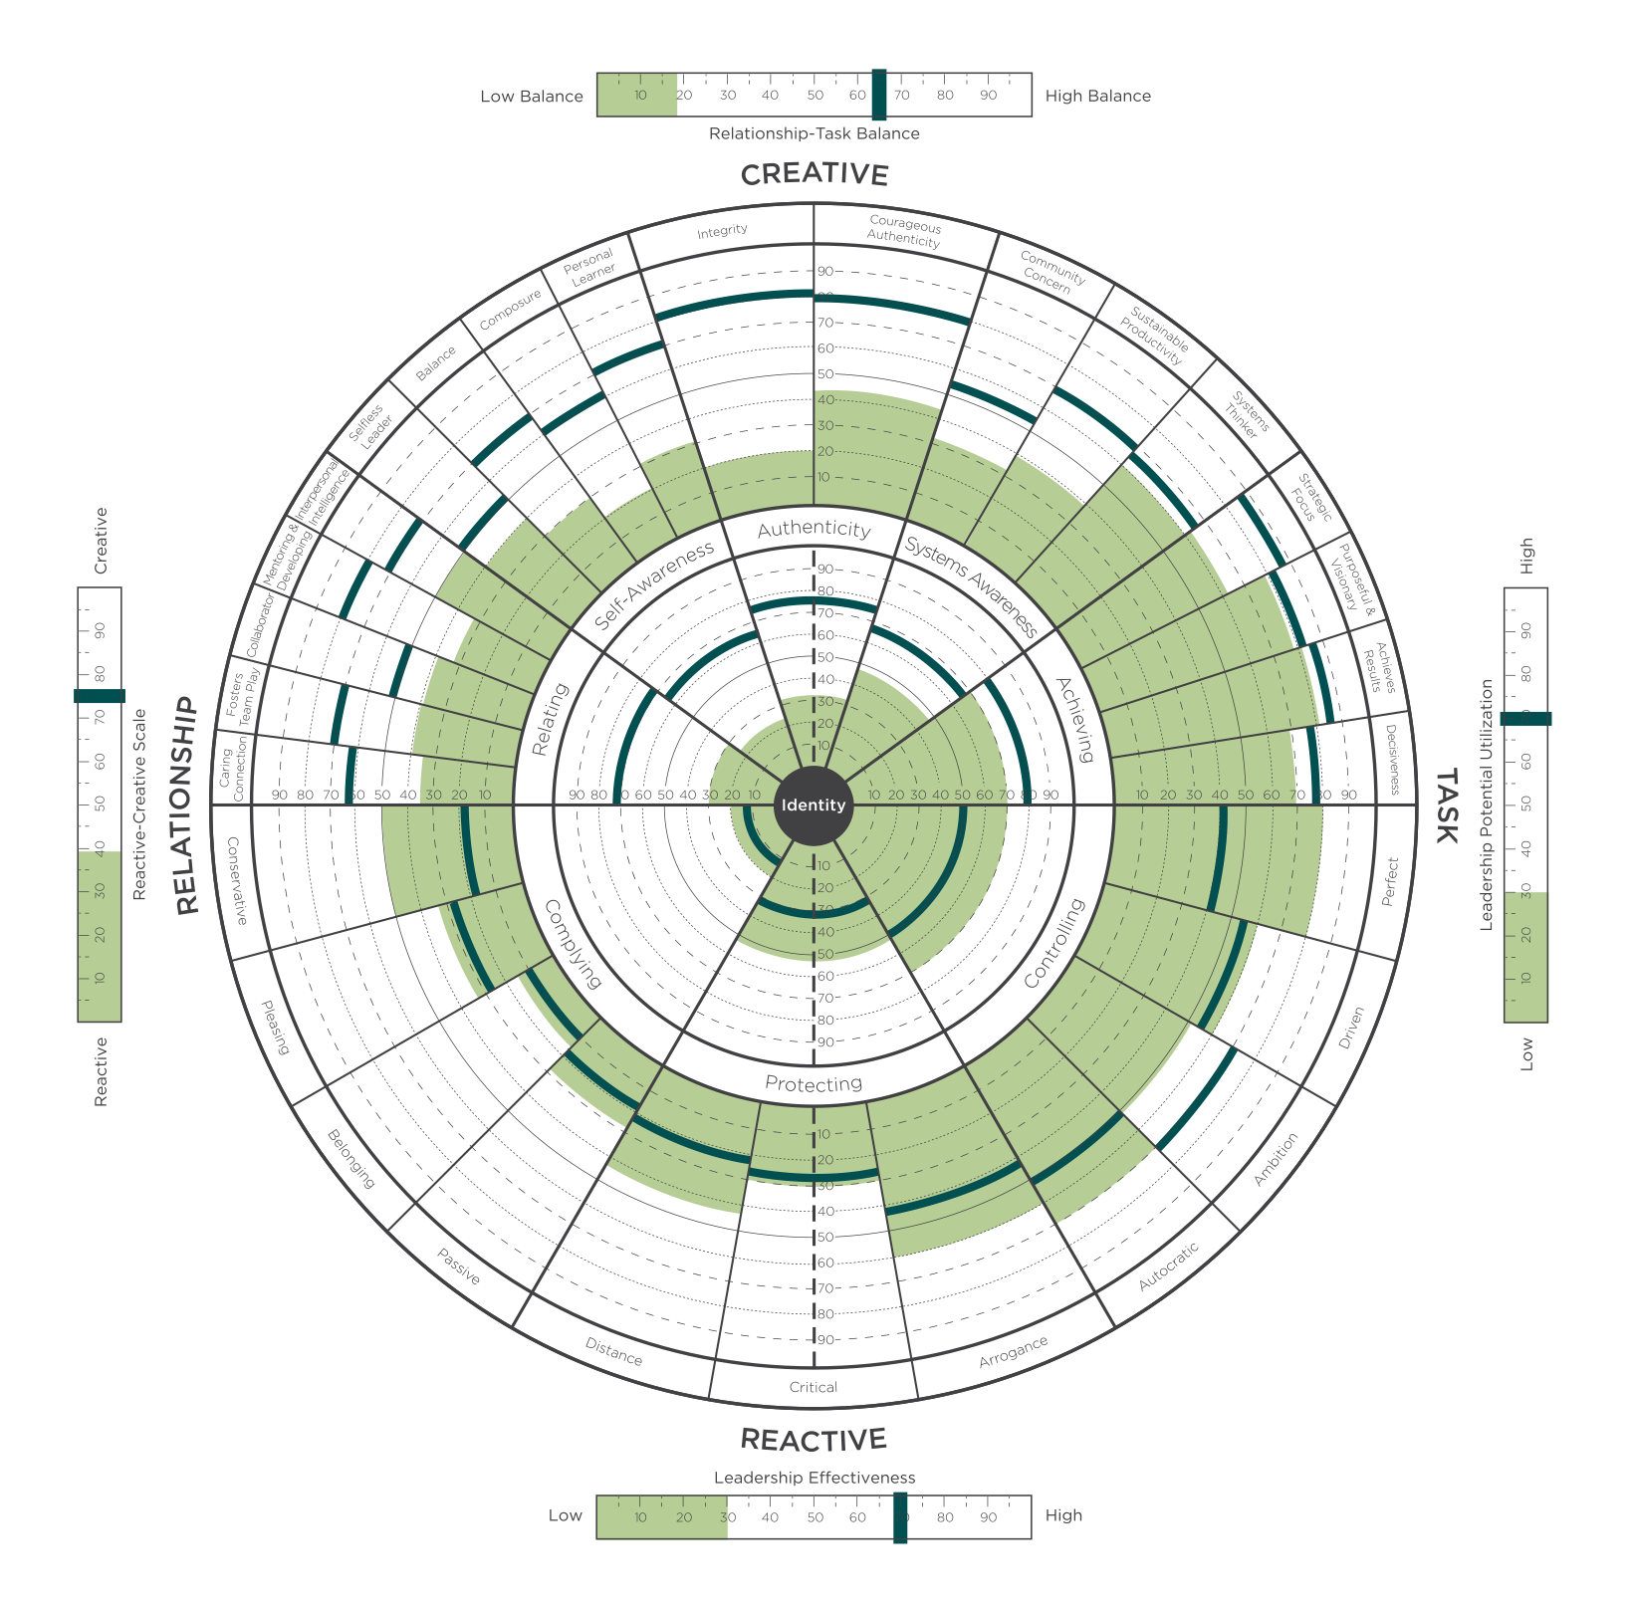
Reactive
Creative Scale
Notes:
Learning Objective 1: for participants to understand the Reactive Creative scale measures the degree that a person’s leadership is experienced by others primarily through their Creative Competencies (high score) or through their Reactive Tendencies (low score) or some combination of the two (medium score).
Learning Objective 2: for participants to understand that this summary measure is a good indication of where a person spends their leadership energy and bandwidth.
Learning Objective 3: for participants to understand that this score reflects the visual of the graph. Lots of green on the top with little green on the bottom (high score). Little green on the top with lots of green on the bottom (low score). Mix of green on both top and bottom (medium score).

Slide 18
Relationship
Task Balance
Notes:
T
Learning Objective 1: for participants to understand the Relationship Task Balance Summary Scale, in particular, that the scale is measuring the relative balance between the Achieving competencies and the Relating competencies and it is not measuring the strength of either dimension.
Learning Objective 2: for participants to understand the sensitivity of this scale increases as the scores for Relating and Achieving reach the higher percentiles. A difference of a very small amount between those two dimensions at the higher ends of the percentile scale (80th percentile or above) will report what seems like an exaggerated lack of balance in the R-T scale. In these cases, it is easy to just look at the inner circle graph and look at Achieving and Relating.

Slide 19
Leadership Potential
Utilization Scale
Notes:
A
Learning Objective 1: for participants to understand that Scoring high here means that when all the dimensions are taken together, the strengths outweigh the weaknesses. High scores indicate there is significant strength in the Creative dimensions and relatively low scores in the Reactive dimensions as well as good balance between people competencies and task competencies. Scoring low suggests that when all the dimensions are taken together, the weaknesses outweigh the strengths. It means that there is more energy going in the reactive direction than in the creative and/or that there is an imbalance in people and task competencies.
Learning Objective 2: for participants to understand the Leadership Potential Utilization Scale is mathematically derived by multiplying the Relationship Task Balance score by the Reactive Creative score and showing the result as a percentile.
Learning Objective 3: for participants to understand that a useful developmental lens on this score is how much development should I consider in my current role? A low score suggests there are lots of developmental opportunities in current role and the challenge will be choosing the most relevant ones. A middle score suggests there are a few critical areas of development that if leveraged successfully would make a big difference in leadership effectiveness in the current role. A high score here may indicate that it would be beneficial to imagine the challenges of the next role (one with more scale, scope, and complexity) and focus developmental effort there.

Slide 20
Leadership
Effectiveness
Scale
Notes:
T
Learning Objective 1: for participants to understand the Leadership Effectiveness Scale reflects the answers to the five ideal leader questions on page 86 of the Profile Interpretation Manual and Slide 57 in this deck. The raw scores are shown on page 2 of the LCP report and the percentile scores are shown on page 3 of the LCP report.
Learning Objective 2: for participants to understand that this score is often a significant attention getter in a debrief particularly when the Self score is significantly different from the All Evaluators score and/or when the score is quite low.

Slide 21
Leadership Effectiveness & Business Results

Slide 22







Reactive and Creative Leadership
UNITIVE
Aligned to Adult Development
INTEGRAL
Self-Transforming Mind
CREATIVE
Self-Authoring Mind
REACTIVE
Socialized Mind
EGOCENTRIC
Notes:
These notes below complement those in the Appendix II in the Leaders’ Guide. Please study: 1) the Leaders’ Guide Appendix; 2) the notes below; and 3) the Mastering Leadership book (pp.61-86). The quotes below are lifted directly from the book as an aid to enriching your lecture.
*Note: Each advancement in the journey from one stage to the next transcends and includes the previous stages
Stage 2: Egocentric (Self-Sovereign Mind)
Roughly from 8 years of age until adolescence ends in early adulthood
“This identity does not notice other’ (often competing) needs.” (p.63)
“Kegan calls this stage “Self-Sovereign” because at this stage our needs are primary (Kegan and Lahey, 2009)” (p.63)
“The strength of egocentricity is the capacity to get our needs met and gain independence. We can defer impulse gratification long enough to plan and organize to meet our needs.” (p.63)
“Meeting our own needs is subject, meaning, we are not aware that we are defined by meeting our needs.” (p.63)
“We are not yet separate from our own needs to manage them—they manage us.” (p.63)
“We do not make decisions based on the impact of our behaviour on others with whom we are in relationship (no Mutual Perspective Taking). We make decisions primarily on what will happen to us if we please or displease others. For example, if we tell a lie, our concern is not about the loss of trust or the feeling of others, but about the consequences to us if they catch us in the lie and whether or not we can risk those consequences.” (pp.63-64)
“The absence of a shared reality is the structural limit of this phase.” (p.64)
“Growth at this phase is taking other’s needs and expectations into account…As this happens, our needs move from subject to object…A subject-object shift moves that to which we were formerly subject to an object of reflection. We are then no longer subject to that limited understanding of ourselves and the world…More behavioural options are available.” (pp.64-65)
“About 5% of leaders who do not fully make this transition and continue to operate with an Egocentric Mind tent to be autocratic and controlling—‘My way or the highway.’” (p.65)
“Unquestioned loyalty to the leader, not the organization, is the first priority. The organization and its employees exist to serve them.” (p.65)
Stage 3: Reactive (Socialized Self) – Kegan “Triumph of development”
As people transition from the Egocentric stage into the Reactive stage, the learn that “…if they want to get on in the world, they need to take on its rules, values, expectations, and ways of operating.” (p.66)
“The developmental challenge of the Reactive Mind is to merge with society.” (p.66)
“This ability to take up membership, to work and live co-relationally with others and within organizations, is the triumph of this stage of development. It enables us to build a life of meaning, self-worth, and security. This is the strength of this stage, and also the liability.” (p.66)
“As we embrace the Reactive Mind, we build our new identity by living up to and into the expectations of others and the culture. Messages and expectations from key influences, institutions and individuals shape who and what we become. …We craft our identity in harmony with these expectations. We internalize them and define our personal worth and security by living up to them.” (pp.66-67)
“We define ourselves, not from the inside out, but from the outside in. Our externally validated sense of self-worth and security are in others’ hands; thus, we must live up to their expectation in order to feel successful, safe, and worthwhile.” (p.67) (External locus of control
“My worth and security = X (where X is a strength) (p.70
I am my work. I am my relationships. They define me. I am my house, my car, my clothes, my achievements.
Lots of achievements: building domain expertise, skills and competencies, influence, momentum, etc. Very positive phase of growth.
75% of managers operate out of a Reactive iOS
The transition from Reactive to Creative is the Hero’s Journey* and requires the shedding of “…some old assumptions that have been running us all our lives; and second, we initiate a more authentic version of ourselves as we shift from Reactive to Creative.” (p.75)
Stage 4: Creative (Self-Authoring Mind)
“By shedding well-patterned assumptions, we start to see the habitual ways of thinking that we adopted while growing up that were socialized into us. These embedded habits of thought form the core of the Reactive iOS. They have served us well and are now reaching operational limits. They are not complex enough for the complexity of life and leadership into which we have grown.” (p.75)
“The central questions of the Independent, Self-Authoring, Creative Mind are: ‘Who am I? What do I care most about? What do I stand for? How can I make my life and my leadership a creative expression of what matters most?’ (p.75)
This stage marks the shift to an internal locus of control.
“We begin to orient our life and leadership less on what we assumed was expected of us as we grew up and more out of our own deeper sense of personal purpose and vision. Transitioning to the Creative Self is the major transition in adult life and leadership.” (p.76-77)
This new self is configured from the inside out, rather than outside in, for the first time.
“Vision springs from within. Action becomes an authentic expression of an emerging sense of inner purpose.” (p.77)
“Creative leadership [based on a Creative iOS] is the minimum level required to create lean, engaged, innovative, visionary, creative, agile, high-involvement, high-fulfillment organizations and to evolve adaptive organizational designs and cultures that can thrive today.” (p.80)
Kegan says that most leadership literature is written for Stage 4 (e.g., on vision, collaboration, dialogue, partnership, etc.).
However, only 20% (roughly speaking) of managers operate primarily at this level.
Stage 5: Integral (Self-Transforming Mind)
In the transition to Integral Mind, “…the hard-earned authentic, self-authoring, visionary, creative self, with which we are identified at the Creative Stage, begins to fray. We begin to realize that not only are we this authentic visionary person; we are also its opposite.” (p. 82)
Here is the first taste of our meaning-making as an illusion created by our stories—narratives about our self.
“…a deeper engagement of the shadow side of the self—the parts of us that we have ignored and not developed. Shadow does not mean dark or bad, but ignored or left behind.” (p.83) We begin to see an integration of all aspects of personality: light and shadow.
“As we embrace our partialness, we no longer need to pretend completeness and can move toward the unacknowledged aspects of ourselves with compassion and curiosity.” (p.83)
“We see others this way—as complex multi-dimensional beings.” (p.83)
“Integral mind is built for complexity. It is a level of mind and leadership that can lead through the redundant polarities and problems that make up complex challenges. Integral Mind can hold opposites in tension without reactive to resolve them quickly (superficially). (p. 82)
“It can hold conflicting visions of the future within a diverse set of stakeholders without championing one over the other. It looks for the merits of all perspectives and works toward synergistic synthesis.” (p.82)
It is open to feedback from all directions, and diversity of thought from all.
For all these reasons, integral Mind is best suited to lead the transformation of complex systems.
Only about 5% of adults develop Integral Mind.
Unitive stage (Note…some would say this the Unitive is not a true stage, but a level of consciousness that is on another plane)
“In the spiritual literature, there is a progression of awareness that moves through sequential stages, up to the highest level of sacred union with All that Is.” (p.85)
“Up to this point, the self has seen itself as a separate self, as located within the body-mind. Now the self realizes that ‘I am not the body, nor the mind.’ In the early phases of the Unitive stage, we identify with the ‘soul’—an essential self in communion with the Divine Reality.” (p.85)
“The Integral self is not discarded. That richly nuanced self is used to act in the world. It is highly functional and effective. It becomes a useful tool of the spirit.” (p.85)
“Leaders at this level function as global visionaries and enact world service for the universal good. From the perspective of Unity, we are all each other.” (p.85)
Less than 1% of the population configures primarily at this level of consciousness, however many of us have experienced Unitive states—peak experiences that connect us to a greater whole.

Slide 23
Reactive and Creative Leadership
UNITIVE
Aligned to Adult Development
5%
INTEGRAL
Self-Transforming Mind
INTEGRAL
CREATIVE
15%
Self-Authoring Mind
CREATIVE
Leadership Effectiveness
80%
REACTIVE
REACTIVE
Socialized Mind
Level of Leadership
EGOCENTRIC
Notes:
These notes below complement those in the Appendix II in the Leaders’ Guide. Please study: 1) the Leaders’ Guide Appendix; 2) the notes below; and 3) the Mastering Leadership book (pp.61-86). The quotes below are lifted directly from the book as an aid to enriching your lecture.
*Note: Each advancement in the journey from one stage to the next transcends and includes the previous stages
Stage 2: Egocentric (Self-Sovereign Mind)
Roughly from 8 years of age until adolescence ends in early adulthood
“This identity does not notice other’ (often competing) needs.” (p.63)
“Kegan calls this stage “Self-Sovereign” because at this stage our needs are primary (Kegan and Lahey, 2009)” (p.63)
“The strength of egocentricity is the capacity to get our needs met and gain independence. We can defer impulse gratification long enough to plan and organize to meet our needs.” (p.63)
“Meeting our own needs is subject, meaning, we are not aware that we are defined by meeting our needs.” (p.63)
“We are not yet separate from our own needs to manage them—they manage us.” (p.63)
“We do not make decisions based on the impact of our behaviour on others with whom we are in relationship (no Mutual Perspective Taking). We make decisions primarily on what will happen to us if we please or displease others. For example, if we tell a lie, our concern is not about the loss of trust or the feeling of others, but about the consequences to us if they catch us in the lie and whether or not we can risk those consequences.” (pp.63-64)
“The absence of a shared reality is the structural limit of this phase.” (p.64)
“Growth at this phase is taking other’s needs and expectations into account…As this happens, our needs move from subject to object…A subject-object shift moves that to which we were formerly subject to an object of reflection. We are then no longer subject to that limited understanding of ourselves and the world…More behavioural options are available.” (pp.64-65)
“About 5% of leaders who do not fully make this transition and continue to operate with an Egocentric Mind tent to be autocratic and controlling—‘My way or the highway.’” (p.65)
“Unquestioned loyalty to the leader, not the organization, is the first priority. The organization and its employees exist to serve them.” (p.65)
Stage 3: Reactive (Socialized Self) – Kegan “Triumph of development”
As people transition from the Egocentric stage into the Reactive stage, the learn that “…if they want to get on in the world, they need to take on its rules, values, expectations, and ways of operating.” (p.66)
“The developmental challenge of the Reactive Mind is to merge with society.” (p.66)
“This ability to take up membership, to work and live co-relationally with others and within organizations, is the triumph of this stage of development. It enables us to build a life of meaning, self-worth, and security. This is the strength of this stage, and also the liability.” (p.66)
“As we embrace the Reactive Mind, we build our new identity by living up to and into the expectations of others and the culture. Messages and expectations from key influences, institutions and individuals shape who and what we become. …We craft our identity in harmony with these expectations. We internalize them and define our personal worth and security by living up to them.” (pp.66-67)
“We define ourselves, not from the inside out, but from the outside in. Our externally validated sense of self-worth and security are in others’ hands; thus, we must live up to their expectation in order to feel successful, safe, and worthwhile.” (p.67) (External locus of control
“My worth and security = X (where X is a strength) (p.70
I am my work. I am my relationships. They define me. I am my house, my car, my clothes, my achievements.
Lots of achievements: building domain expertise, skills and competencies, influence, momentum, etc. Very positive phase of growth.
75% of managers operate out of a Reactive iOS
The transition from Reactive to Creative is the Hero’s Journey* and requires the shedding of “…some old assumptions that have been running us all our lives; and second, we initiate a more authentic version of ourselves as we shift from Reactive to Creative.” (p.75)
Stage 4: Creative (Self-Authoring Mind)
“By shedding well-patterned assumptions, we start to see the habitual ways of thinking that we adopted while growing up that were socialized into us. These embedded habits of thought form the core of the Reactive iOS. They have served us well and are now reaching operational limits. They are not complex enough for the complexity of life and leadership into which we have grown.” (p.75)
“The central questions of the Independent, Self-Authoring, Creative Mind are: ‘Who am I? What do I care most about? What do I stand for? How can I make my life and my leadership a creative expression of what matters most?’ (p.75)
This stage marks the shift to an internal locus of control.
“We begin to orient our life and leadership less on what we assumed was expected of us as we grew up and more out of our own deeper sense of personal purpose and vision. Transitioning to the Creative Self is the major transition in adult life and leadership.” (p.76-77)
This new self is configured from the inside out, rather than outside in, for the first time.
“Vision springs from within. Action becomes an authentic expression of an emerging sense of inner purpose.” (p.77)
“Creative leadership [based on a Creative iOS] is the minimum level required to create lean, engaged, innovative, visionary, creative, agile, high-involvement, high-fulfillment organizations and to evolve adaptive organizational designs and cultures that can thrive today.” (p.80)
Kegan says that most leadership literature is written for Stage 4 (e.g., on vision, collaboration, dialogue, partnership, etc.).
However, only 20% (roughly speaking) of managers operate primarily at this level.
Stage 5: Integral (Self-Transforming Mind)
In the transition to Integral Mind, “…the hard-earned authentic, self-authoring, visionary, creative self, with which we are identified at the Creative Stage, begins to fray. We begin to realize that not only are we this authentic visionary person; we are also its opposite.” (p. 82)
Here is the first taste of our meaning-making as an illusion created by our stories—narratives about our self.
“…a deeper engagement of the shadow side of the self—the parts of us that we have ignored and not developed. Shadow does not mean dark or bad, but ignored or left behind.” (p.83) We begin to see an integration of all aspects of personality: light and shadow.
“As we embrace our partialness, we no longer need to pretend completeness and can move toward the unacknowledged aspects of ourselves with compassion and curiosity.” (p.83)
“We see others this way—as complex multi-dimensional beings.” (p.83)
“Integral mind is built for complexity. It is a level of mind and leadership that can lead through the redundant polarities and problems that make up complex challenges. Integral Mind can hold opposites in tension without reactive to resolve them quickly (superficially). (p. 82)
“It can hold conflicting visions of the future within a diverse set of stakeholders without championing one over the other. It looks for the merits of all perspectives and works toward synergistic synthesis.” (p.82)
It is open to feedback from all directions, and diversity of thought from all.
For all these reasons, integral Mind is best suited to lead the transformation of complex systems.
Only about 5% of adults develop Integral Mind.
Unitive stage (Note…some would say this the Unitive is not a true stage, but a level of consciousness that is on another plane)
“In the spiritual literature, there is a progression of awareness that moves through sequential stages, up to the highest level of sacred union with All that Is.” (p.85)
“Up to this point, the self has seen itself as a separate self, as located within the body-mind. Now the self realizes that ‘I am not the body, nor the mind.’ In the early phases of the Unitive stage, we identify with the ‘soul’—an essential self in communion with the Divine Reality.” (p.85)
“The Integral self is not discarded. That richly nuanced self is used to act in the world. It is highly functional and effective. It becomes a useful tool of the spirit.” (p.85)
“Leaders at this level function as global visionaries and enact world service for the universal good. From the perspective of Unity, we are all each other.” (p.85)
Less than 1% of the population configures primarily at this level of consciousness, however many of us have experienced Unitive states—peak experiences that connect us to a greater whole.

Slide 24

Leadership Effectiveness Scale Questions
I am satisfied with the quality of leadership that this leader provides.
This leader is the kind of leader that others should aspire to become.
This leader is an example of an ideal leader.
This leader’s leadership helps this organization to thrive.
Overall, this leader provides very effective leadership.
Notes:
Learning Objective 1: for participants to understand that when a person completes a LCP, they answer each of the 119 questions against the backdrop of their (perhaps unconscious) tacit belief in what makes someone an effective leader. The 5 questions explicitly ask evaluators to rate the leader directly against their picture of the ideal leadership.
Learning Objective 2: for participants to understand that these additional five questions constitute a “survey within a survey,” in that they answers are not used to compute any part of the graph other than this Leadership Effectiveness Scale.

Slide 25
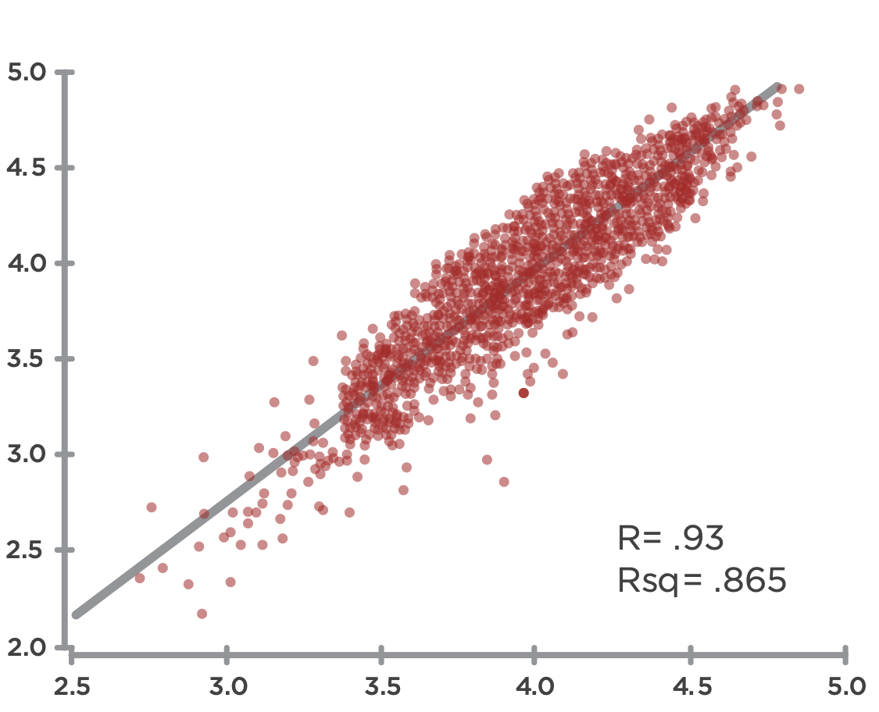
Leadership Effectiveness & Creative Competencies
Leadership Effectiveness
Creative Competencies
Notes:
Learning Objective 1: for participants to understand that an initial research question was the degree to which the LCP model actually measured what is commonly understood to be effective leadership. We found a strong positive correlation between the Creative aspects of the LCP and the LE questions indicating that the battery of 18 Creative competencies in the LCP are tracking with what it takes to be an effective leader across many contexts.
Learning Objective 2: for participants to understand that r = the relationship between the two variables or the line of best fit through the data—so how much of the movement of one variable is described by movement of the other. In this case, r = 0.93 means that if the Average Creative Score increases 1.00 (one unit of measure), the Leadership Effectiveness score will likely increase on average by 0.93. This is a very strong correlation.
Learning Objective 3: for participants to understand that rsq = the degree to which the data tightly cluster around the line of best fit. A high rsq means that the data don’t vary much and fit tightly together around the line of best fit (the prediction of the model). A low rsq means that the data are more scattered around the line of best fit. (Technically, rsq measures the amount of variability among the data points that can be explained by the model or predicted by the line of best fit).

Slide 26
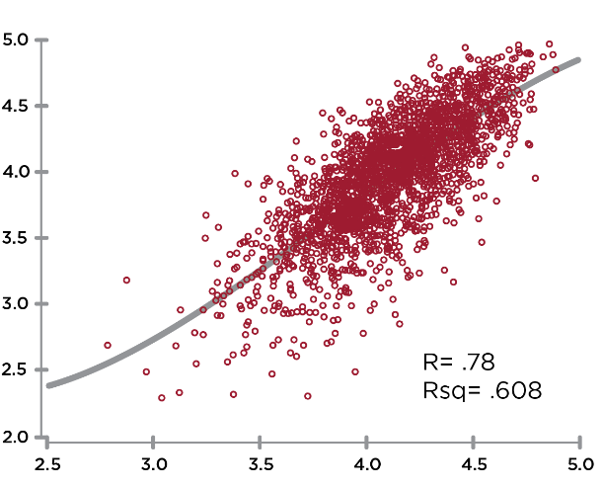
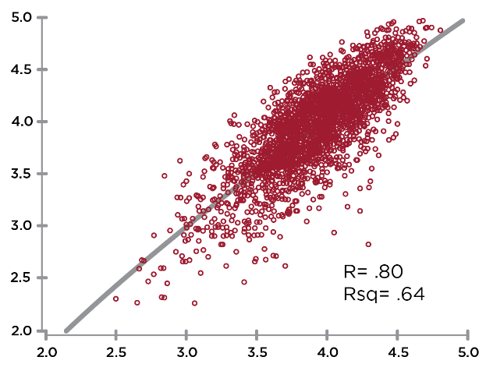
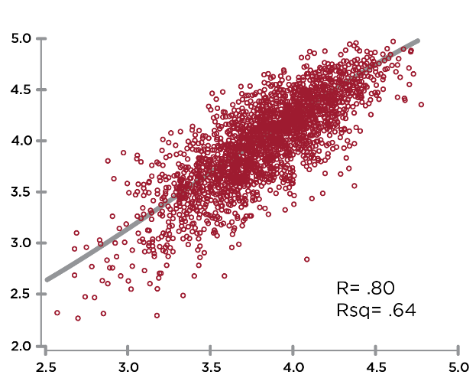
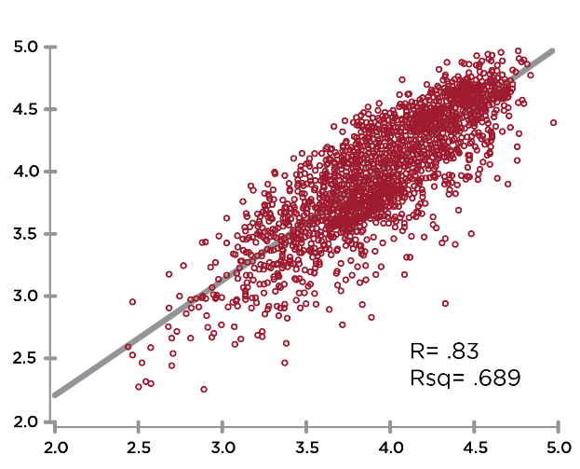
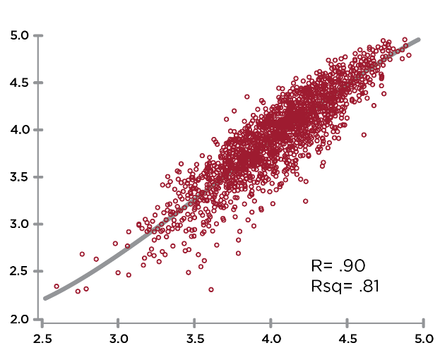
CREATIVE Correlations to
Leadership Effectiveness
Leadership Effectiveness
Leadership Effectiveness
Leadership Effectiveness
R=.78
Authenticity
R=.76
R=.84
Self Awareness
Systems Awareness
Leadership Effectiveness
Leadership Effectiveness
R=.85
R=.91
Relating
Achieving
Notes:
Learning Objective 1: for participants to understand that perceptions of Leadership Effectiveness (the 5 questions on the scale) are strongly correlated with the Creative Competencies.

Slide 27
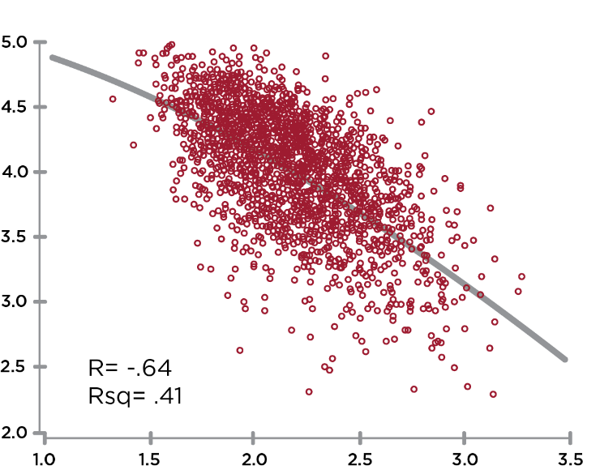
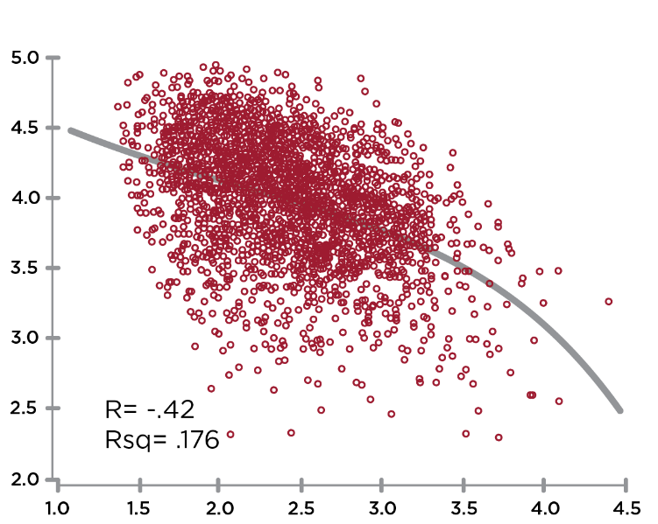
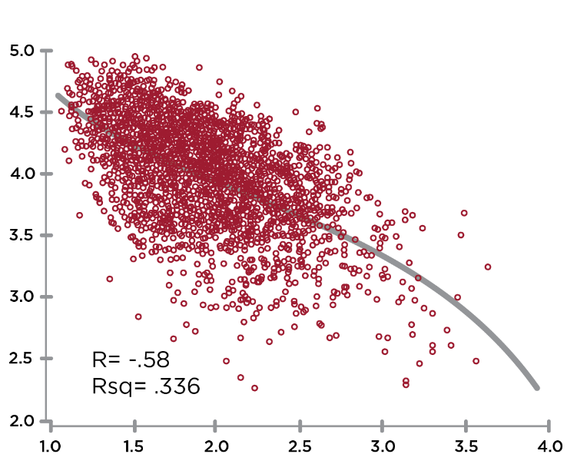
REACTIVE Correlations to
Leadership Effectiveness
Leadership Effectiveness
Leadership Effectiveness
R= -.63
R= -.41
Complying
Leadership Effectiveness
Controlling
R= -.56
Protecting
Notes:
Learning Objective 1: for participants to understand that perceptions of Leadership Effectiveness (the 5 questions on the scale) are strongly correlated with the Creative Competencies.

Slide 28
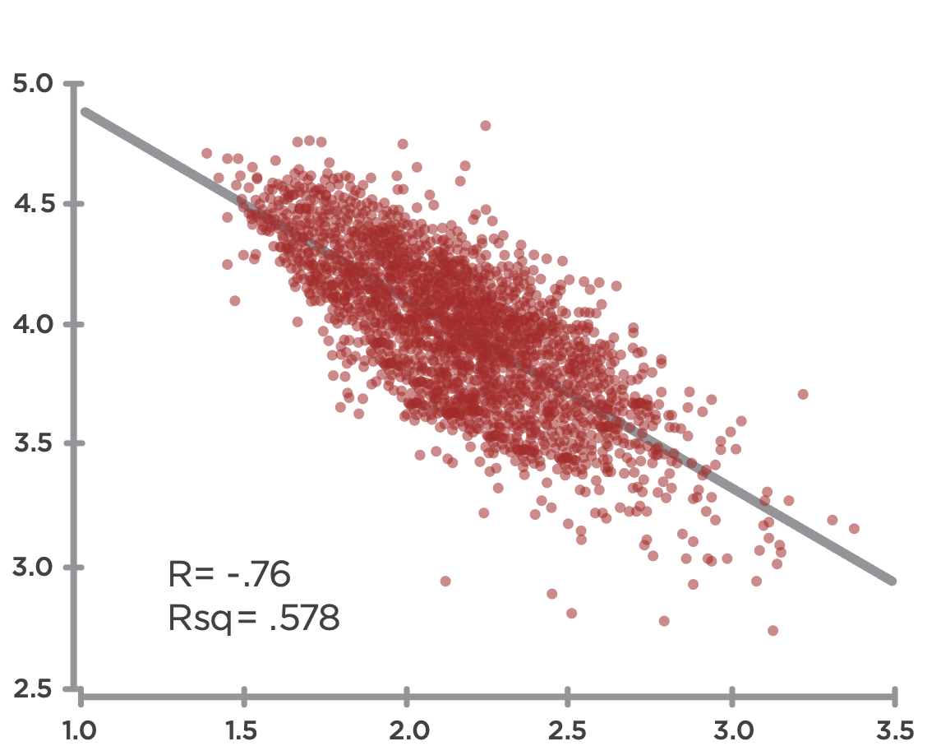
Creative Competencies & Reactive Tendencies
Creative
R= -.76
Rsq= .578
Reactive
Notes:
Learning Objective 1: for participants to understand that the Creative Competencies are strongly negatively correlated (-.76) with the Reactive Tendencies.
Learning Objective 2: for participants to understand that the implication of this correlation is that Reactive Tendencies significantly block/cancel the expression of Creative Competencies.

Slide 29
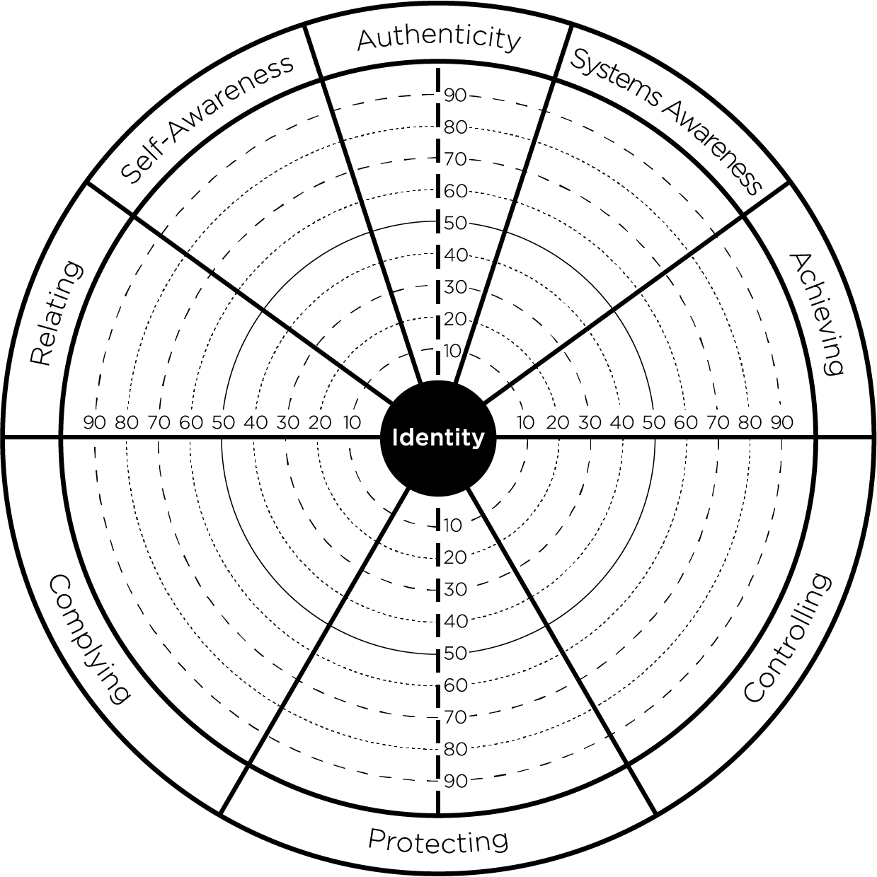



Neighbors
Notes:
Do neighbor slide and then move to the mat – opposites on the mat
Learning Objective 1: for participants to understand that the elements right across the border from each other (Neighbors) are Relating-Complying, Protecting-Authenticity, Achieving-Controlling. These are anchored in the same kind of energy (heart, head, will) and have lower negative correlations than other relationships across the graph.

Slide 30
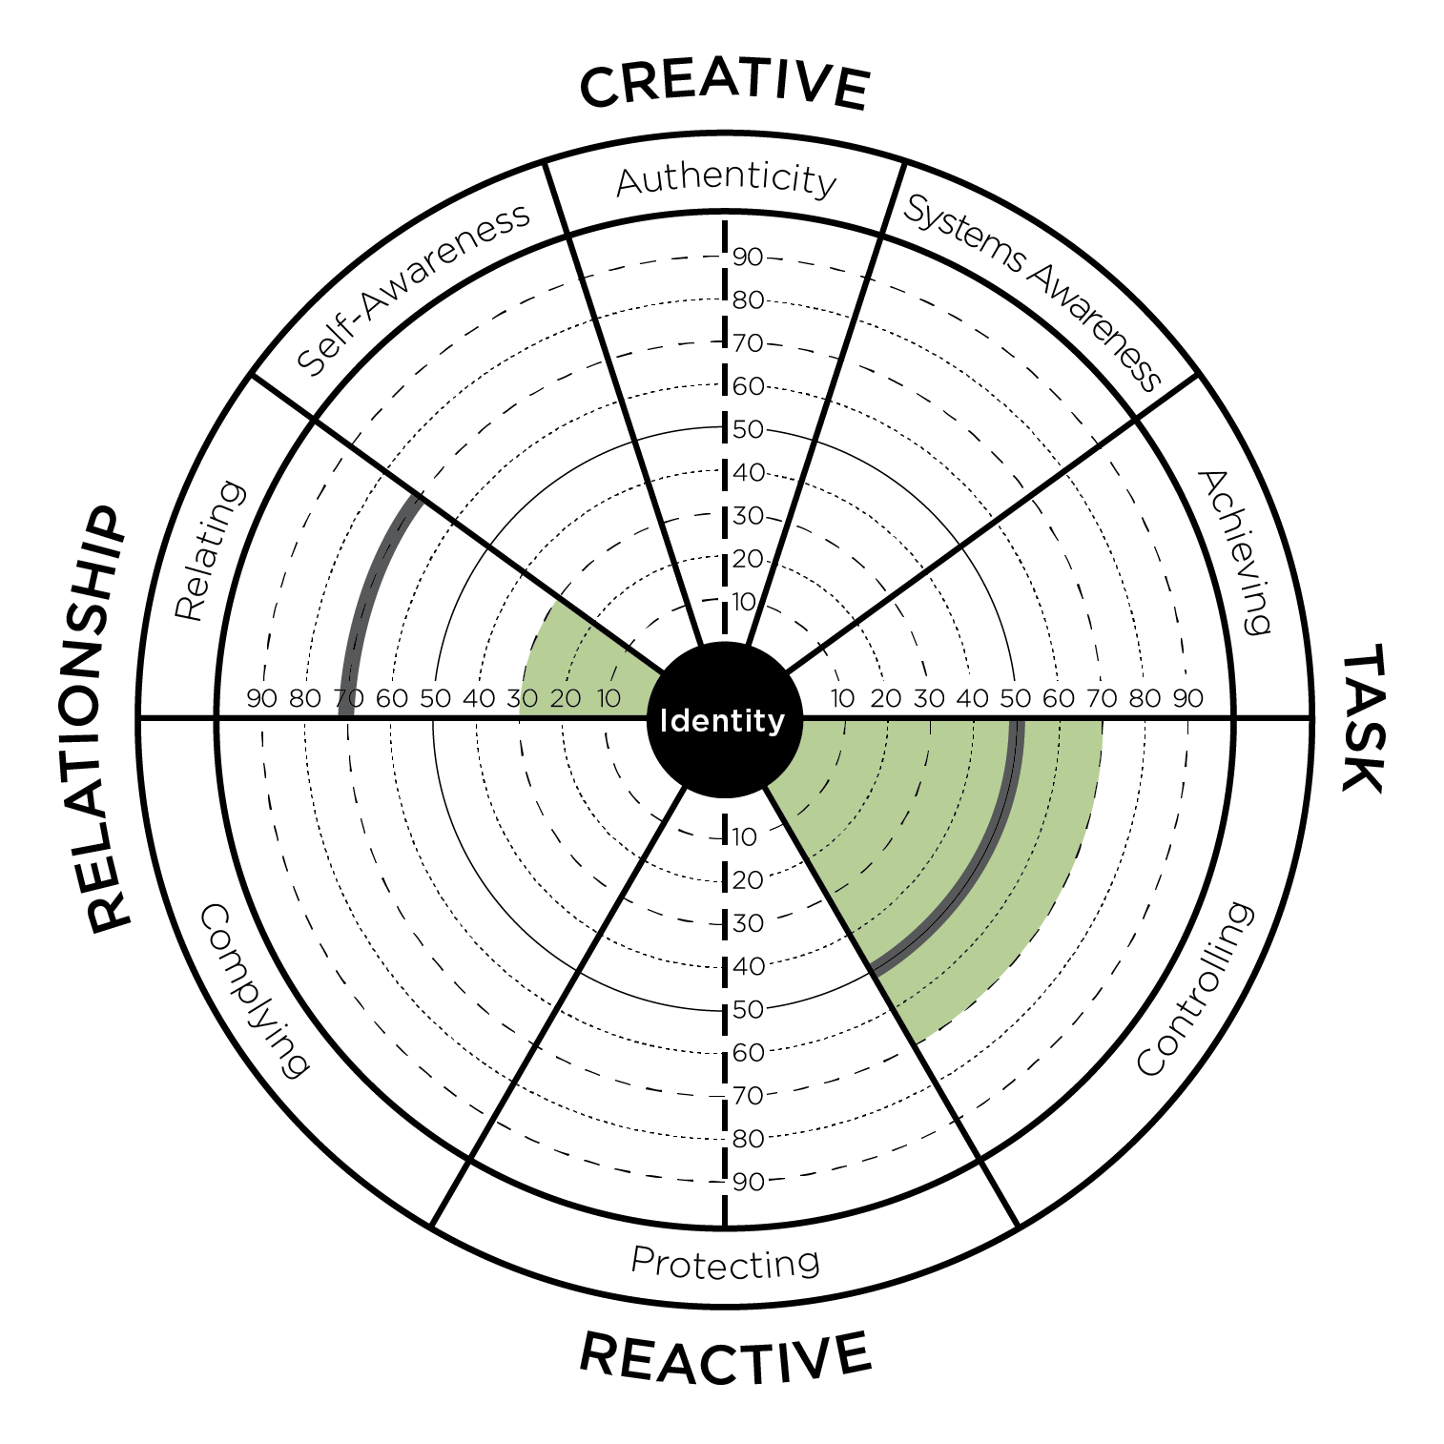
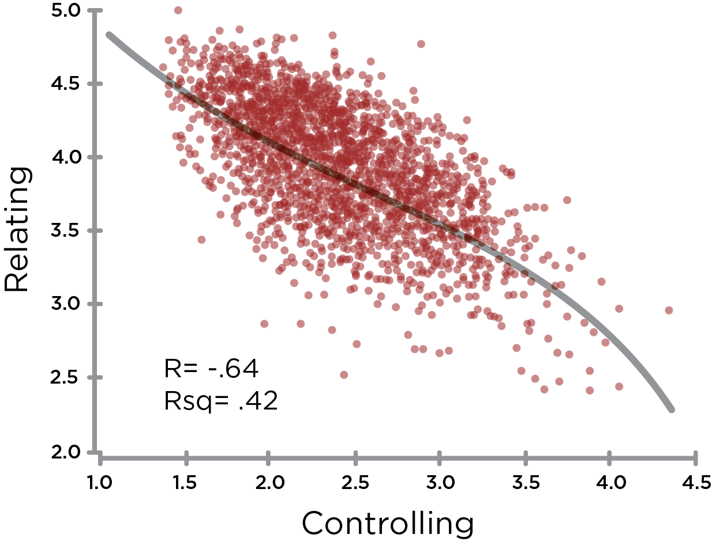
Opposites: Controlling & Relating
Notes:
Learning Objective 1: for participants to understand that Controlling has a large negative effect on Relating (-.65) and thus they are opposite one another on the graph.
Learning Objective 1: for participants to understand that Controlling also has a large negative effect on Self Awareness (-.66) and thus they are also opposite one another on the graph.
Learning Objective 3: for participants to understand that a typical developmental trajectory for someone with high Controlling would be up and across the graph working on improving Relating and/or improving Self Awareness.
Learning Objective 4: for participants to understand that Controlling is negatively correlated with Relating (-.65).

Slide 31
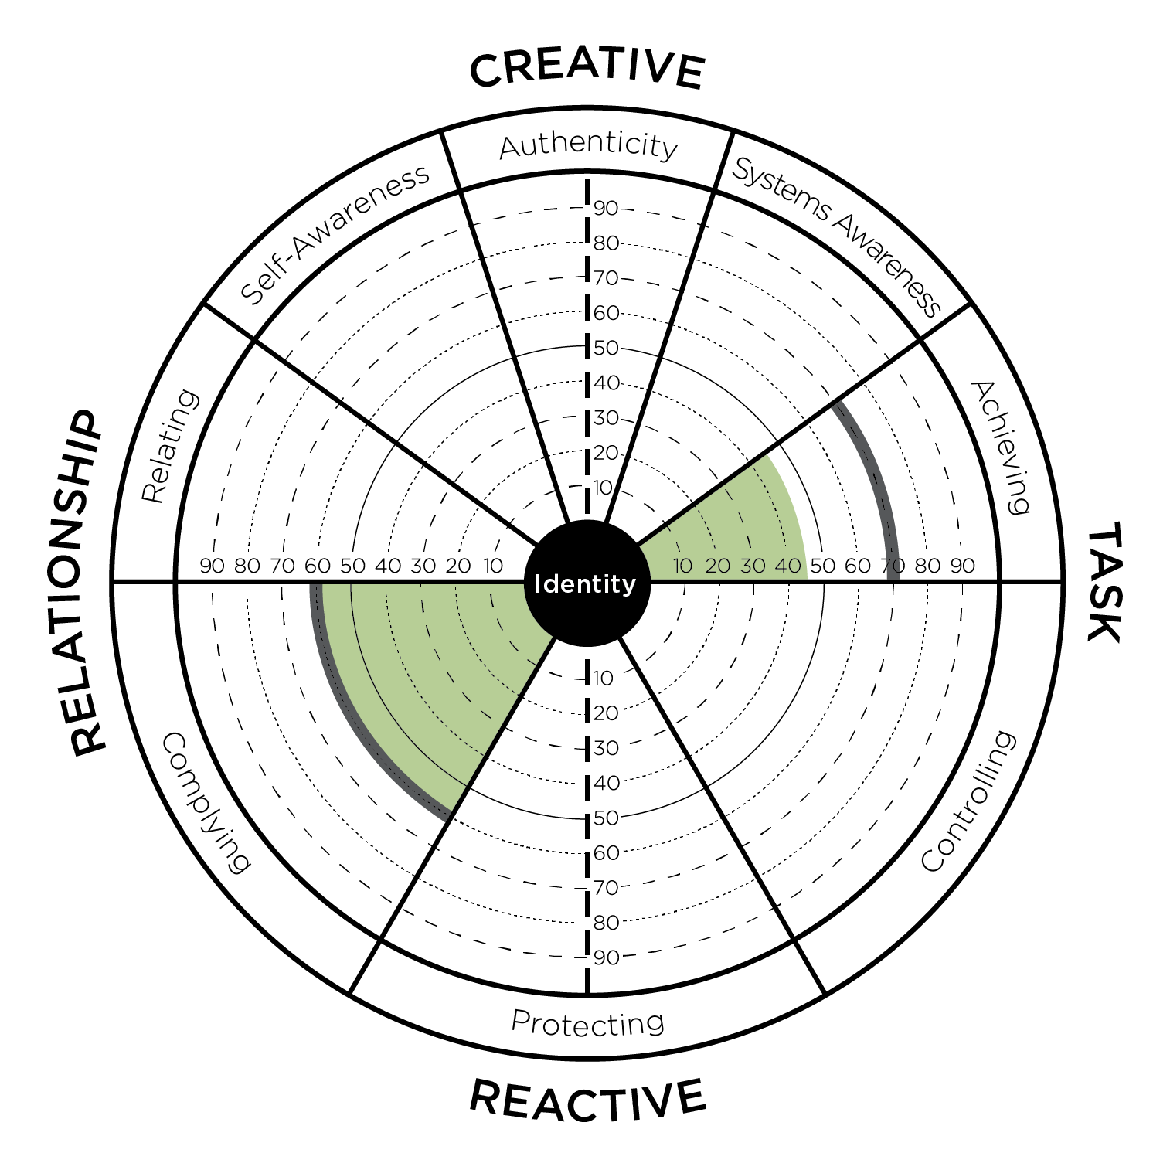
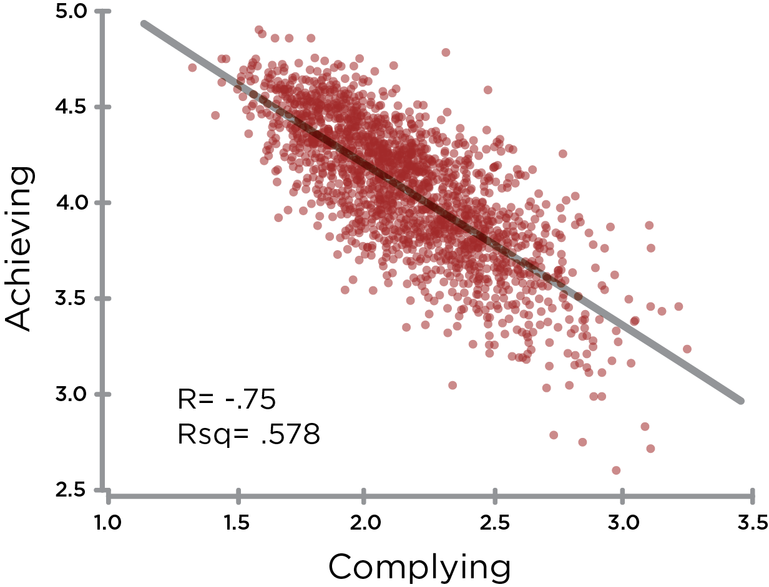
Opposites: Complying & Achieving
Notes:
Learning Objective 1: for participants to understand that Complying has its biggest negative effect on Achieving (-.76) and thus they are opposite one another on the graph.
Learning Objective 2: for participants to understand that a typical developmental trajectory for someone with high Complying would be up and across the graph working on improving Achieving.
Learning Objective 3: for participants to understand that Complying has its second biggest negative effect on Authenticity (-.62) and this is also another common developmental trajectory (particularly working on Courageous Authenticity).
Learning Objective 4: for participants to understand that Complying is negatively correlated with Achieving (-.76).

Slide 32
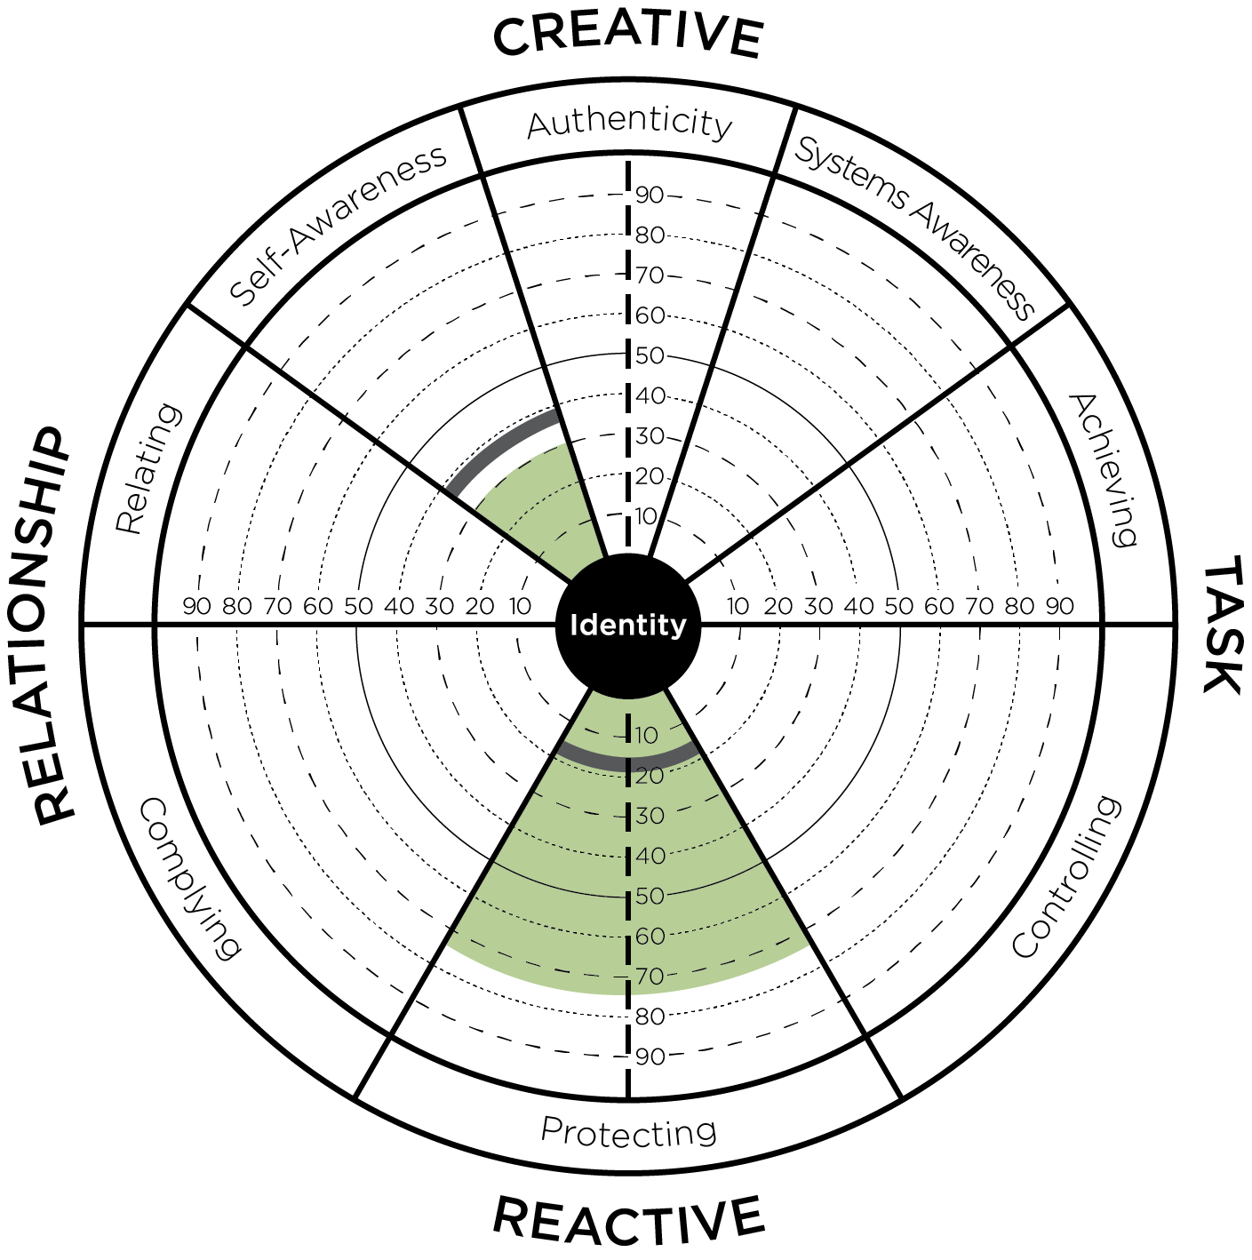
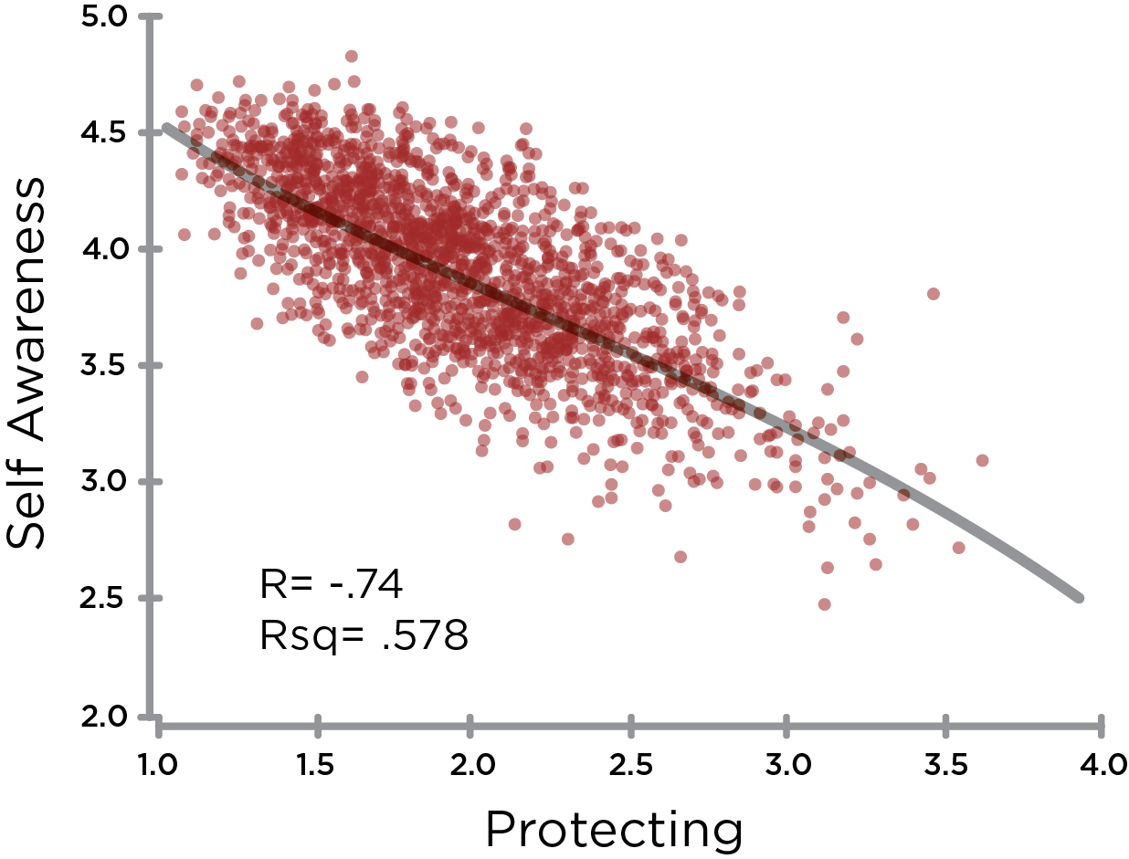
Opposites: Protecting & Self Awareness
Notes:
Learning Objective 1: for participants to understand that Protecting has a large negative effect on Self Awareness (-.70) and thus they opposite on the graph.
Learning Objective 2: for participants to understand that Protecting has a large negative effect on Relating as well (-.73).
Learning Objective 3: for participants to understand that a typical developmental trajectory for someone with high Protecting might be up and to the left across the graph working on improving Self Awareness and Relating.
Learning Objective 4: for participants to understand that Protecting is negatively correlated with Self Awareness (-.76).

Slide 33
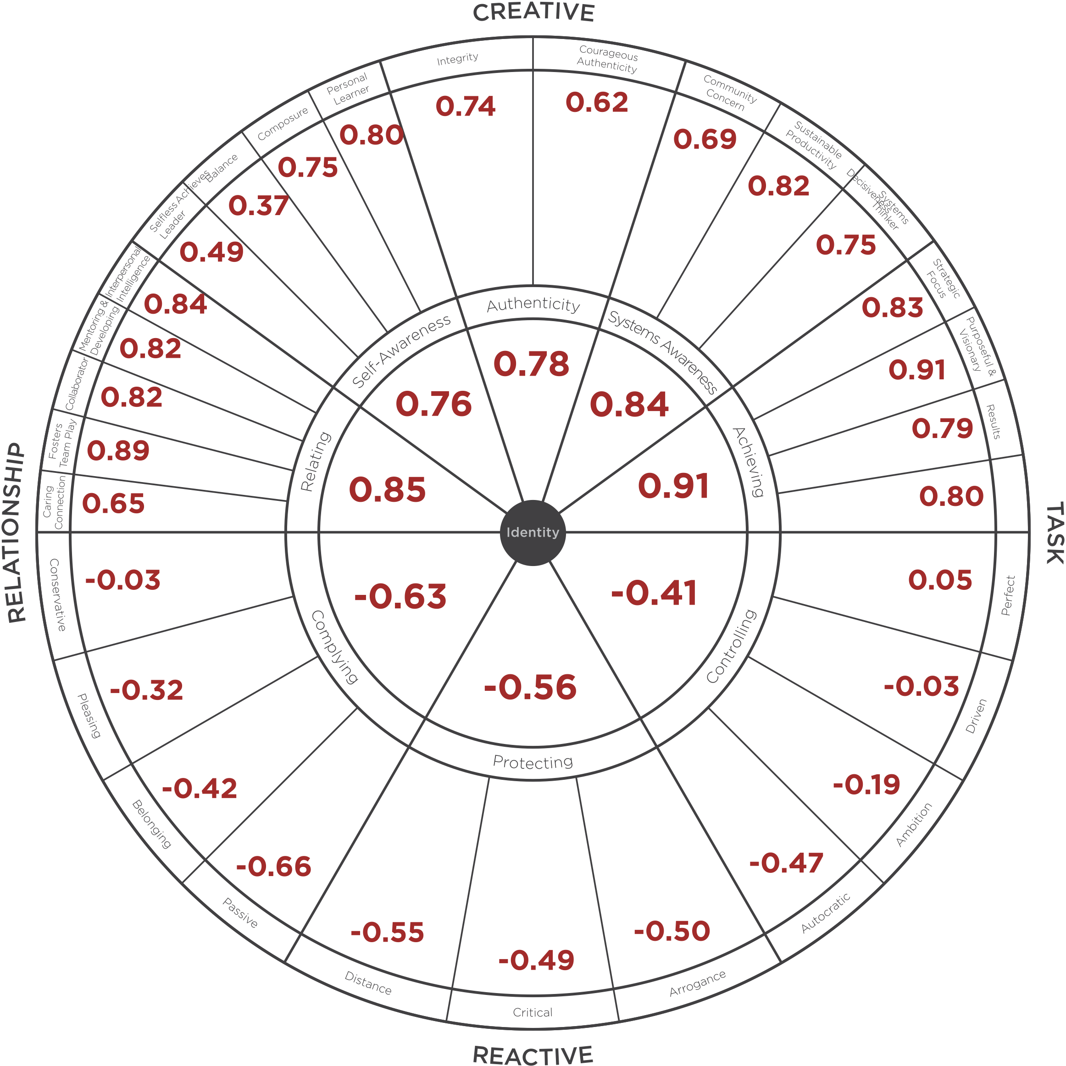
LCP Correlations to
Leadership Effectiveness
Leadership Effectiveness Scale Questions
I am satisfied with the quality of leadership that this leader provides.
This leader is the kind of leader that others should aspire to become.
This leader is an example of an ideal leader.
This leader’s leadership helps this organization to thrive.
Overall, this leader provides very effective leadership.
Notes:
Before moving into the debrief practice, ground them in the correlations one more time using this slide (refer to back of slim-print. This helps them get ready for why this matters in their debriefs. Validity will be discussed at the end of the day – as time permits. (also all available in adeption workouts post cohort session.
Learning Objective 1: for participants to understand that each of the 29 Creative/Reactive dimensions of the LCP have their own unique correlation to Leadership Effectiveness (the five Ideal Leader questions).
Learning Objective 2: for participants to look at their own LCP data through the lens of these more granular correlations to see if it generates any new developmental understanding or insight.
Learning Objective 2: for participants to imagine/brainstorm how they might use these correlations with their clients.

Slide 34
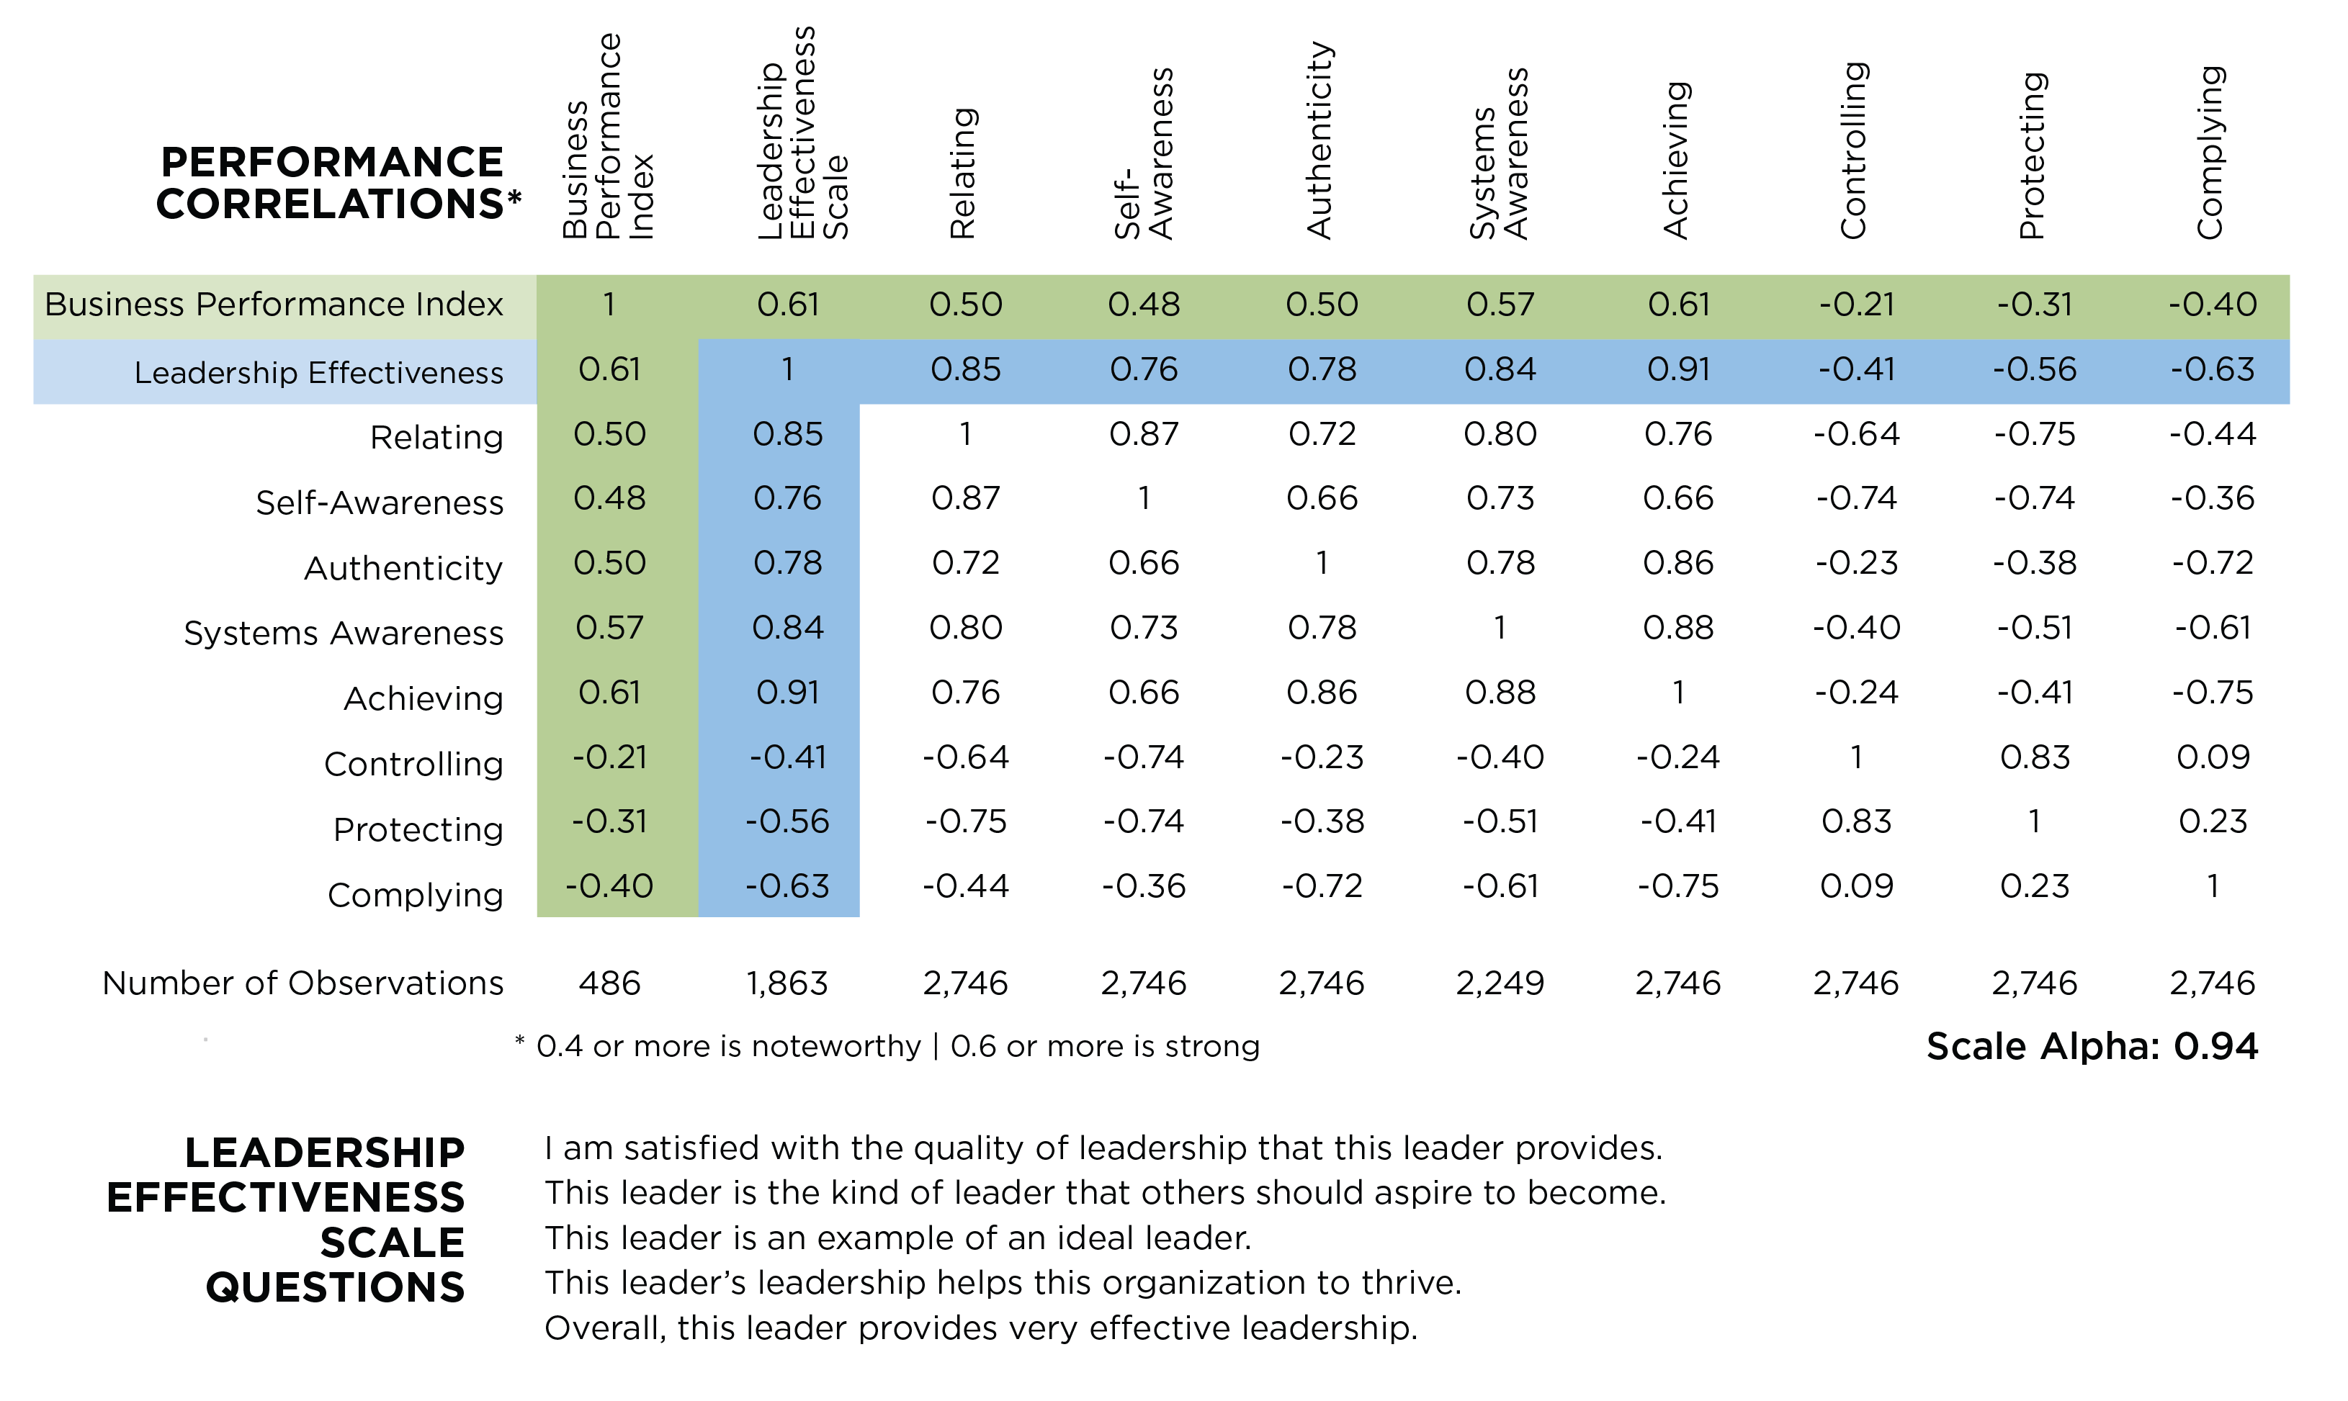

Slide 35
Business Performance Index
Research based on 486 organizations and organizational units.
There were six categories for evaluating business performance:
Sales / Revenue
Market Share
Profitability / ROA
Quality of Products & Services
New Product Development
Overall Performance
Notes:
Learning Objective 1: for participants to understand the methodology of the Business Performance Research Study. In this case, that a BPI was utilized that was made up of six measures of business performance.
Tech facilitator – have link ready for the study to share with cohort.
Learning Objective 2: for participants to understand that 486 leaders each took the LCP, attached to the LCP was the BPI. Then, just looking at the top 10% and the bottom 10% of the business performance results we aggregated those LCPs together (about 50 in each sample).

Slide 36
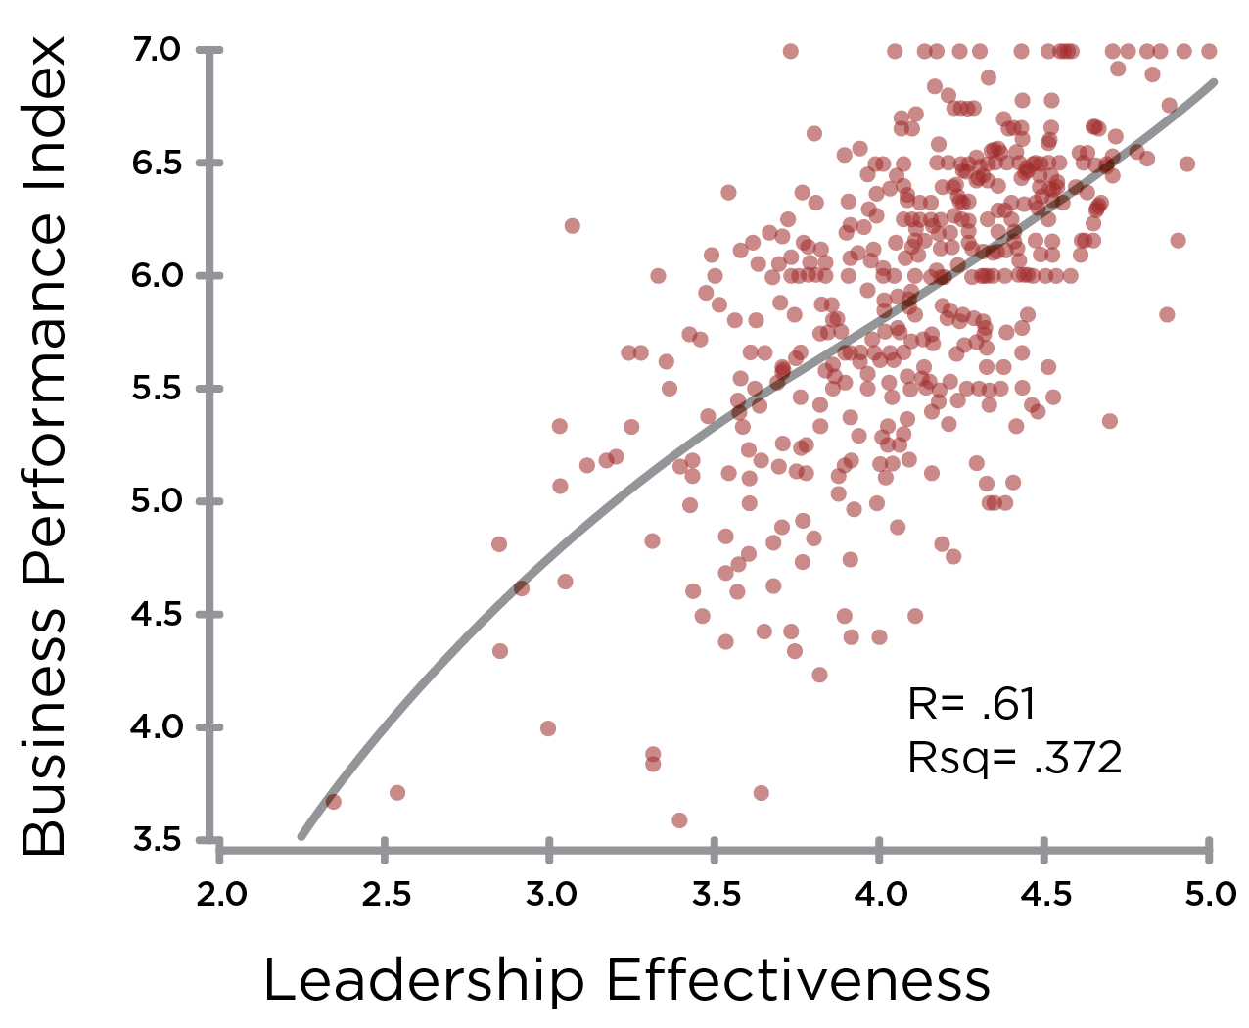
Leadership Effectiveness & Business Performance
Notes:
Learning Objective 1: for participants to understand the correlation between Leadership Effectiveness (measured by the five ideal leader questions) and Business Performance (measured by the six elements of the Business Performance Index).

Slide 37
Leadership Effectiveness & Business Performance
Top 10%
Bottom 10%

Slide 38
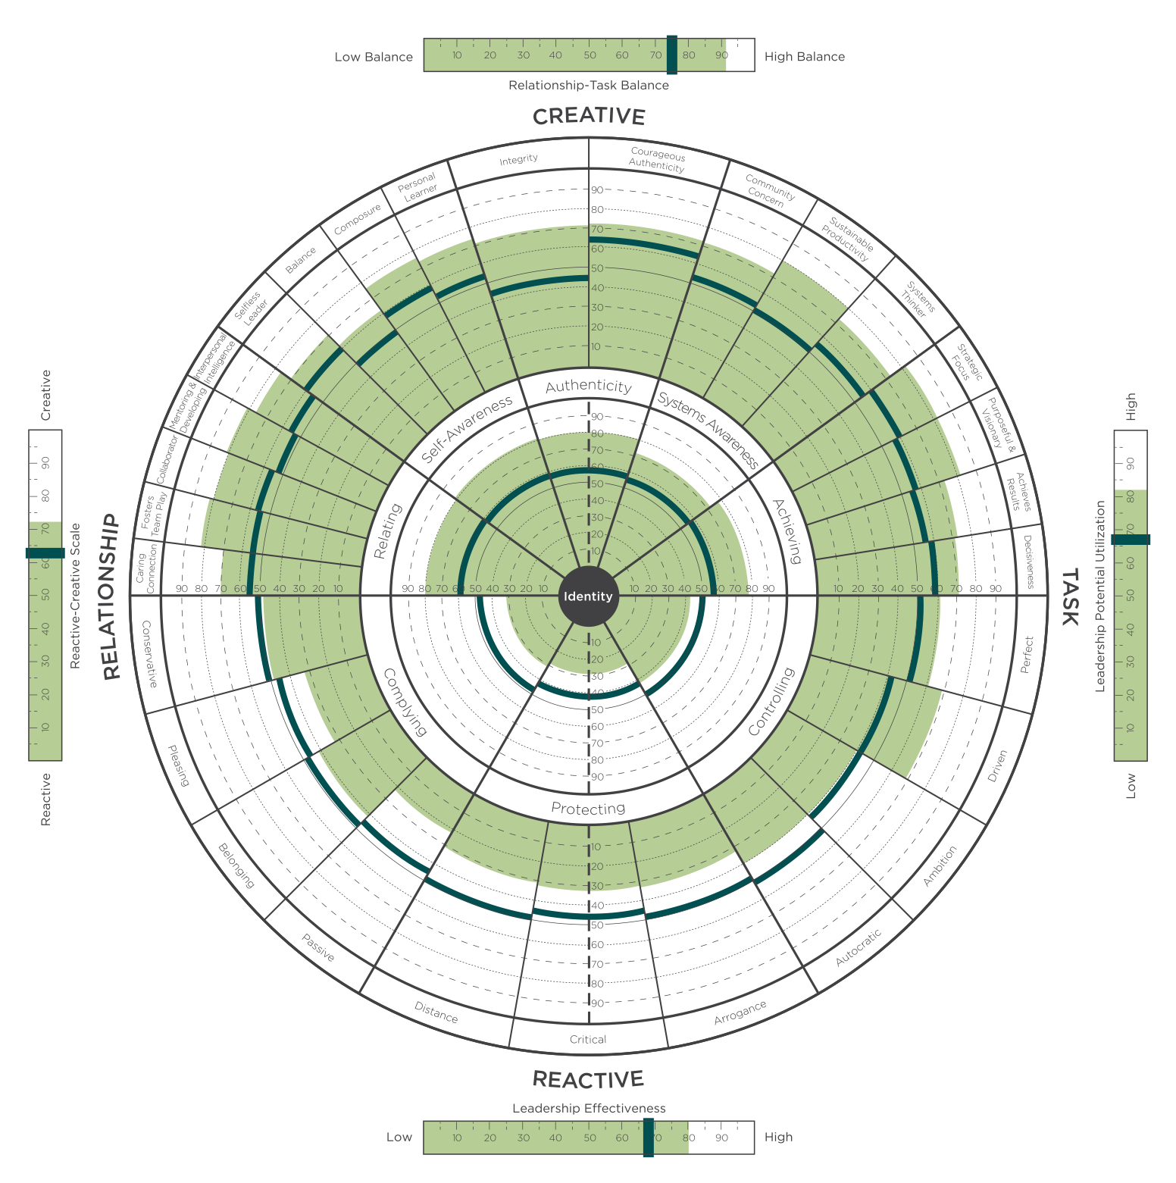
Top 10%
Aggregate Profile of Those Leaders Whose Businesses Were Evaluated as
Highest
Performing
Notes:
Learning Objective 1: for participants to understand that sorting the data by just the Business Performance Index (here the top 10%) yielded this kind of highly Creative aggregate leadership profile (this is the rollup of the approximately 50 leaders in the top performing businesses.
Learning Objective 2: for participants to understand that this makes the business case for why pursue development with the LCP?
Learning Objective 2: for participants to understand that there may also be a halo effect bias in play. If the business is performing well our view of the effectiveness of the leaders can be positively influenced.

Slide 39
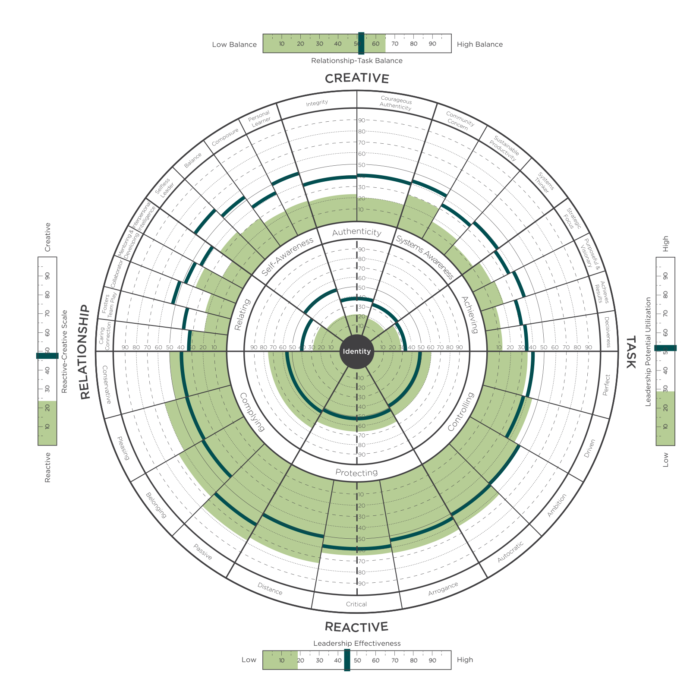
Bottom 10%
Aggregate Profile of Those Leaders Whose Businesses Were Evaluated as
Lowest
Performing
Notes:
Learning Objective 1: for participants to understand that sorting the data by just the Business Performance Index (here the bottom 10%) yielded this kind of highly Reactive aggregate leadership profile (this is the rollup of the approximately 50 leaders in the worst performing businesses.
Learning Objective 2: for participants to understand that this makes the business case for why pursue development with the LCP?
Learning Objective 2: for participants to understand that there may also be a halo effect bias in play. If the business is performing poorly our view of the effectiveness of the leaders can be negatively influenced.

Slide 40
Bottom 10%
Top 10%
Notes:
Learning Objective 1: for participants to understand that this is the developmental journey many senior teams and organizations are hoping to take (particularly once they understand the correlation between the LCP and Business Results).

Slide 41
Additional Slides

Slide 42

The Leadership Circle 360 – A Developmental Can Opener
SELF-TRANSFORMING
VUCA
Volatility
Uncertainty
Complexity
Ambiguity
Demand on Complexity
of Mind
SELF-AUTHORING
Developmental
Challenge
COMPLEXITY
OF SELF
COMPLEXITY
OF CONTEXT
SOCIALIZED
Current Leadership Consciousness Threshold
Stability
Certainty
Simplicity
Clarity
CHILDHOOD STAGES
SCSC
Notes:
Learning Objective 1: for participants to understand that the LCP gives us data about how a person’s leadership is experienced at a particular point in time in a particular environment with particular level of VUCA conditions. It is person-in-context data.
Learning Objective 2: for participants to understand this contextual reality is why we can’t compare one person’s LCP to another’s LCP in an apples-to-apples kind of fashion. The LCP is powerfully contextual.
Learning Objective 3: for participants to understand that the LCP debrief is a developmental can opener, it opens the door to a transformational conversation pointed at the gap between a person’s current way of knowing the world and their contextual lived reality.

Slide 43
Zenger’s Relationship between
Leadership Competency & Results
+
Results—ROI
+2K
+1K
Top 20%
0
-1K
-
20%
50%
80%
Aggregate 360° Feedback

Slide 44
Zenger’s Relationship between
Leadership Competency & Results
+
Results—ROI
+2K
+1K
Top 20%
0
-1K
-
20%
50%
80%
Aggregate 360° Feedback

Slide 45
360º Benefits
Focuses development on key competencies
Identifies strengths to build upon
Shows the impact of your leadership style on others
Highlights gaps in awareness
Links thinking and behavior
Reduces potential for derailment

Slide 46
Design Criteria
Measure Key Leadership Competencies
Assess Belief Systems and Assumptions
Point to Stage of Development
Integrate our Theoretical Framework
Organize Results – so as to bring key developmental opportunities to the surface immediately

Slide 47
Theory Base
The Creative and Reactive Orientations – Fritz, Senge, and Kiefer
Cognitive Psychology – Rational Emotive Therapy – Burns, Ellis
Vision; dependency and ambition; political scripts – Peter Block
* * * * * *
Character Structure – Karen Horney
  moving toward (complying)
  moving against (controlling)
  moving away (protecting)
Enneagram – 9 different types each organized by a core delusion – Sufi Tradition
Ego/Shadow – Carl Jung
Body Characterology – Riech, Kurtz, Lowen, Pirrakos
Stage Development Frameworks – Kohlberg, Kegan, Wilber, Hall, Beck, Fowler, Cook-Greuter
Mystical Literature of all traditions
3 Paradigms (Dependent, Independent, Interdependent) – Covey
Leadership Literature – Bennis, Drucker, Collins, Goleman, etc.
Leadership 360°Research – Zenger and Folkman, etc.

Slide 48

The Reactive Character Structure
COMPLYING
CONTROLLING
#1
Excel
Achieve
Dominate
Control
Win
Loved
Meeting
Expectations
Pleasing
Accepted
IDENTITY
SAFETY
WORTH
PROTECTING
Superior
Right
Self-Sufficient
Distant
Notes:
Use mural. Can use as a recap (on mural or slide here) This is demonstrated very clearly through group learning on the mat.

Slide 49

Notes:
Learning Objective 1: for participants to have a visual model of the LCP that is holistic and normalizing—we all have roots in the Reactive, here lies the origins of our gifts. Our developmental task is to grow something on top of those roots—to have the gifts flower in a way that serves the world.

Slide 50
The Identity Hook
If I am not _____________ then ______________
Follow procedure &
rules, urge conformity
Flawless results,
extremely high
standards
Conservative
Perfect
Seek support, &
approval, avoid
personal rejection
Complying
Controlling
Overdrive, push mode,
work for success
Pleasing
Driven
Conform, play it safe,
meet expectations
Get ahead, move up,
be better than others
Protecting
Give away power, meek,
self-doubting, cautious
Forceful, aggressive,
controlling, powerful
Belonging
Ambition
Withdrawn, aloof,
emotionally uninvolved
Superior, egotistical,
self-centered
Finding fault, cynical,
putting others down
Passive
Autocratic
To be is to be _____________
Not to be ______________is not to be
Distance
Arrogance
I have to be_____________
or else ______________
Critical
Notes:
Learning Objective 1: for participants to understand that our identity can be deeply rooted in the Reactive—it can be our primary experience of our self or an aspect of identity that we experience quite frequently .
Learning Objective 2: for participants to understand that being able to see our Identity Hook, take perspective on it (versus just being hooked by it) is a specific example of witnessing the self in action and another example of a healthy subject/object differentiation.

Slide 51
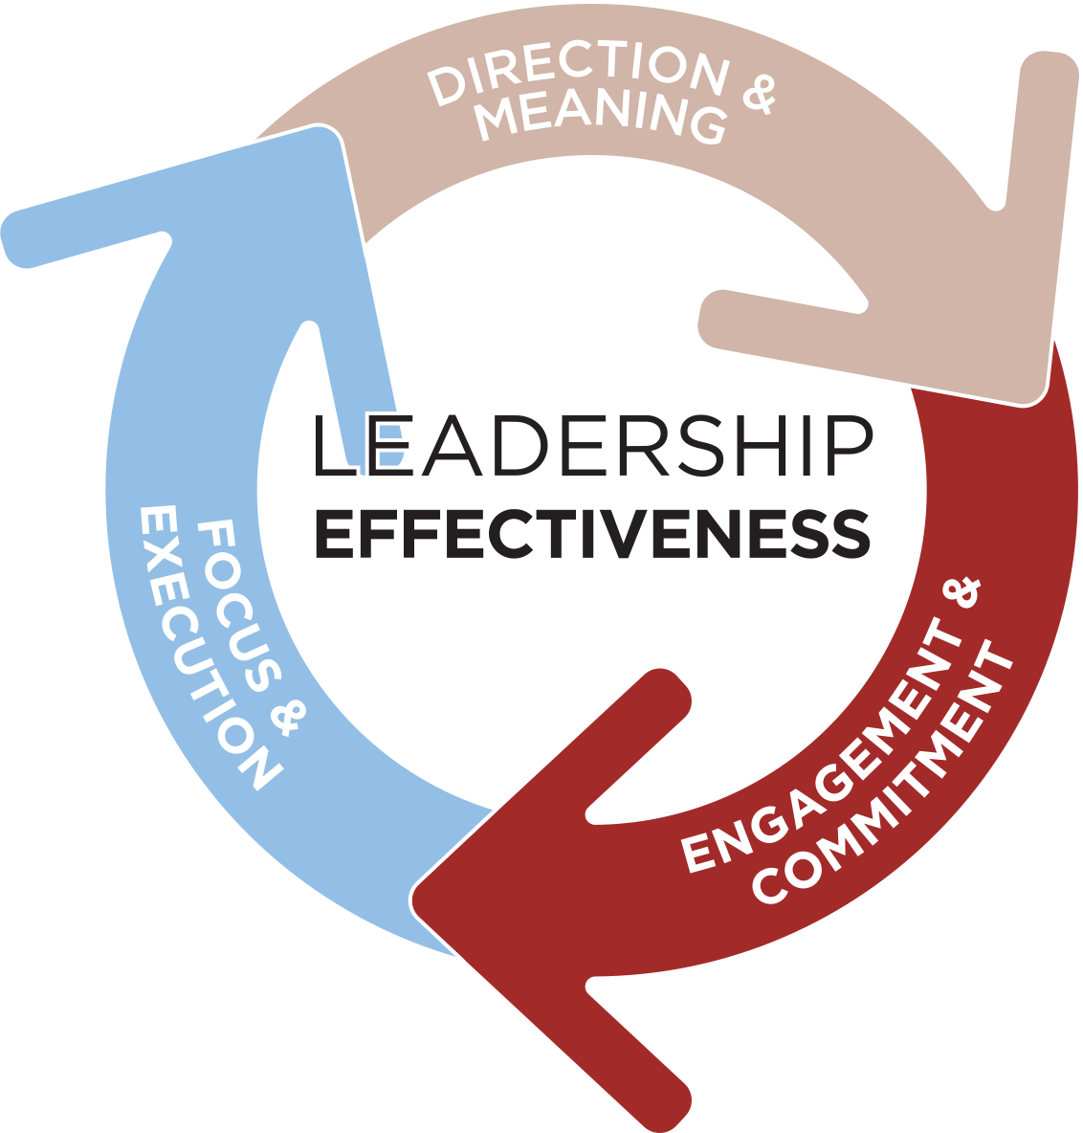
The Four Promises Of Leadership

Slide 52
38% probability that improved leadership effectiveness translates into higher business performance.
Leadership effectiveness is a primary contributor to business performance.
An organization cannot outperform the collective effectiveness of its leadership!

Slide 53
A Complete Development System
Universal Leadership Model
Common language
Foundation for Coaching and ongoing feedback
Leadership Development Plans
Promise of Leadership Program
Mastering Leadership Book
Peer Coaching and Action Learning

Slide 54
Actually Measures What It’s
Designed to Measure
Data Backed by
Hundreds of Thousands of Raters
Notes:
With the LCP you get the full picture of your leadership. At last, you see, in one assessment, what you are missing in all the others. TLC is unique because it measures
-- (Click) Leadership competencies
--(Click) Assumptions that drive Behavior
Assumptions that lead to effectively developing key leadership competencies
Assumptions that run reactive, self-limiting behavior.
-- (Click) and LCP reveals style and personality…all at the same time.

Slide 55
More Revealing
Links Competencies to Core Beliefs

Slide 56
More Advanced
Coaching Starts at a Breakthrough

Slide 57
More than an Assessment
Framework Provides Pathway for Transformation

Slide 58
More Efficient
User Friendly Report That Saves Coaching Time

Slide 59
Widely Accepted
Used by Leading Organizations, Top Universities, and Government Agencies

Slide 60
Differentiators
Creative and Reactive
Circle Graph
Research and Validity
Alignment to Adult Development
Commitment to Service

Slide 61
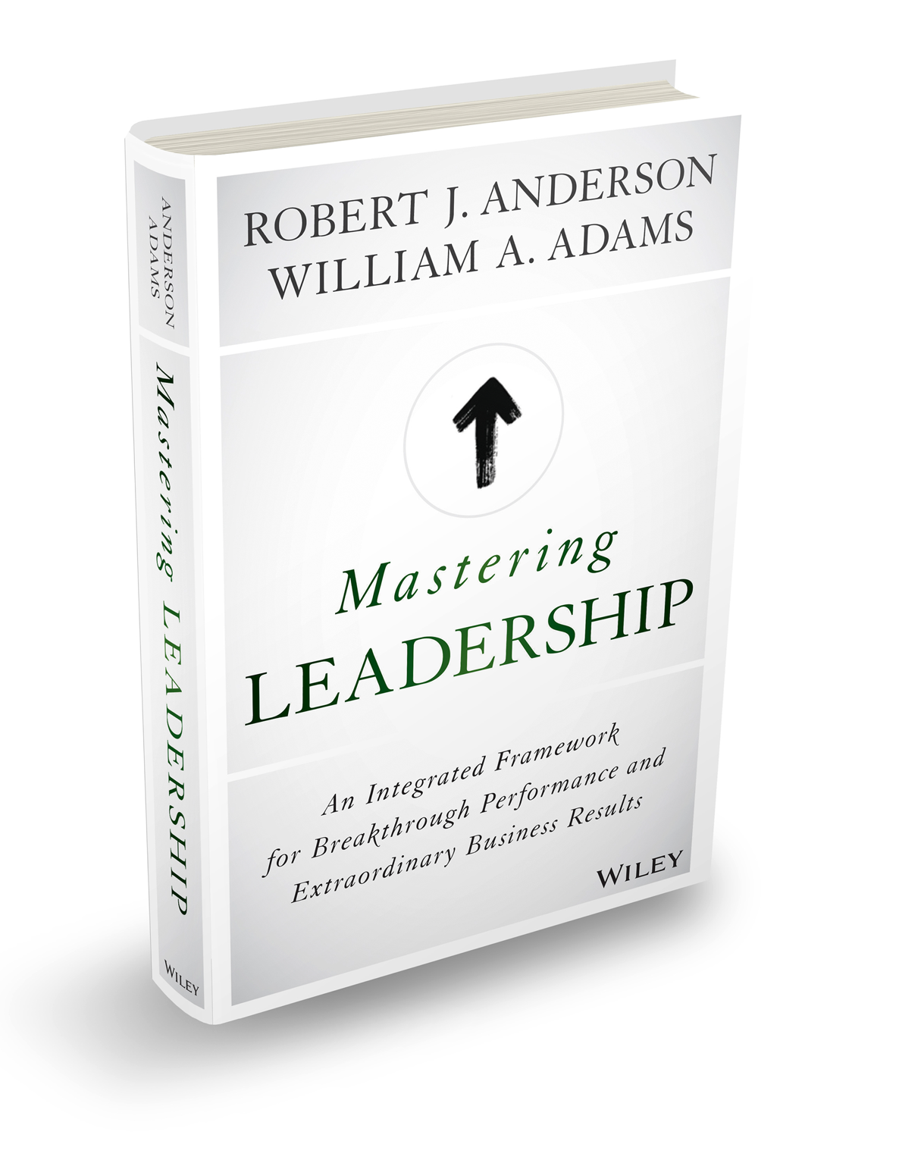
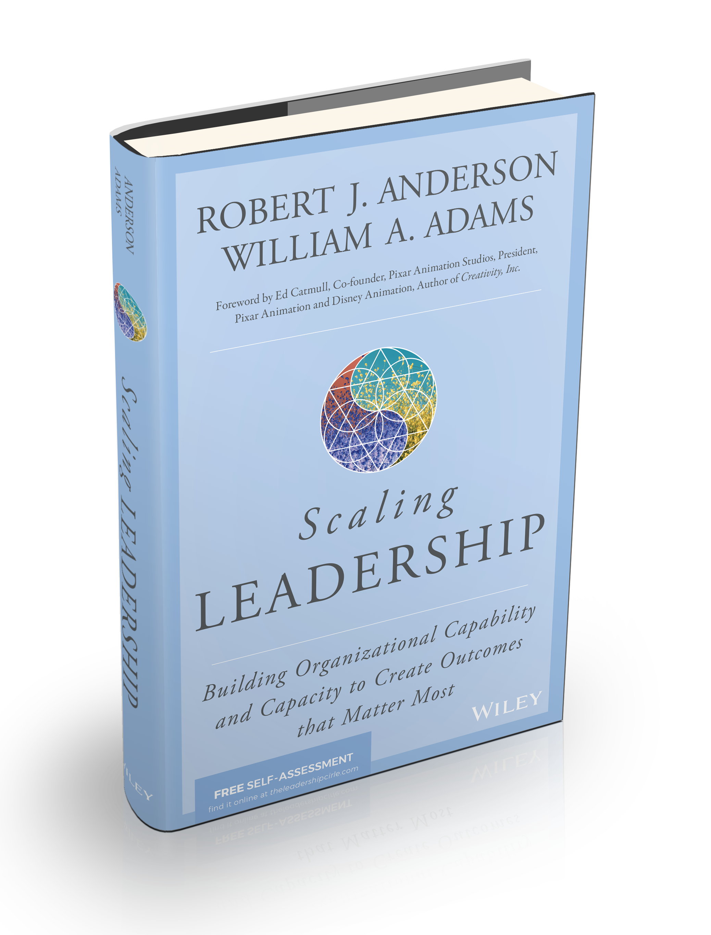
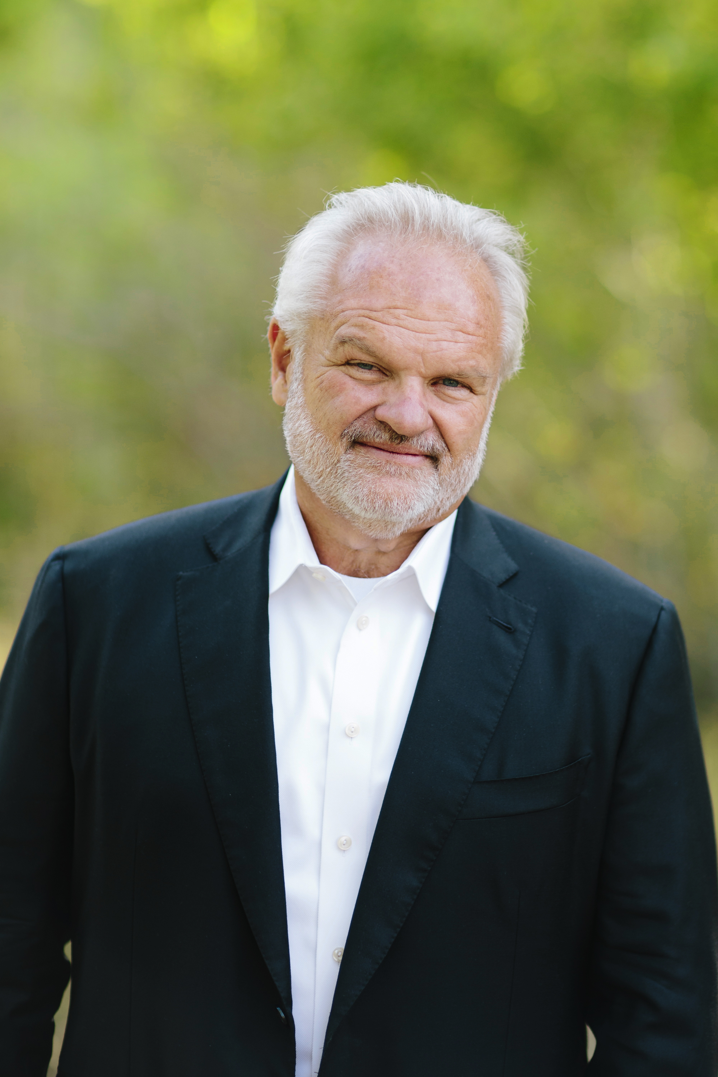

MASTERING LEADERSHIP:
An Integrated Framework for
Breakthrough Performance and Extraordinary Business Results
SCALING LEADERSHIP:
Building Organizational Capability and Capacity to Create Outcomes that Matter Most
Bill Adams
Bob Anderson

